Slide 1

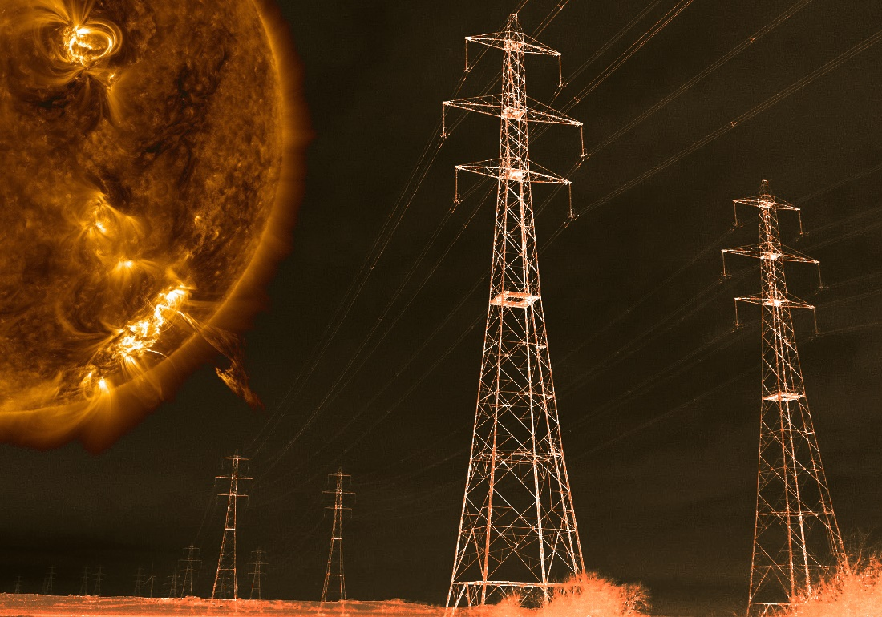

Temporal, directional, and spatial statistics of extreme dB/dt
Neil Rogers, James Wild, and Emma Eastoe
Lancaster University, UK
European Space Weather Symposium (online)
2nd – 6th November 2020

Slide 2
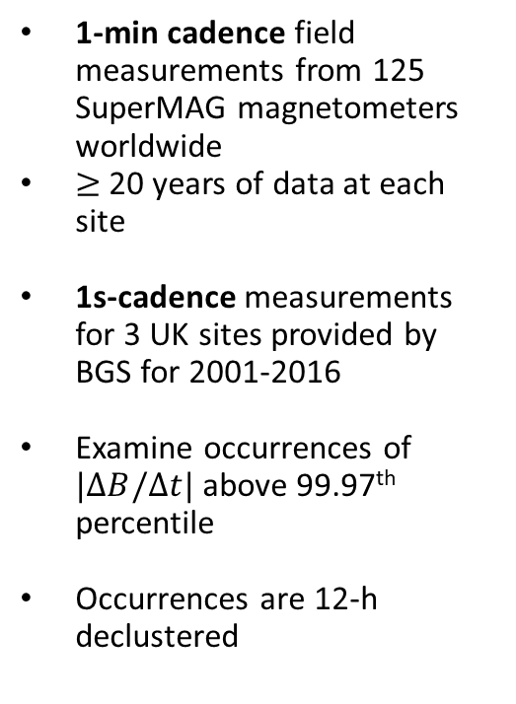
Magnetic Field Measurements
1-min cadence field measurements from 125 SuperMAG magnetometers worldwide
$≥$20 years of data at each site
1s-cadence measurements for 3 UK sites provided by BGS for 2001-2016
Examine occurrences of $|ΔB/Δt|$ above 99.97th percentile
Occurrences are 12-h declustered
Contours show corrected geomagnetic latitudes (from IGRF Epoch 2000).
Notes:
Note the increase in |dB/dt| at 60-75° geomagnetic (North and South).
BRW (Barrow) is the outlier in Northern Alaska.

Slide 3
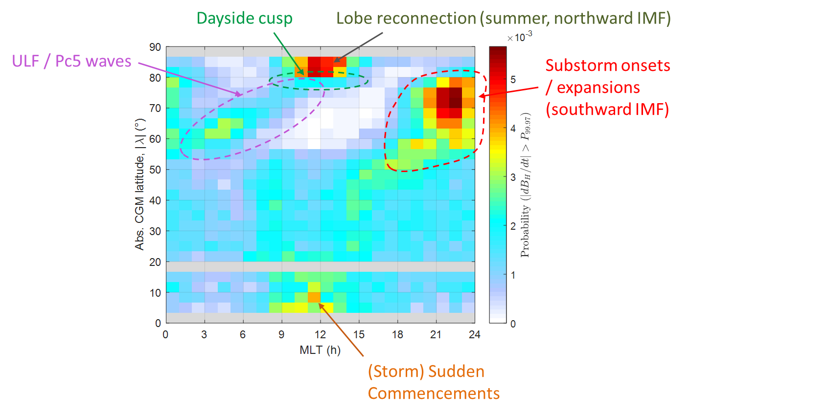

Occurrence Probabilities
Pr($|ΔB/Δt|$ > 99.97th percentile)
$nΔt=$ 1 minute
Fitted spherical harmonic expansion
provided in Rogers et al. 2020, JSWSC
https://doi.org/10.1051/swsc/2020008

Slide 4
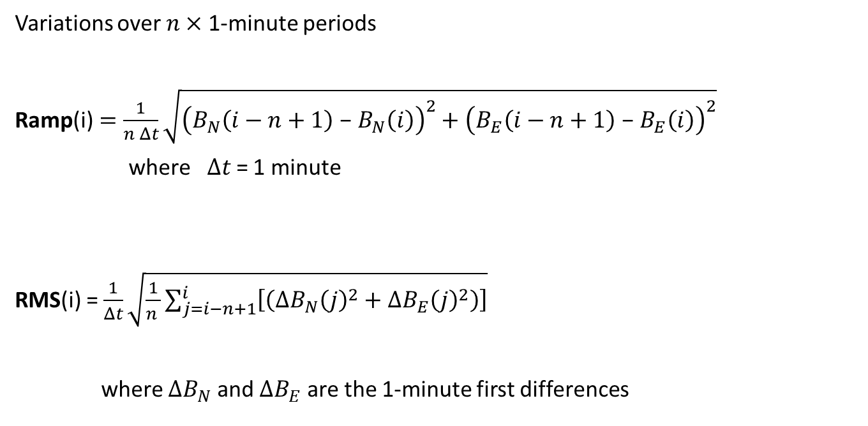
Ramp and RMS Field Fluctuations
Variations over $n×$ 1-minute periods
Ramp(i)$=\frac{1}{n Δt}\sqrt{{\left(B_{N}\left(i−n+1\right)\text{ − }B_{N}\left(i\right)\right)}^{2}+{\left(B_{E}\left(i−n+1\right)\text{ − }B_{E}\left(i\right)\right)}^{2}}$
  where$Δt$= 1 minute
RMS(i) = $\frac{1}{Δt}\sqrt{\frac{1}{n }\sum_{j=i−n+1}^{i}{\left[\left({ΔB}_{N}{\left(j\right)}^{2}+{ΔB}_{E}{\left(j\right)}^{2}\right)\right]}}$
  where $ΔB_{N}$ and $ΔB_{E}$ are the 1-minute first differences

Slide 5

Occurrence Probabilities: Ramp vs RMS
$nΔt=$ 1 minute
Ramp RMS
(These are equal)

Slide 6

Occurrence Probabilities: Ramp vs RMS
$nΔt=$ 10 minutes
Ramp RMS

Slide 7

Occurrence Probabilities: Ramp vs RMS
$nΔt=$ 30 minutes
Ramp RMS

Slide 8

Occurrence Probabilities: Ramp vs RMS
Most likely region for sustained power in fluctuations
Most likely region for long-period fluctuations
$nΔt=$ 60 minutes
Ramp RMS

Slide 9
P_{99.97} and 100-year Return Levels vs. Sampling Frequency
(Shading indicates 95% C.I.)

Slide 10

Modelling temporal (frequency) dependence
Percentiles and return levels are well modelled by quadratic functions of sampling frequency
Fitted coefficients vary predictably with abs. mag. latitude.
99.97th percentile |dB/dt|
100-year Return Level
Fitted $y=p1x^{2}+p_{2}x+p_{3}$
with $y=\log_{10}{P_{99.97}}$ and $x=\log_{10}{f_{s}}$

Slide 11
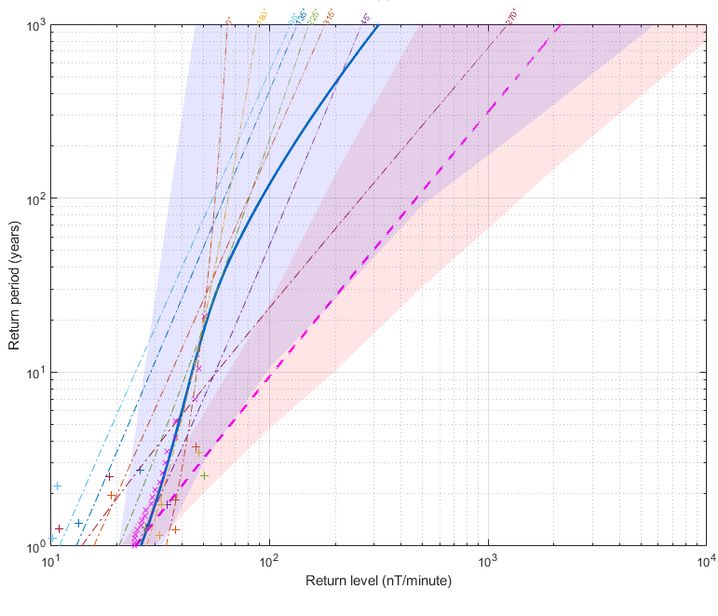
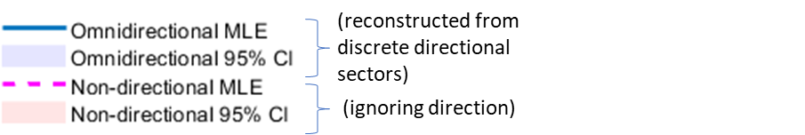
Extremes of Directionally Anisotropic Distributions
Ascension I. (low lat. site)
Models that take into account direction of dB/dt yield more accurate results since they explain more of the variability in the data
Fit GP distributions in 8 discrete directional sectors of 45° width and reconstruct return levels (RL) by combining GP distributions from all sectors
Difference in 100-year RL
Omni. (reconstructed) – Non-directional (MLE) (nT/min.)
Incorporating direction yields lower RLs for low latitude sites, and higher-RLs for high-latitude sites
Reference: Rogers et al. 2020b http://www.ursi.org/proceedings/procGA20/papers/PID6336971.pdf
Notes:
IID = Independent and Identically Distributed

Slide 12
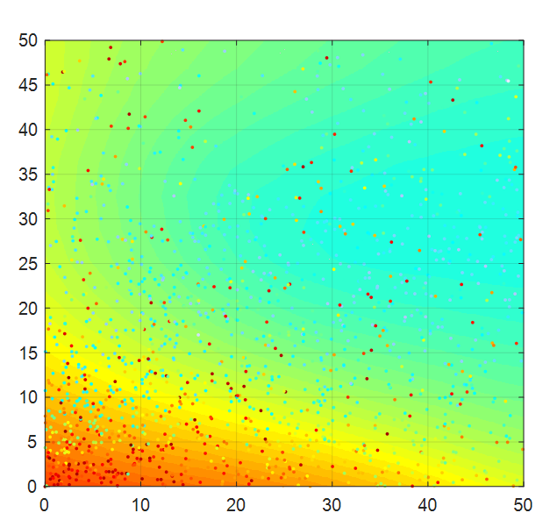

Spatial coherence
Comparing daily max.($|dB/dt|$) at each pair of sites we find large correlation between sites < 55° and with sites > 80°
Auroral sites exhibit strong correlation only where closely spaced in magnetic latitude or conjugate latitude
Difference in CGM latitude (°)
Correlation coefficient
Difference in CGM latitude (°)
Difference in CGM longitude (°)

Slide 13
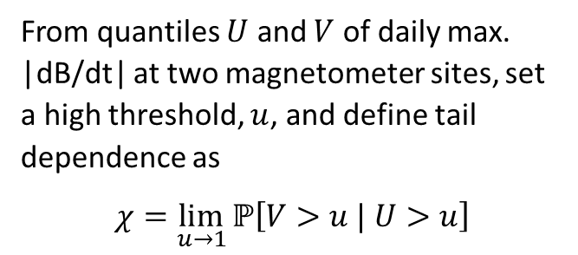

$χ:$Tail dependence
From quantiles $U$ and $V$ of daily max. |dB/dt| at two magnetometer sites, set a high threshold, $u$, and define tail dependence as
$$χ=\lim_{u→1}{ℙ\left[V>u | U>u\right]}$$
V
1
u
Daily max. |dB/dt| quantiles at site B
We find that sites < 55° tend towards asymptotic dependence, whilst auroral sites exhibit asymptotic independence
0
0
u
1
U
Daily max. |dB/dt| quantiles at site A

Slide 14
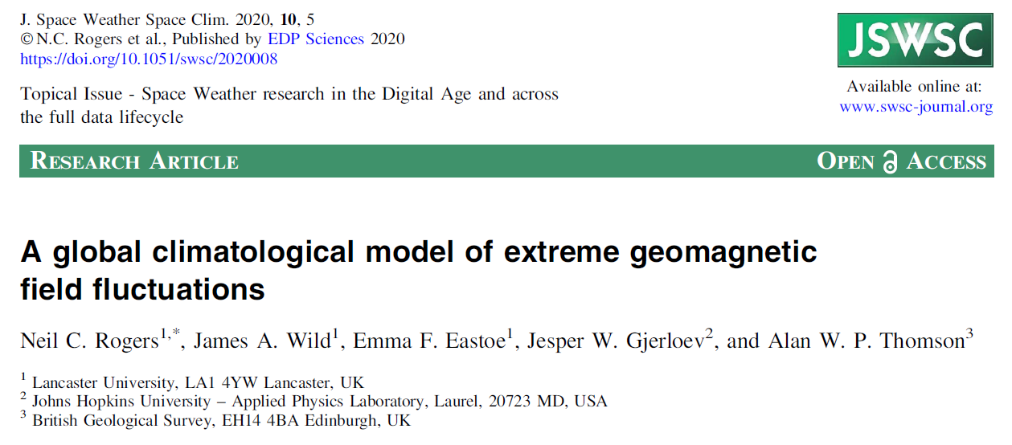
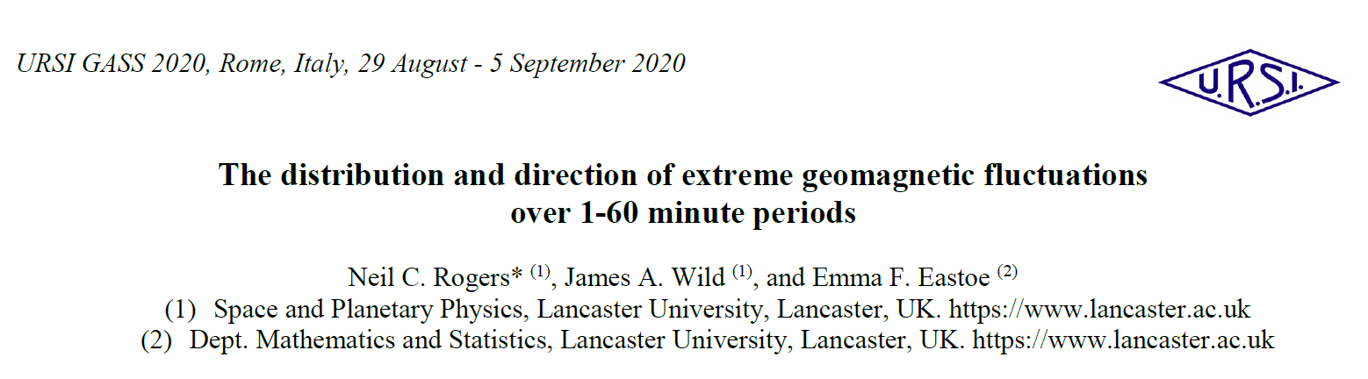
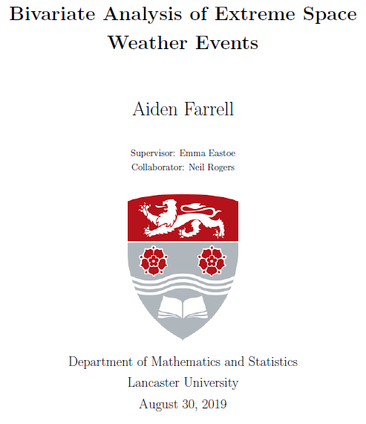
Further reading
Article in J. Space Weather & Space Climate (Jan. 2020) https://doi.org/10.1051/swsc/2020008
URSI General Assembly 2020 Conference paper http://www.ursi.org/proceedings/procGA20/papers/PID6336971.pdf
Farrell A. “Bivariate Analysis of Extreme Space Weather Events” MSc. Thesis, Lancaster University 30 Aug. 2019.

