Slide 1


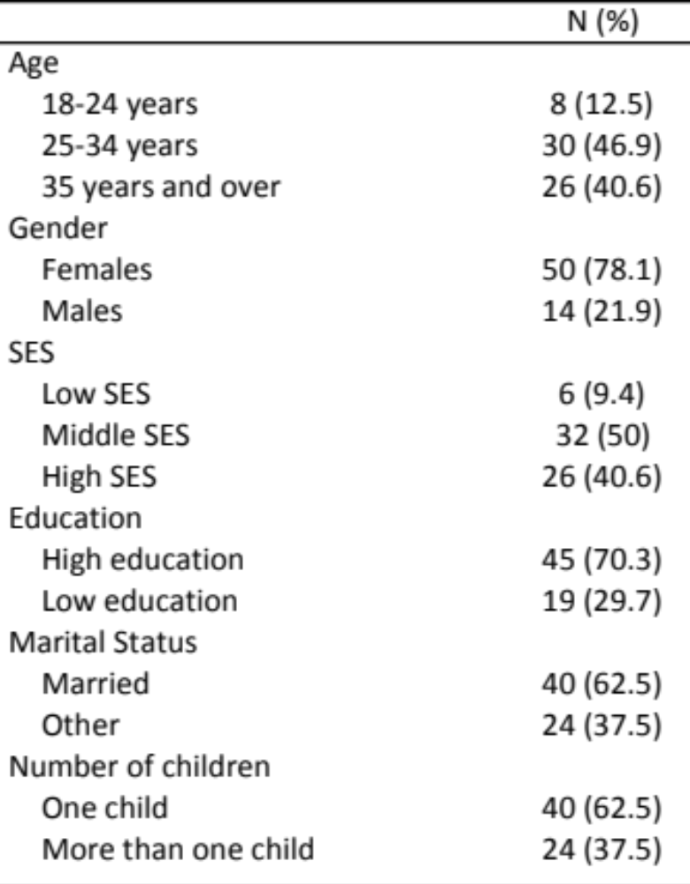
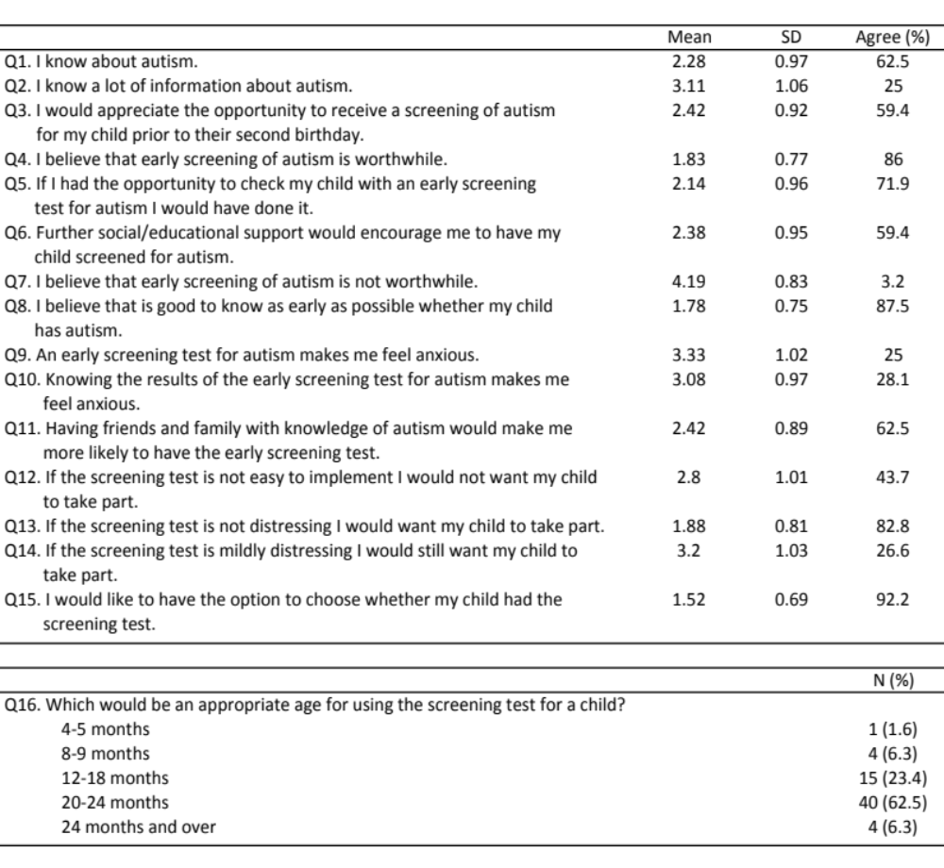
Understanding parental attitudes towards early screening for autism spectrum disorders
Marina Loucaides, M.Sc., ₁ , Judith Lunn, P.hd., ₁ , Vincent Reid, P.hd., ₁ , Emma Bruce, M.Sc, ₁ ,
Husan Hassan Basri, M.Sc, ₁ , & Megan R Thomas, P.hd. ₂
¹ Lancaster University, UK ² Child Health, Blackpool Teaching Hospitals NHS Foundation Trust,
Blackpool, UK
Abstract
Results
Conclusion
The current study examined what parental factors may influence parents’ reactions towards a potential early screening (ES) test for autism and what they would require to show a more positive approach. The results showed that age, gender, socioeconomic status, education level, the number of children of a participant and its personality were related to how parents perceived the introduction of (ES) for autism spectrum disorders (ASD).
1) Demographic Questionnaire (Sample Characteristics)
2) PANAS (Watson et al., 1988) (Sample Characteristics)
To conclude, the results of the current study add information to the limited literature of parents’ approaches towards ES for ASD. Participants’ age, gender, education level, SES and number of children were found to be factors that affected how parents viewed the introduction of an ES. Interestingly, personality was indeed able to influence parents’ opinions about ES of ASD. The findings showed that parents require social and educational support and a non-distressing ES and their majority supported that they would like to choose whether their child is going to have the ES. This finding is important, as it is crucial for the development of an autistic child to have parental participation in the procedure and in respect to EIs, as this is a significant factor if the intervention is to be successful. The results for the acceptance of ES are encouraging, as parents agreed (86%) that ES for ASD is worthwhile and gaining the acceptance of parents provides better life outcomes for autistic children.
Introduction
According to previous research, the early detection of ASD is crucial (Holzer et al., 2006) to provide to the affected child the appropriate early intervention (EI), which is suggested to be beneficial (Dawson et al., 2012; McEachin, Smith, & Lovaas, 1993) as it enhances social and adaptive behaviour, language, IQ and autism symptoms and guide behavioural and brain development towards the normal pathway (Dawson, 2008). It is important to consider that parents are also affected if their child has ASD (Abbott, Bernard, & Forge, 2012) and they have a significant role in the success of EI (Remington et al., 2007).
Thus, it is important to investigate what would encourage parents to allow ES of ASD for their child if it was available.
This study focused on how personality and demographic parental factors could influence parents’ approach towards a potential ES for ASD and what would reinforce parents to agree for their child to take it.
Research Hypotheses:
Demographic variables, such as gender and education level were considered to determine if they have any effect on parents’ answers about a potential ES for ASD.
It was hypothesized that parents with high positive affect (PA) would be positive towards ES due to their optimistic nature and parents with high negative affect (NA) would be more reluctant due to their pessimistic nature.
Positive Affect
Negative Affect
3) Early Screening Questionnaire for ASD Frequencies
Acknowledgements
This study was the first author’s honors thesis for Masters level Degree at Lancaster University. We want to thank the BabyLab at Lancaster University for their help and support during data collection and all the participants.
Contact Information
Marina Loucaides: m.loucaides@lancaster.ac.uk
Judith Lunn: j.lunn1@lancaster.ac.uk
Vincent Reid: v.reid@lancaster.ac.uk
Emma Bruce: emmabruce@gmail.com
Husan Hassan Basri: husnahb@yahoo.com
Megan Thomas: dr.Thomas@bfwhospitals.nhs.uk
References
Holzer, L., Mihailescu, R., Rodrigues-Degaeff, C., Junier, L., Muller-Nix, C., Halfon, O., & Ansermet, F. (2006). Community Introduction of Practice Parameters for Autistic Spectrum Disorders: Advancing Early Recognition. Journal Of Autism & Developmental Disorders, 36(2), 249-262.
Dawson, G., Jones, E. J., Merkle, K., Venema, K., Lowy, R., Faja, S., ... & Webb, S. J. (2012). Early behavioral intervention is associated with normalized brain activity in young children with autism. Journal of the American Academy of Child & Adolescent Psychiatry, 51(11), 1150-1159.
McEachin, J. J., Smith, T., & Lovaas, O. I. (1993) Long- Term Outcome for Children With Autism Who Received Early Intensive Behavioral Treatment. American Journal on Mental Retardation, 97(4), 359-372.
Dawson, G. (2008). Early behavioral intervention, brain plasticity, and the prevention of autism spectrum disorder. Development and psychopathology, 20(03), 775-803.
Pennington, B. F. (2006). From single to multiple deficit models of developmental disorders. Cognition, 101(2), 385-413.
Abbott, M., Bernard, P. & Forge, J. (2012). Communicating a diagnosis of Autism Spectrum Disorder- a qualitative study of parents’ experiences. Clinical Child Psychology and Psychiatry, 18(3), 370-382.
Remington, B., Hastings, R. P., Kovshoff, H., degli Espinosa, F., Jahr, E., Brown, T., ... & Ward, N. (2007). Early intensive behavioral intervention: outcomes for children with autism and their parents after two years. American Journal on Mental Retardation, 112(6), 418-438.
Watson, D., Clark, L. A., & Tellegen, A. (1988). Development and validation of brief measures of positive and negative affect: The PANAS scales. Journal Of Personality And Social Psychology, 54(6), 1063-1070.
Methods
1) Demographic Questionnaire
A detailed demographic questionnaire was used to collect personal information (age, gender, etc.) about parent participants.
2) PANAS (Watson et al., 1988)
PANAS is a personality measure with two different mood scales (10 single-words each), PA and NA.
3) Early Screening Questionnaire for ASD
A structured interview questionnaire about a potential ES (ESQ) for ASD was developed and contained a likert scale section and a categorical question.
Statistical Analysis
Age and Q1, F(2, 62) = 3.39, p = .040, η_{p}² = .10. The 35-and-over group differ significantly (p = .048) from 18-to-24 age group.
Gender and Q13, F(2, 62) = 4.94, p = .030, η_{p}² = .074. Females were more likely to strongly agree compared to males.
SES and Q2, F(2, 62) = 5.49, p = .006, η_{p}² = .152. Middle SES and high SES differ significantly (p = .007); low SES did not differ significantly from middle (p= 1) and high (p = .158) SES.
Number of children and Q4, F(2, 62) = 4.10, p = .047, η_{p}² = .062.
PA had no significant relationship with ESQ’s questions, Wilks’ λ = .739, F(15, 48) = 1.13, p = .359, η_{p}² = .261.
High PA (83%, n = 30/36) and low PA (89%, n = 25/28) agreed that ES is worthwhile.
NA had significant relationship with ESQ’s questions Wilks’ λ = .571, F(15, 48) = 2.4, p = .011, η_{p}² = .429.
  Q4, F(2, 62) = 5.82, p = .019, η_{p}² = .086. High NA participants were more likely to agree compared to low NA participants.
  Q13, F(2, 62) = 5.17, p = .026, η_{p}² = .077. Low NA participants strongly agreed compared to high NA participants that only agreed.
  Q15, F(2, 62) = 12.98, p = .001, η_{p}² = .173. Low NA participants had a stronger tendency (MD = -.6) to strongly agree (M = 1.31, SD = .52) compared to high NA (M = 1.91, SD = .81).
Participants
64 (14 males, 50 females) participants between the ages 18 to 54 (M = 32.81, SD = 6.99) with no autistic children

