Slide 1


On the emergence of modern experimentalism:
the Renaissance and after.
Stephen Pumfrey,
Department of History,
University of Lancaster

Slide 2
On the emergence of modern experimentalism:
the Renaissance and after.
Are experiments done or had?
Are experiments interior or exterior?

Slide 3
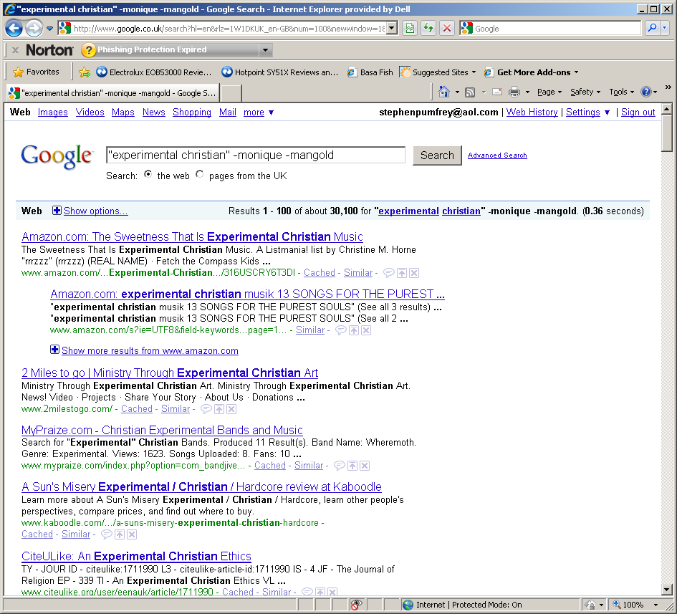

Slide 4
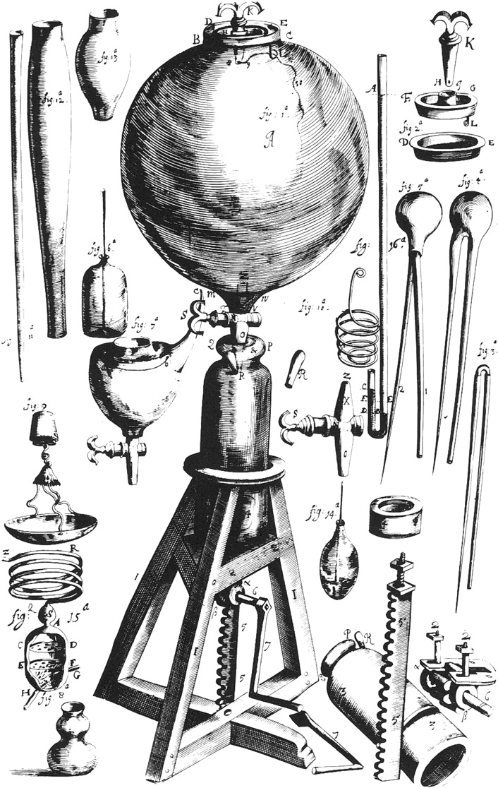
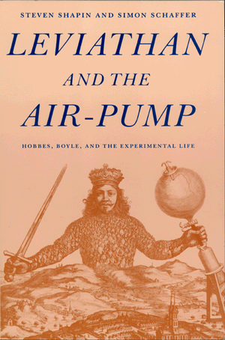

Slide 5
Peter Dear, Discipline and Experience.
Universal Experience versus Event experience.
“When dropped, stones fall down.”
“The experiment was made, in the receiver of an air or vacuum pump with the air exhausted, to see if the leaf fell as quickly as the stone. We observers testify that it did.”

Slide 6
Great is the power of experience [experientia] which arises from the memory of things which sense time and time again supplies, for indeed memory comes from repeated sensation. Many memories of the same thing grant the means of one experience [experientia]; moreover, cognition of the first principles comes from experiments [experimenta]... The principles are derived from experiment [experimentum]; as for example, the principles of astronomical science [scientia] are collected from astronomical experience [experientia].
Francesco Buonamici, De Motu (Florence, 1591), quoted from Schmitt.

Slide 7
In contrast to the modern experiment….
Experience is:
    Cumulative
    Passive
    Not produced
    Collective
“Experience arises from the memory of things which sense time and time again supplies.” (Buonamici.)

Slide 8
He is / and euer hath ben reputed the wysest / whiche by the experyence of aduerse fortune hath byholden and seen the noble Cytees / maners / and variaunt condycions of the people of many dyuerse Regyons / For in hym is presupposed the lore of wysedome and polycye / by the experyment of Ieopardyes and peryllys whiche haue growen of folye in dyuerse partyes and contrayes.
From Caxton’s 1482 translation of Ranulf Higden’s 14th-century “Polychronicon”.

Slide 9
“You give me a proufe and experiment of thy wonderfull bountie.”
Psalm 30 (1539)
O sacred, and dreadfull, and mysterious Trinity, though I cannot conceive thee, yet let me daily experiment thy goodness.
Thomas Ken, An exposition on the church-catechism, or, The practice of divine love (1685)

Slide 10
Occurrences of “experimental philosophy”
in EEBO keystroked subset, 1640-1699.

Slide 11
1662↓
Occurrences of the word “experimental”
in EEBO, 1650-1670, year by year.
Red = word in religious context
Blue = word in scientific context
Green = word in other context, often political

Slide 12
Younge, Richard
The cure of misprision or Selected notes (1646)
Found: 1 hit(s):
... the Weake Christian, the Experimentall Christian, the Atheist,...
.
Burgess, Anthony, d. 1664.
Spiritual refining: or A treatise of grace and assurance (1652)
Found: 1 hit(s):
... this only the experimental Christian feels. ...
.
Bellers, Fulk, b. 1605 or 6.
The good old-mans buriall in a good old age opened in a sermon (1656)
Found: 1 hit(s):
...how abundant that worthy and experimentall Christian was...
Younge, Richard
The whole duty of a Christian (1653)
Found: 2 hit(s):
...the approbation of one wise experimentall Christian is enough...
... the pleasure that an experimental Christian finds in the Divine...
Spencer, John, d. 1680
Kaina kai palaia Things new and old, or, A store-house of similies, sentences, [etc.] (1658)
Found: 2 hit(s):
... Yet the knowing experimental Christian is nothing troubled thereat...
...The experimental Christian, the undaunted Christian,....

Slide 13
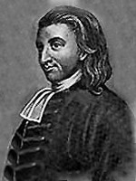
Thomas Boston (1676-1732)
Calvinist leader in the Church of Scotland.
Provoker of “the Marrow Controversy” of the 1720s and 30s.
Advocated that where Christ is heartily received, the believer will experience full repentance, a new life and the presence of God .

Slide 14
A man may have a competent, nay, a very extensive acquaintance with the whole doctrines of the Christian religion... yet if you have not the experimental knowledge of Christ, all your knowledge is in vain as to the salvation of your souls.
There are two ways of knowing, one by hearing a thing, another by sight and feeling; one by the relation of another [person], another by experience, as one knows honey, and all the virtues of it by report, which he believes, another by tasting it himself. The apostle [Paul] knew Christ by faith... finding by experience him to be what he has heard and believed him to be.
Thomas Boston,
“Discourse on the Experimental Knowledge of Christ”
(c.1725?)

Slide 15
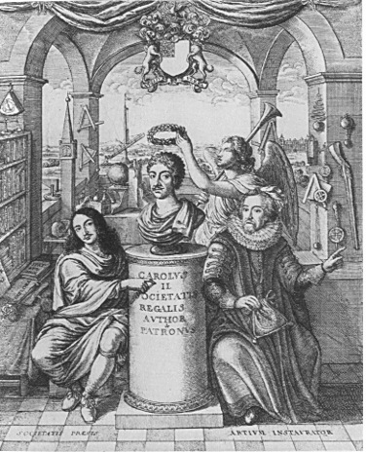
The History of the Royal Society of London for the Promotion of Natural Knowledge.
Founded 1662.
Motto: “Nullius in verba.”
Note the presence of many instruments – and Lord Francis Bacon (d. 1626)

Slide 16
Four proposed conditions of possibility for the succession of the experience of pre-modern science by the modern scientific experiment.
Epistemological crisis – especially concerning Aristotelian universals
Valorisation of practices generating new facts and experiences.
Valorisation of practices of human intervention in nature.
Mechanistic ontology supersedes organic ontology.

Slide 17
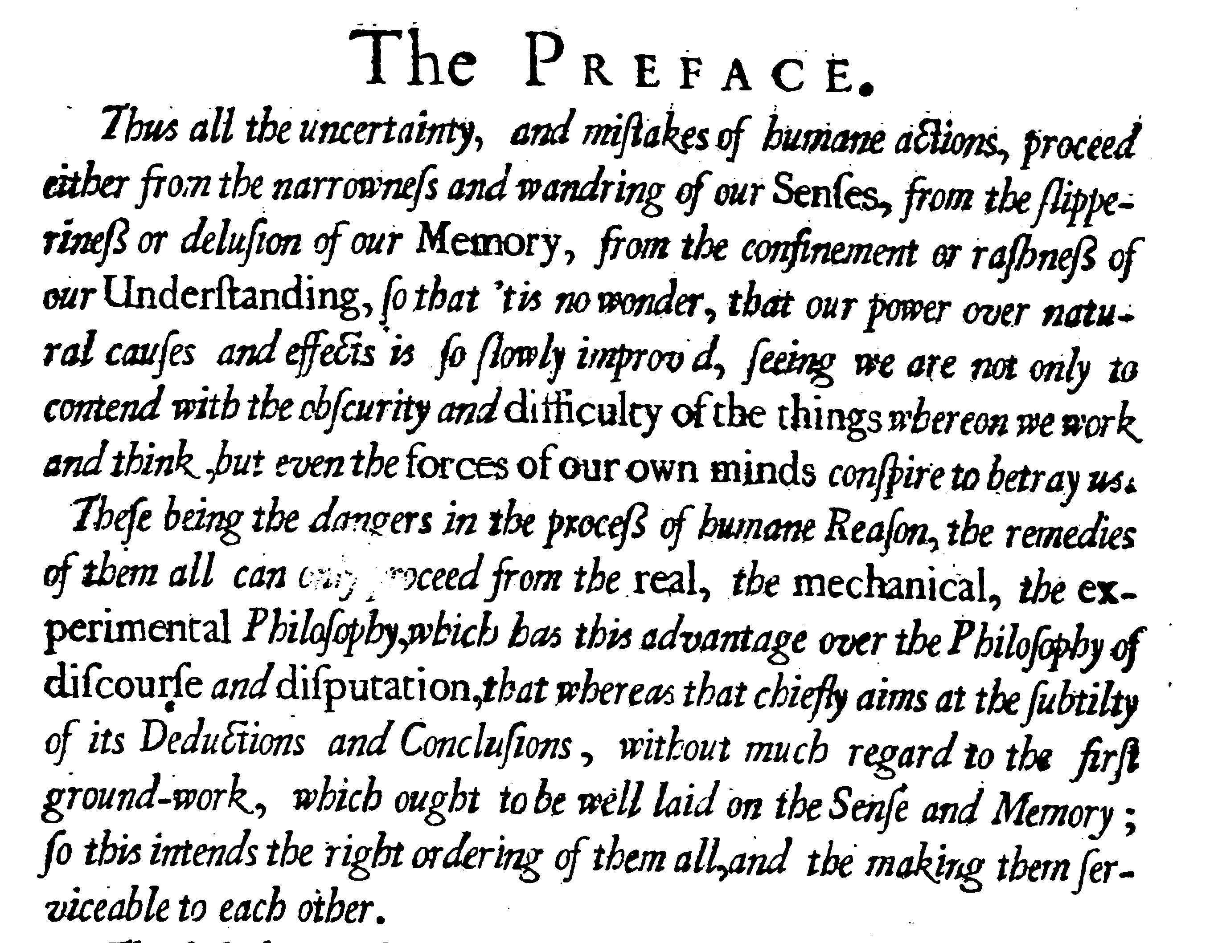
R. Hooke, Micrographia, 1665

Slide 18
On the emergence of modern experimentalism:
the Renaissance and after.
Stephen Pumfrey,
Department of History,
University of Lancaster

