Slide 1



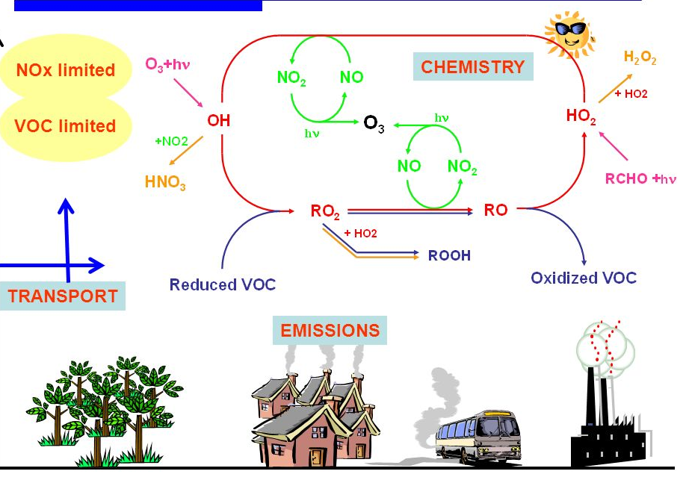

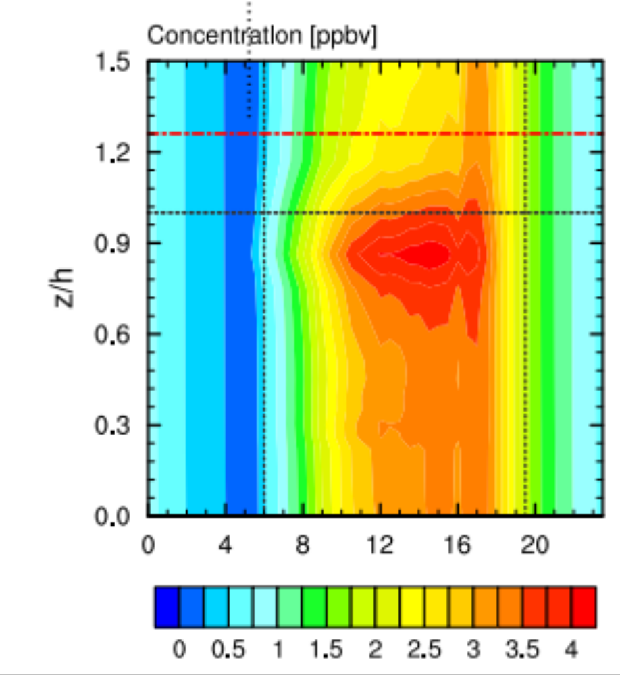

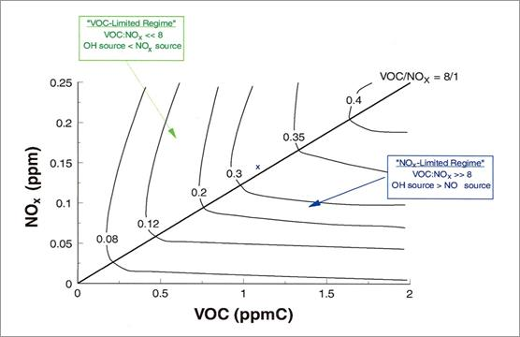

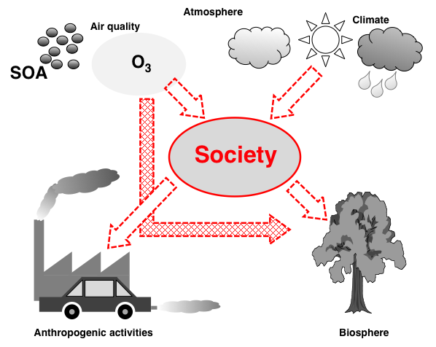
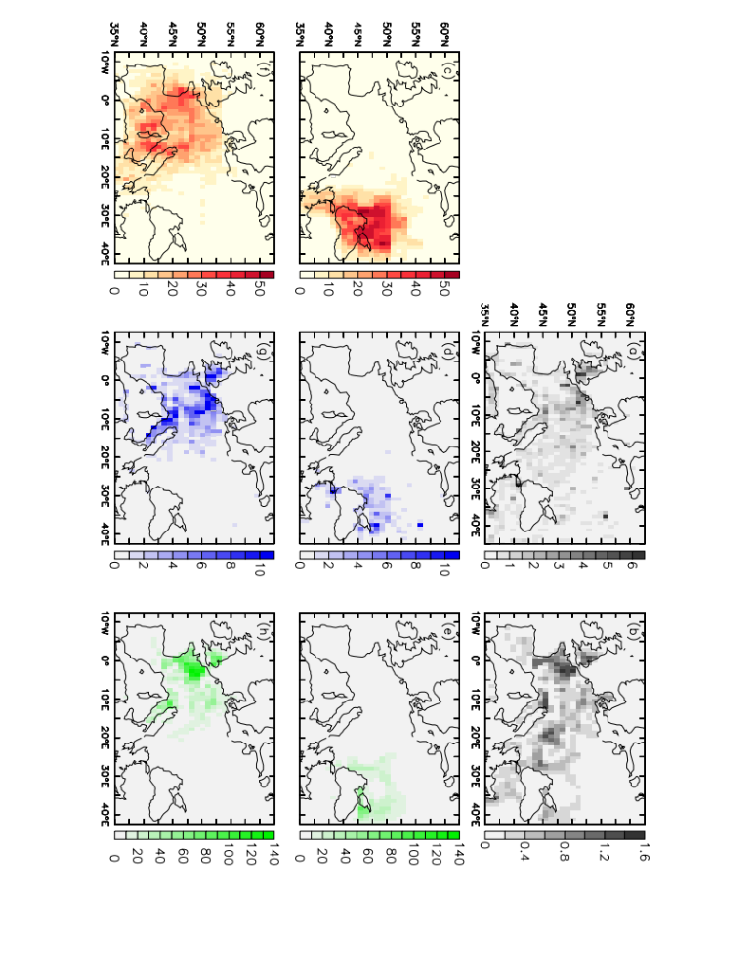
Potential applications of small sensor technology at the nexus of land-atmosphere-society
Kirsti Ashworth, Royal Society Dorothy Hodgkin Research Fellow, Lancaster Environment Centre, Lancaster University
Modelling biosphere-atmosphere exchange processes
Model height ~4.5 km
Field measurements
More measurements are needed to evaluate and constrain model output and inform development.
Small sensors have the potential to be:
- used within or above the canopy
- deployed from novel platforms
- static or mobile
- used for long-term measurements
- applied creatively to fill gaps in existing data
O₃
SOA
Chemistry
Atmosphere
Model levels
Turbulence
Flux
Heterogeneity
Spatial and temporal heterogeneity of:
- meteorology
- canopy structure
- species distribution
→ heterogeneity
of concentrations and fluxes of highly reactive compounds over both time and space
Tropospheric photochemistry of O₃ and secondary organic aerosol formation
Instrument height(s)
The NO_{x}:VOC ratio
- determines the VOC oxidation route, and hence the rate of formation of pollutants.
- fluctuates widely over small distances in both space and time.
Ave canopy height
Deposition
Turbulence
Emissions
Chemistry
Ground level
Schematic of the FORCAsT 1-D canopy exchange model. FORCAsT incorporates all of the processes involved in the production and loss of secondary pollutants. 1-D models span the gap between single-point observations and 3-D air quality (AQ) models.
O₃ isopleths show the effect of VOC and NO_{x} concentration on O₃ production potential.
Motivation
The biosphere is often overlooked in AQ modelling and impact assessments but >90% VOCs are biogenic.
Population growth, urbanisation and reforestation will drive widespread land use change.
Urban and peri-urban green spaces improve well-being.
- How will future change affect land-atmosphere interactions and regional AQ?
- How will these changes in AQ feedback on the land?
- What will be the impacts on society: human and ecosystem health, food security and quality of life?
SOA
O₃
VOC
Small sensor technology
Offers an unrivalled opportunity to monitor, constrain, improve understanding, underpin development, alert @
- single point → temporal variation
- multiple sites → spatial heterogeneity
- mobile monitoring → fluctuations over space and time
Advanced statistical techniques allow aggregation of spatially and temporally varying data → continuum
SOA
O₃
VOC
NO_{x}
NO
Schematic showing the interactions and feedbacks between land, atmosphere and society mediated by changes in air quality and climate arising from perturbations to the VOC-NO_{x}-O₃ continuum.
Modelling regional air quality impacts
Site-dependent impacts of biofuel cultivation
Human health and well-being
- We estimated an additional 500 (2%) and 1200 (5.5%) deaths from cardio-respiratory diseases when poplar is grown in Ukraine and NW Europe respectively
- AQ impacts on human health are calculated using epidemiological dose-response relationships for premature mortality, morbidity and work-days lost
- Populations are assumed static, and gridcell average O₃ concentrations representative
Poplar plantations in Ukraine and NW Europe have different effects on O₃ concentrations, and hence different impacts on population (premature death) and crops (production losses)
Population
Crops
Ozone
Crop production and food security
- We estimated crop production losses of 4.0 (28%) and 8.7 (60%) Mt of the combined wheat and maize harvest when poplar is grown in Ukraine and NW Europe respectively
- AQ impacts on vegetation including crops are calculated using dose-response relationships for yield reductions
- Gridcell average O₃ concentrations assumed representative
- Changes in nutritional content and feedbacks on biogenic emissions ignored
Field measurements
Measurements are needed to evaluate and constrain model output, improve dose-response relationships and inform development. Small sensors have the potential to:
- be used to track and report actual population and ecosystem exposure
- identify and monitor pollution hotspots
- measure plant uptake and record visible damage
- provide real-time alerts
AQ model output for LUC associated with cultivation of biofuel feedstock in Europe. The top row shows (a) population distribution (millions) and (b) maize and wheat yields (Mt). The middle row shows (c) increases in O3 concentration (ppbv); (d) number of premature deaths; (e) crop production losses (kt) if cultivation is confined to Ukraine. The bottom row shows the same for cultivation in NW Europe.

