Slide 1
FORCAsT
FORest Canopy-Atmosphere Transfer
FORCAsTing bi-directional exchange
Kirsti Ashworth^{1,2}, Allison L Steiner¹, Serena H Chung³
Karena A McKinney⁴, J William Munger⁴ and Ying Liu⁴
¹University of Michigan, ²Lancaster University, ³Washington State University, ⁴Harvard University
Notes:
1. So now I’d like to go through a recent case study with the FORCAsT canopy exchange model that highlights just how powerful the unique features of these models can be. This follows up on the plots that Laurens showed of using the compensation point approach to modelling NOx exchange.

Slide 2
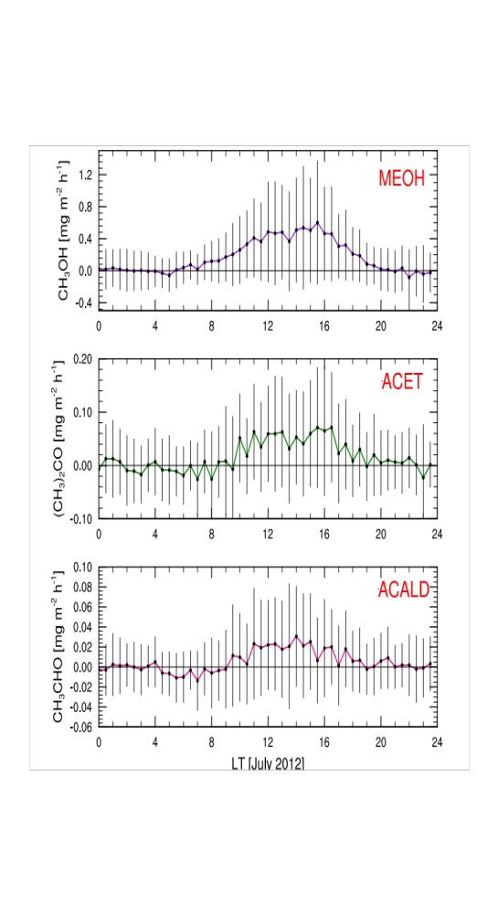
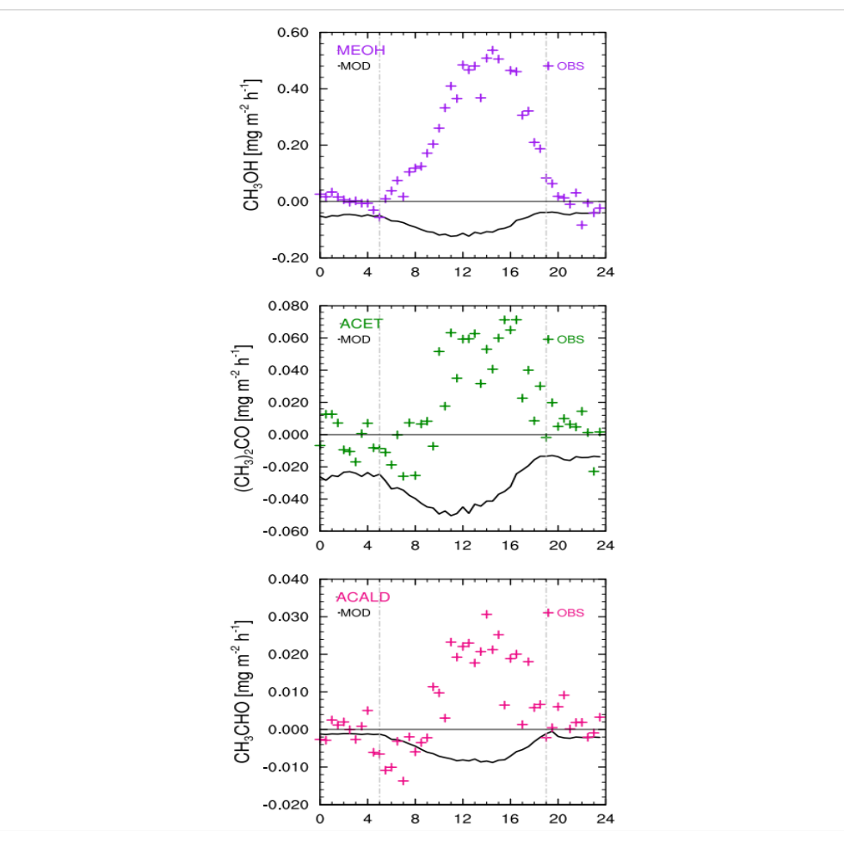
FORCAsT: FORest Canopy-Atmosphere Transfer
Notes:
3. We had observations of both fluxes and concentrations at 29m, which is just above the average canopy height at HF. I set FORCAsT up for the site for an average day in July 2012. Here are the observed fluxes of methanol, acetone and acetaldehyde for that average day. The coloured lines show the average flux at each measurement time (half-hourly), the vertical bars show 1 s.d above and below to give you an idea of the day-to-day variability. So, how does FORCAsT do? Well, taking it straight out of the box and driving the model with average met data for July 2012, which was also measured at HF, we get… this. The crosses show the mean observed fluxes (without the variability) and the modelled fluxes also at 29m are shown by the black lines. Now I am biased, but even so I have to say that is not doing a good job. But WHAT ARE WE MISSING? WHY does FORCAsT simulate negative fluxes at all times when measurements show positive or just about zero fluxes for most of the day?

Slide 3
Fluxes
UP +
DOWN -
Concentration gradient
Flux = -K_{H}.dC
dz
Eddy diffusivity
Notes:
4. Well, as Laurens has already explained fluxes are essentially the product of the concentration gradient between different heights in the atmosphere and the efficiency of the vertical mixing which we describe with this term here the eddy diffusivity. And we have this minus sign because we define upward fluxes as positive. So we get positive fluxes when the concentration gradient is negative so that's when concentrations are higher in the canopy than above, and we get negative fluxes when the gradient is positive.

Slide 4
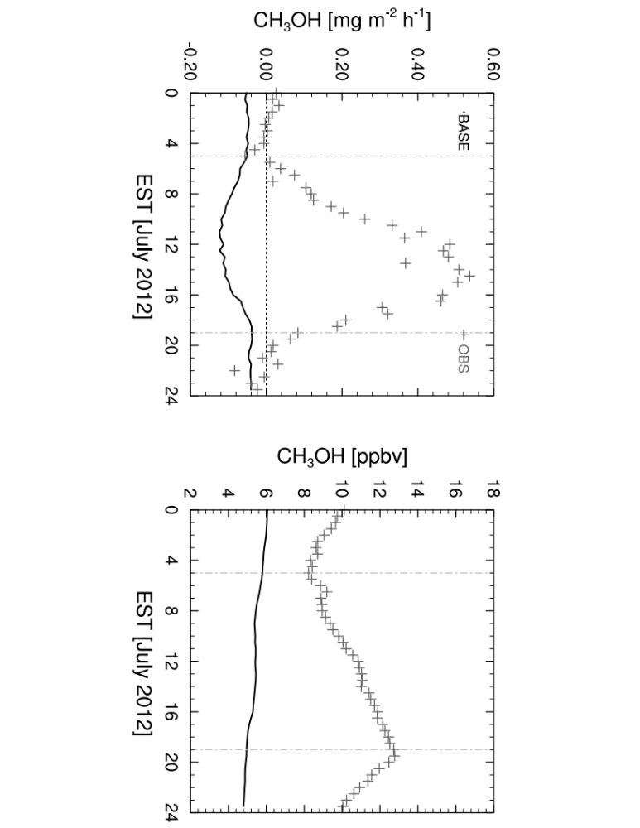
MEOH
Concentration
Flux
Concentration
Flux
Notes:
7. Right, let’s start with acetaldehyde. Here is the out-of-the-box effort again. We have the modelled and measured fluxes at 29m on the left. And we’ve already seen that we’re getting negative fluxes when they should be positive during the day and the diurnal cycle is muted. Looking at the concentration at 29m on the right, the modelled concentrations are always too low and miss the drop-off at night that we see in the observations. So what are the sources and sinks of acetaldehyde within the canopy? It could be that we are losing too much to a sink in the canopy (deposition or chemical loss) but let’s start by assuming that in fact we are missing a strong daytime source of acetaldehyde. The diurnal cycle of fluxes gives us a hint of where we might start looking…

Slide 5

Biogenic emissions
storage
combo
direct
synthesis
storage
emissions
Notes:
8. So a quick trip round biogenic emissions to explain some terminology I'll be using here. Biogenic VOCS are synthesised in plant cells. Once they've been produced, most of these compounds are then held in storage structures within the plant and released slowly over time. These emissions are generally only dependent on temperature. And I'll be referring to these as storage. At the other extreme we have isoprene which is pretty much released immediately it is produced. I'll be calling these type of emissions direct emissions and just as photosynthesis they’re dependent on both light and temperature so they fall to zero at night. Now, the vast majority of VOCs probably combine the two routes with a proportion directly emitted and the rest released from storage. I'll be calling these combo emissions.

Slide 6

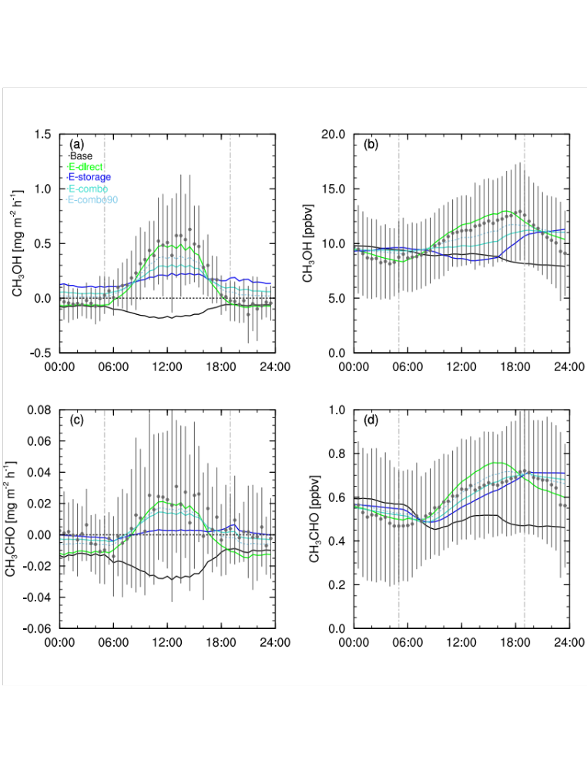
MEOH
Flux
Concentration
Notes:
10. And now methanol. Fluxes on the left and concentrations on the right again. And it’s the same story as for acetaldehyde. I introduced primary emissions again; with pretty much the same effect: storage only (in blue) don’t give us either the magnitude or diurnal profile of the fluxes and in fact show an inverse diurnal profile in concentration. Again the diurnal profile of fluxes is most pronounced for 100% direct emissions (in green) and combo emissions don’t capture the night-time drop-off in either flux or concentration. And increasing the proportion from storage doesn’t help the fit. This time though, direct emissions also give us a good match to observed concentrations, peaking at about the right time and with the right magnitude and then dropping off strongly. So a great big KERCHING!

Slide 7
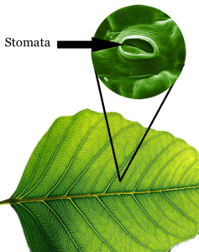

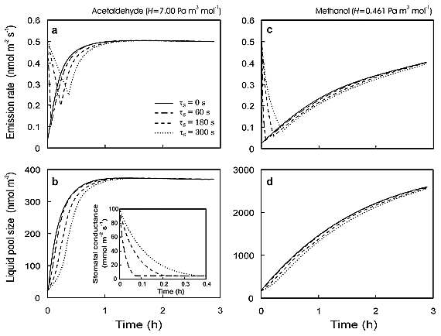
Stomatal control
deposition
emissions
Niinemets et al., 2003
Notes:
11. Well, I could have stopped there. I’d taken the model, compared the output to observations; used the discrepancy in fluxes to improve the model by including strong foliage emissions of oxyVOCs. But one of the strengths of FORCAsT is that it started life as a plant-soil-atmosphere model and plants are living entities. They breathe, eat and excrete – all via the stomata. And that’s included within FORCAsT, stomatal aperture is calculated at every timestep. And the stomata play an important role in determining the canopy environment (T, humidity, etc.) but they also directly affect 2 of our sources and sinks. Some dry deposition is just to the surface but a portion of it is taken into the plant through the stomata. This is fully accounted for in FORCAsT. But that’s not the case for emissions, they are just kind of assumed to emanate from the leaf surface which is true of all canopy models btw not just FORCAsT. BUT lab experiments have shown that at very low stomatal apertures emissions of stored VOCs can be impeded by the stomata for VOCs with high solubility including acetaldehyde and methanol. So that means at transitions between dark and light as the stomata are opening or closing. Hmmm, so is this observable at the canopy scale given all the other processes that occur between the point of emission and fluxes at the top?

Slide 8
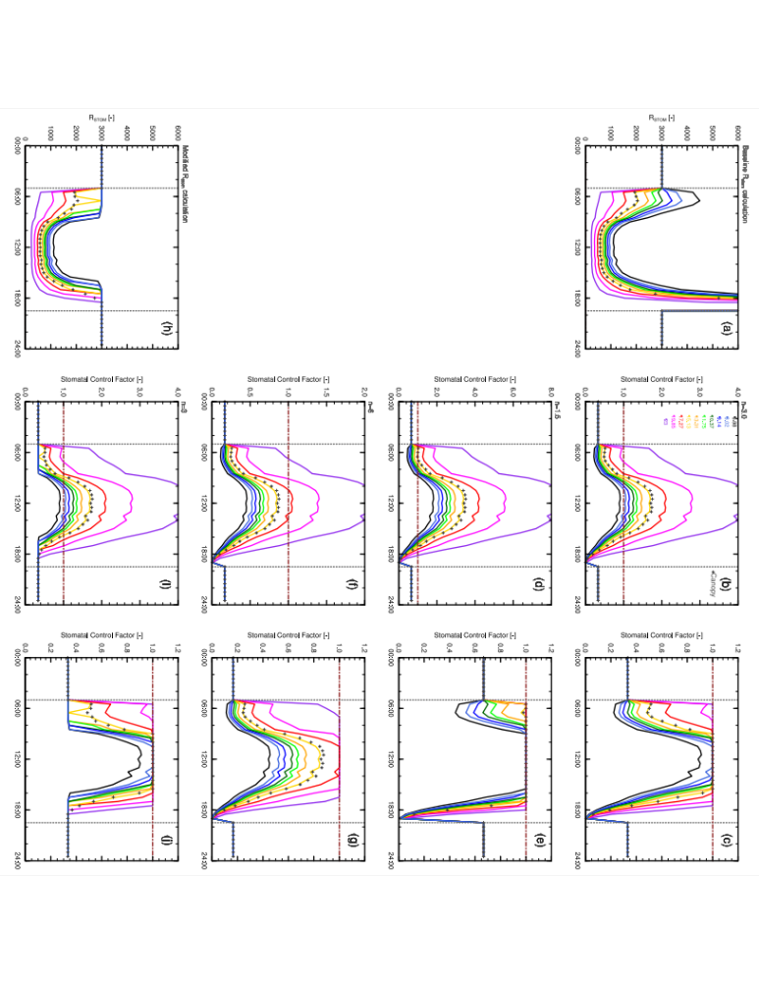
Stomatal control
Simple sensitivity test:
γ_{T} = e^{-β(TL-TS)}.R_{fct}
where R_{fct} is:
R_{fct} = 3000.0
3R_{stom}
or 1.0
Notes:
12. So I dug down into the code and applied stomatal control to the emissions from storage pools. In a very simplistic way to begin with, just as a sensitivity test; if hitting it with a hammer is effective, I can then go back and be more rigorous in my approach. So I started with a simple scaling factor that’s proportional to stomatal aperture. This shows the stomatal resistance which is actually the inverse of aperture calculated at every time step for every canopy level (and a kind of overall canopy average shown by the crosses). So we have low resistance (large apertures) during the middle of the day, and pronounced transition periods around dawn and dusk. And now here is the stomatal control factor, proportional to the aperture during the ends of the day and limited to 1.0 during the middle of the day to prevent my sledge hammer from enhancing midday emissions. And you can see that lower down in the canopy the stomata are never fully open in my sensitivity test and so emissions are reduced throughout the day. on the other hand toward the top of the canopy stomatal aperture only affects emissions for a relatively short time after dawn and before dusk. Although that is still over a longer period than might be expected from the lab results – sledgehammer.
So, if stomatal control is relevant at the canopy scale we would expect to see this scaling factor make a real difference to the modelled concentrations and fluxes at those transition periods.

Slide 9
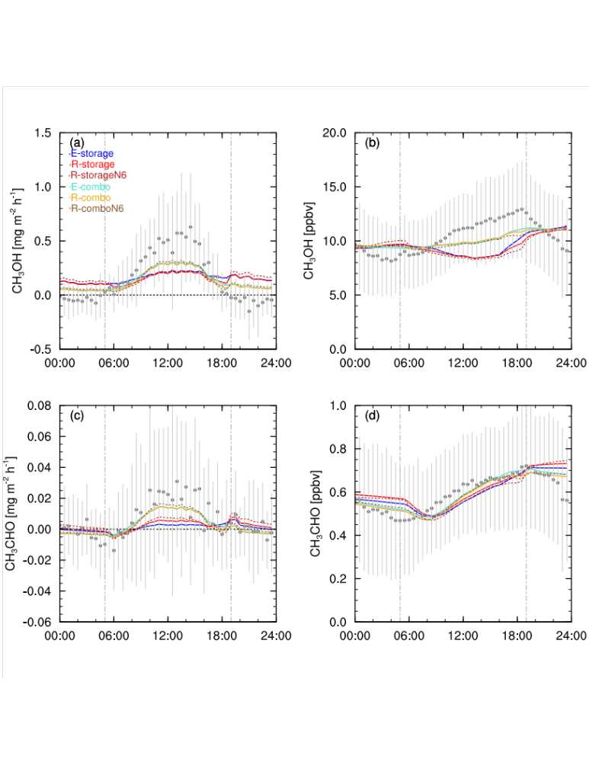
Stomatal control
Notes:
12. So do we?
Well no. We do see the effect if we look at emissions, but looking simply at canopy-top fluxes and concentrations: even my sledgehammer barely registers. What does that tell us? Stomatal control of emissions of highly soluble oxygenated VOCs is simply not something that we need to worry about at the canopy-scale => no need to include in 3-D (i.e. regional or global) models.

Slide 10
Take home
FORCAsT provides insights into drivers
Key processes:
MEOH – primary DIRECT emissions
Scale lab experiments to the canopy scale
Inform 3-D models
Notes:
14. So what I hope I've shown is that FORCAsT can capture bi-directional fluxes simply by getting the fundamental processes right. But more importantly, I think this gives a great demonstration of how we can use the model to try to understand the key drivers in each case and to really dig down into observations. Using the model has confirmed that at HF, we see strong foliage emissions of acetaldehyde and methanol. Moreover, we can best reconcile observed fluxes through combo emissions with 80% temperature dependent and 20% light and temperature dependent (as included in MEGANv2.1). But for this site methanol emissions appear to be strongly light-dependent, whereas they tend to be modelled as combo (if they’re included at all).
BUT we’ve been able to take our model and explore whether a phenomena observed in the lab is relevant at the larger scale. Allowing us to determine how it should be represented in regional and global models. or in this case, NOT included.
And that sums up why canopy models are so exciting and so powerful. Why you should all be itching to use them (whether you’re an experimentalist or a 3-D modeller). And why we desperately need this MiP.

