Slide 1

NETHERWORLDS & GREYNESS:
GREEN-LIPPED GEISHAS AND OLD SHEEP DOGS
Pip Dickens
Lecturer Fine Art (Painting)
Lancaster University

Slide 2
Colour categories:
ARCHITECTURE
CHEMISTRY
CLASSIFICATION
COLORANTS
COMPUTING & TELEVISION
DECORATION
DESIGN (TEXTILES AND GRAPHICS)
DRESS & COSMETICS
DYEING
FLORA & FAUNA
FOOD
GLASS
HISTORY (AND HERALDRY)
LIGHTING
METROLOGY
MUSIC
OPTICS
PAINTING
PERCEPTION
PHILOSOPHY
PHOTOGRAPHY & CINEMA
PRINTING (INCLUDING TEXTILES)
SYMBOLISM
TERMINOLOGY
THERAPY
VISION

Slide 3
“Human adults with normal color vision can generally discriminate between 120 to 150 color differences across the visible spectrum. When saturation and brilliance are included, the number jumps into the millions. Although we are inclined to treat color as if it were a property – an affordance of things in themselves, color is a subjective phenomenon that is never registered in isolation and can be perceived only in a dynamic interaction.”
“Moreover, color is relative to context. Seen next to another color, it changes characteristics and may seem lighter, darker, or a different hue.”
Ann Marie Seward Barry. Visual Intelligence: Perception, Image and Manipulation in Visual Communication, New York: State University of New York Press, 1997

Slide 4
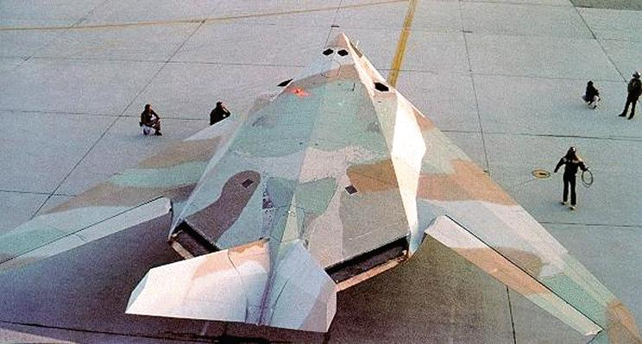
F117 Nighthawk - Camouflage Version
Source: http://fas.org/ Federation of American Scientists

Slide 5
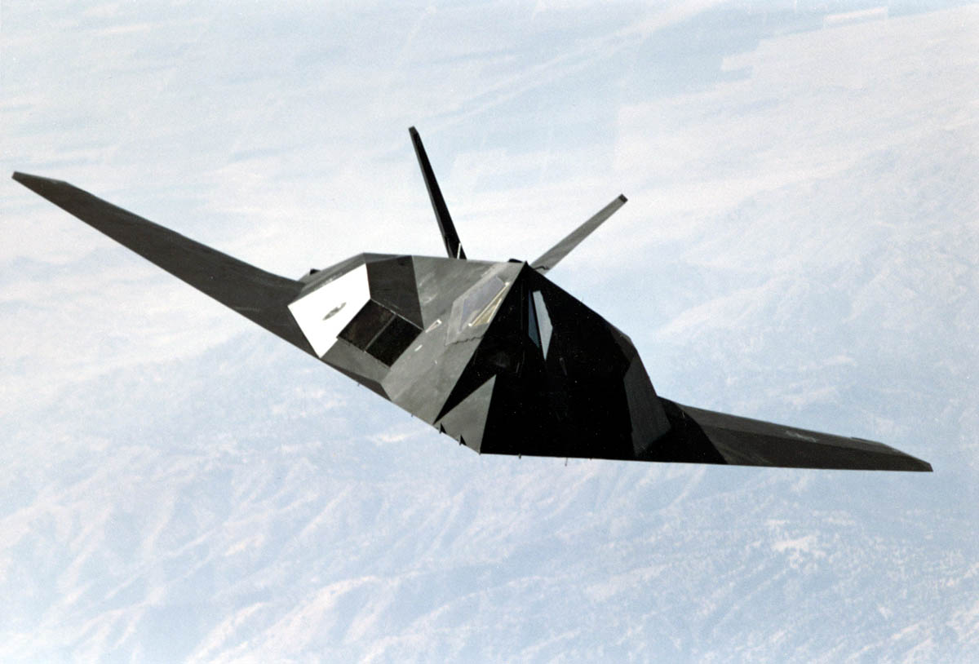
F117 Nighthawk – Black Version
Source: http://www.combatindex.com/

Slide 6
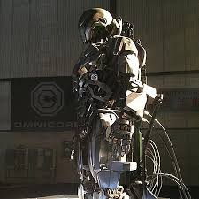
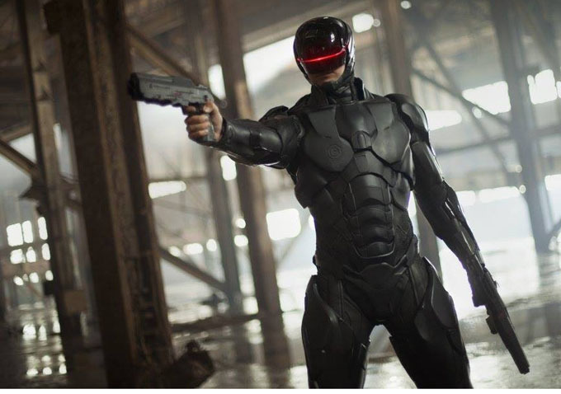
“Let’s go with black...it’s more menacing!”
Robocop, 2014, Metro-Goldwyn-Mayer. Director: José Padilha

Slide 7
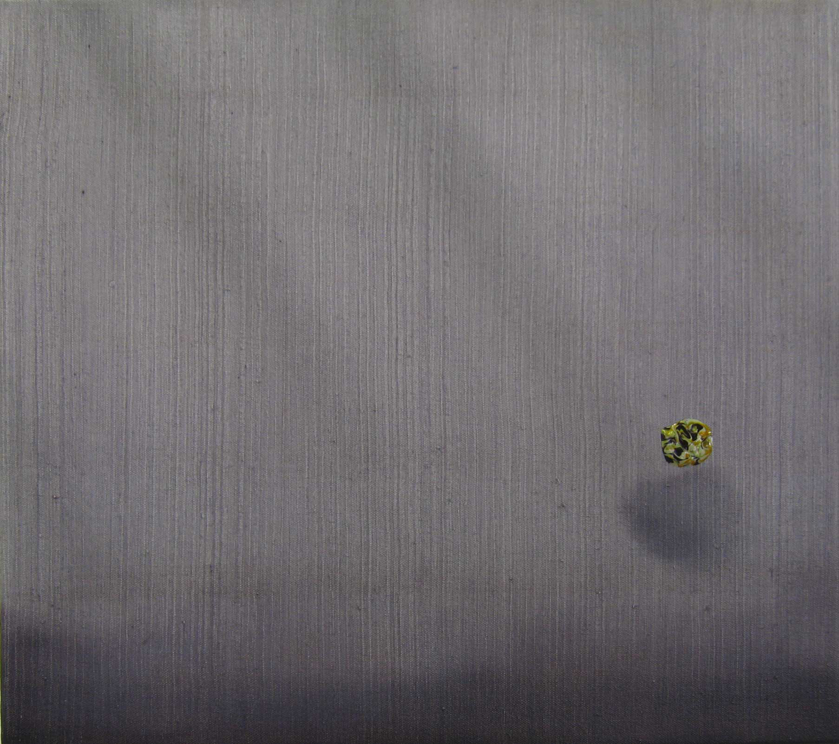
Pip Dickens
The Offing – SHIBUSA series
Oil on canvas, 41 x 46 cm, 2011

Slide 8
I have spoken of the practice of [women] blackening the teeth, but was not shaving the eyebrows also a device to make the white face stand out? What fascinates me most of all, however, is that green, iridescent lipstick, so rarely used today even by Kyoto geisha. One can guess nothing of its power unless one imagines it in the low, unsteady light of a candle. The woman of old was made to hide the red of her mouth under green-black lipstick, to put shimmering ornaments in her hair; and so the last trace of colour was taken from her rich skin. I know of nothing whiter than the face of a young girl in the wavering shadow of a lantern, her teeth now and then as she smiles shining in lacquered black through lips like elfin fires.
Junichiro Tanizaki. In Praise of Shadows, Vintage Classics, 2001

Slide 9
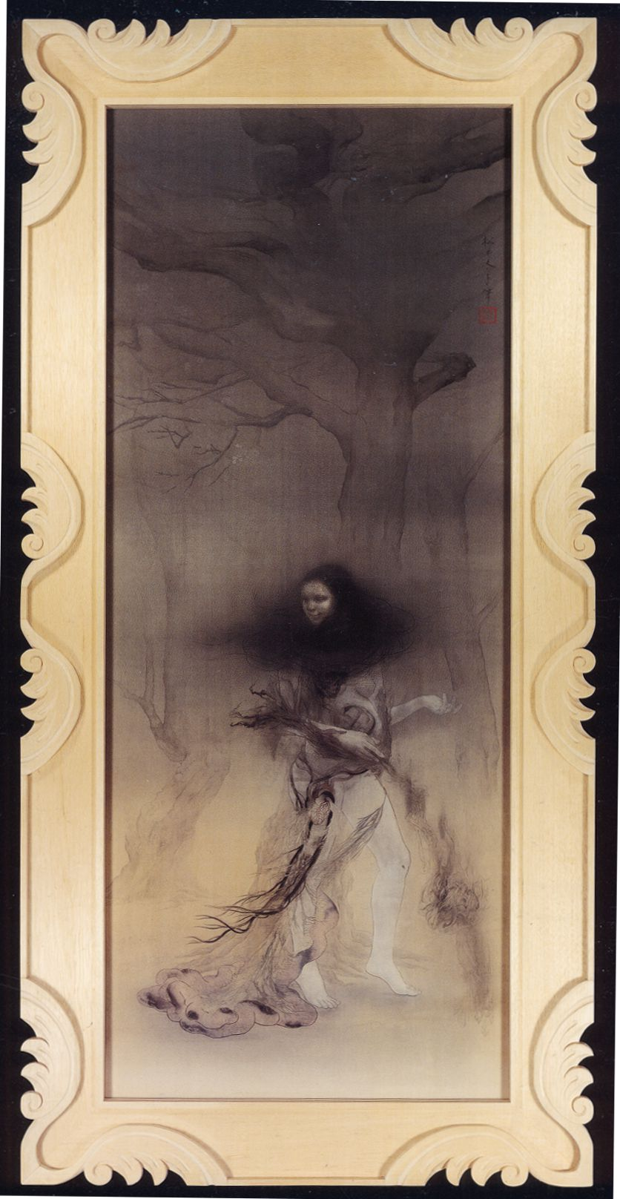
Matsui Fuyuko
Light Indentations Mingle and Run in All Directions
190 x 78 cm
Color Pigment on Silk
2008

Slide 10
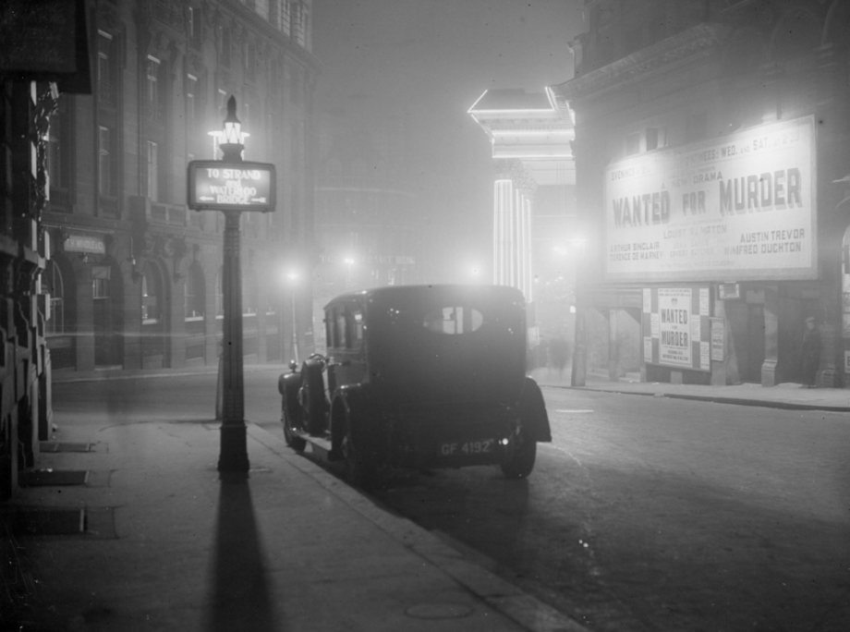

Slide 11
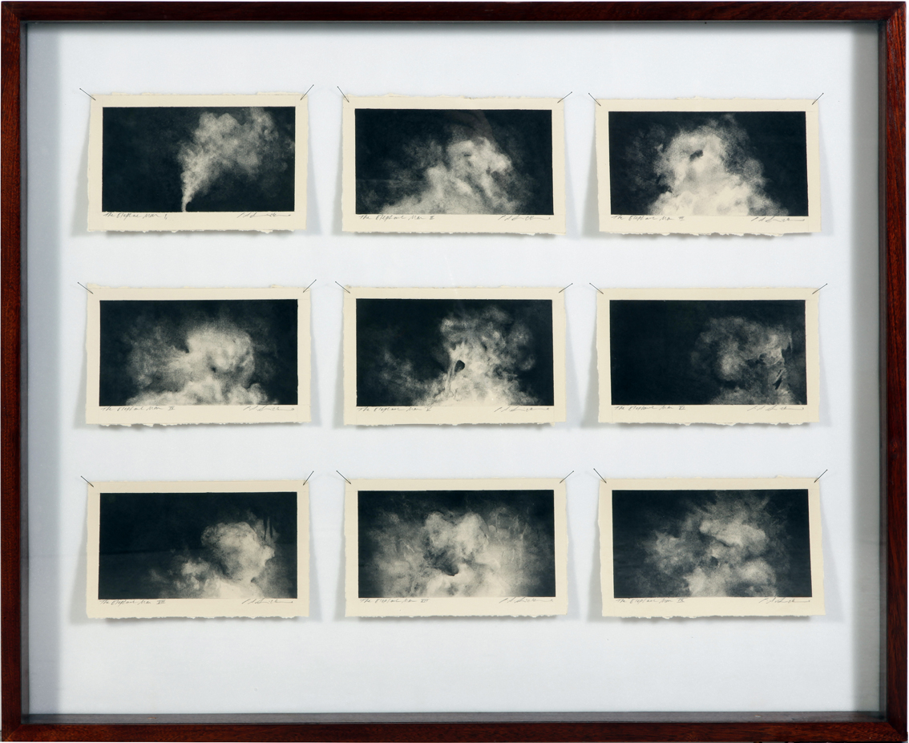
Elephant Man (Cloud) Drawings
A series of nine charcoal drawings on Arches paper, pinned into bespoke entomological drawer (waxed sapelewood, laminated glass and brass fixings)
©Pip Dickens

Slide 12
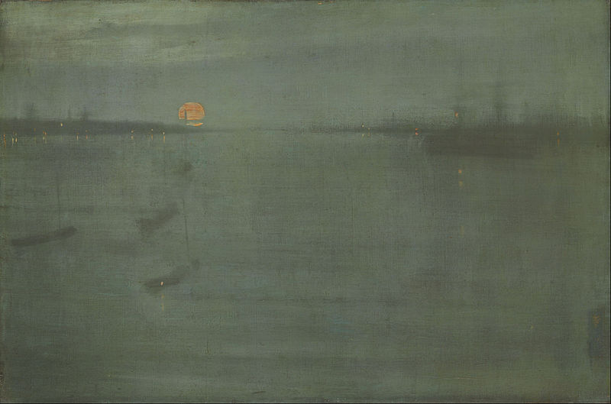
James McNeill Whistler, Nocturne: Blue and Gold—Southampton Water
oil on canvas, 50.5 cm x 76 cm, 1872

Slide 13
“In the process of colouring, the surface of the canvas should receive the greatest possible richness in light-emanation-effect and, at the same time, it should retain the transparency of a jewel. The light and form should control illusory oscillation into space and out of space…The pictorially decorative effect is achieved through musical contrasts and rhythmic relations conditioned in space…for every medium contains its own rhythmic laws and thus its strict limitations through which it is distinguished as the specific way of expression that it is."
Hans Hoffman on ‘The Aims Of Art’, 1932

Slide 14
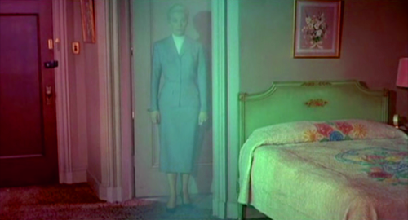
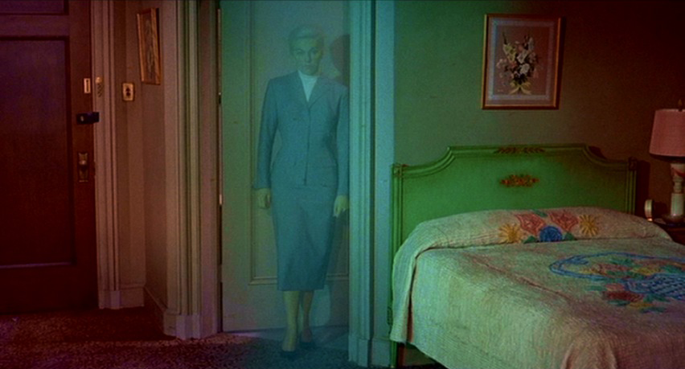
Vertigo, 1958, Director Alfred Hitchcock

Slide 15
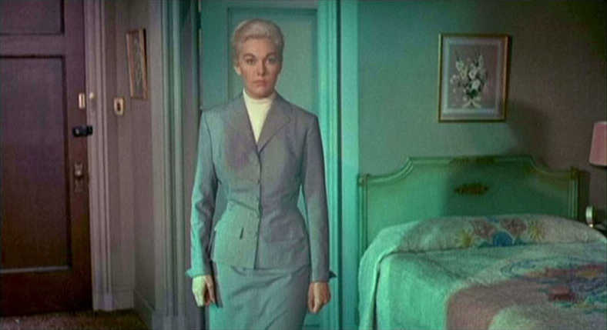
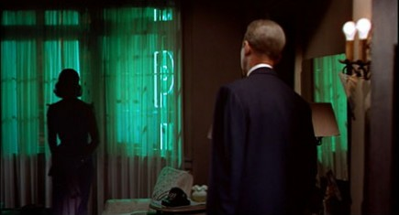
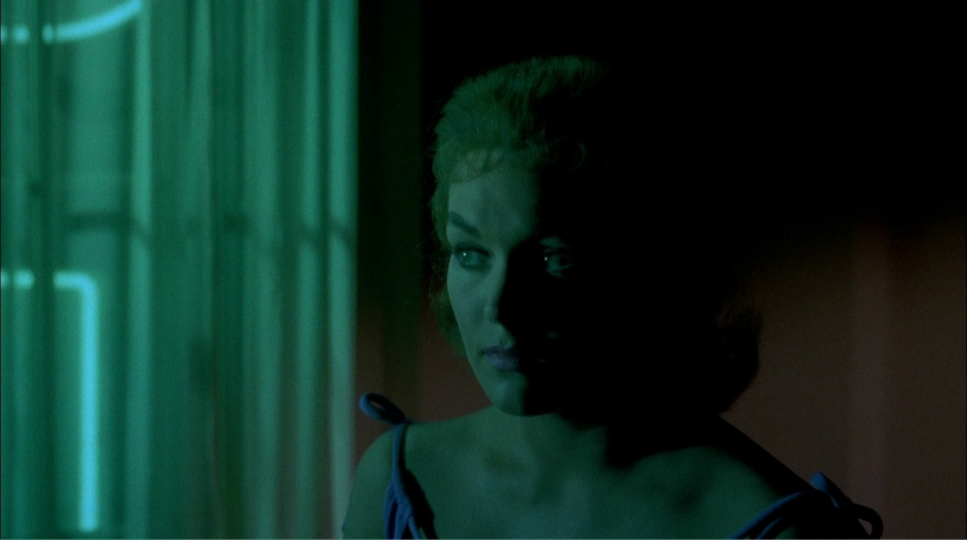

Slide 16
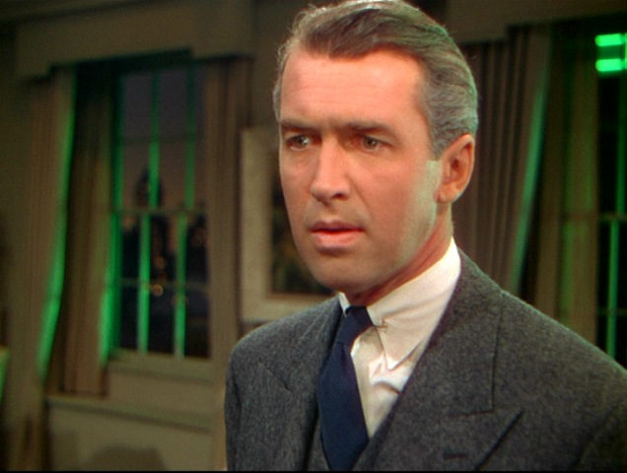
Rope, 1948, Director Alfred Hitchcock

Slide 17
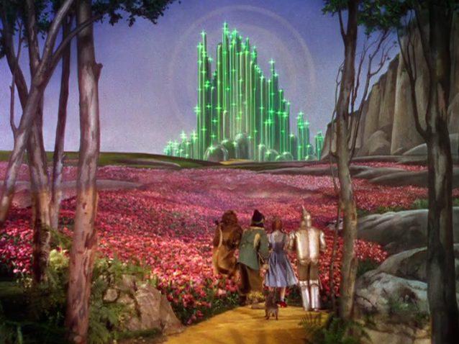
The Wizard of Oz, 1939, Director Victor Fleming

Slide 18
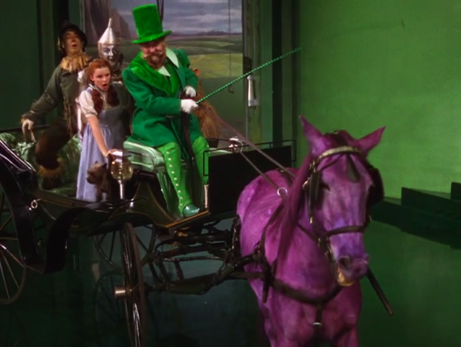
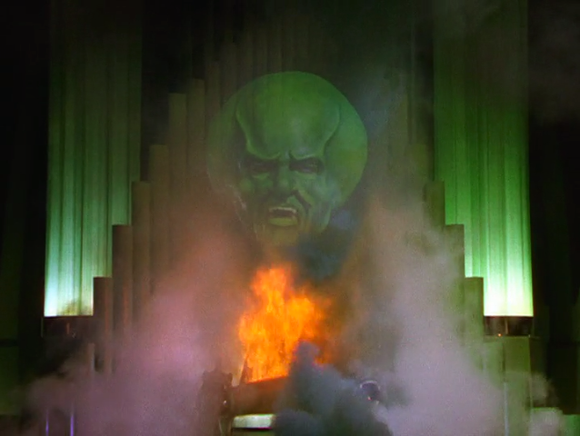
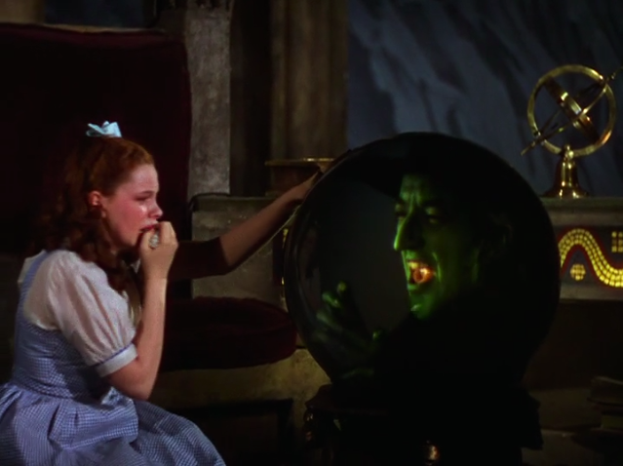
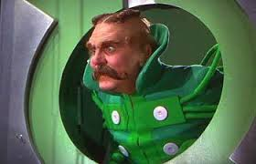
The Wizard of Oz, 1939, Director Victor Fleming

Slide 19
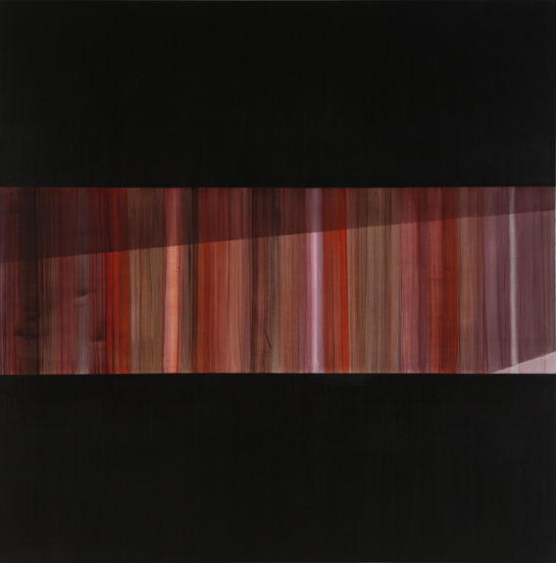
www.pip-dickens.com

