Slide 1

Making resilient language learners
a work in progress…
Isabelle Baron, Lancaster university, 2019

Slide 2
A few things that crossed my mind…
(2017-18) Why do we have to teach students how to Adjust positively to adverse situations?
(2017-18) is this us “mothering” our students ?
(2018-19) Is resilience simply a fad or a new way of thinking?
(2019) too much awareness / “myth” of transition / trauma ?
(2019) The age of the selfie, are we encouraging the trend/ selfie- fulfilling prophecy ?

Slide 3
it has been reported that at least 50% of language learners suffer from high levels of anxiety (Lanir: 70). In language teaching, smaller group tuition and regular sustained practice are essential components of the acquisition of linguistic knowledge, but this also contributes to the anxiety-generating perception on the part of students that " there is nowhere to hide ".
Such anxiety may express itself as ‘lassitude or hostility’ . Learners’ self-confidence diminishes considerably and their ability to project a gratifying self-image is greatly impaired, as their capacity to communicate has been taken away from them (Brookfield: 37).
This may result in a reluctance to use the language, to take risks and therefore to widen their field of linguistic acquisition through an ‘overconcern’ with errors compounded by more generic student concerns with academic achievements (Nation and Macalister: 66-67).

Slide 4
2018 Year Abroad conference, September 2018, Newcastle.
YA related topics, presentations concerned with:
Reflections on student wellbeing and mental health issues on the Year Abroad
Managing Year Abroad Crisis
Student concerns about their stay abroad
Positive Mental Health during the Year Abroad….

Slide 5
the Year Abroad programme, whether spent in a university or in teaching or non-teaching work placement, was perceived as a joyful and carefree endeavour.
Year Abroad tutors and administrators are now faced with managing students’ increased vulnerability in the face of real and imaginary challenges.

Slide 6
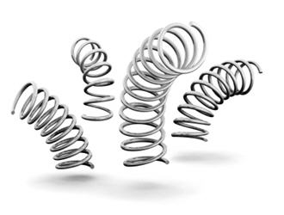
Learning strategies to recover from setbacks in your academic and personal life during your time at university and abroad as a language student and creatively manage challenges and difficulties

Slide 7
Activity 1:
(2017-18) With your group, discuss ‘resilience’ and give a definition of ‘resilience’
(2018-19) With your group, discuss ‘resilience’ and how you feel when you feel resilient ?

Slide 8
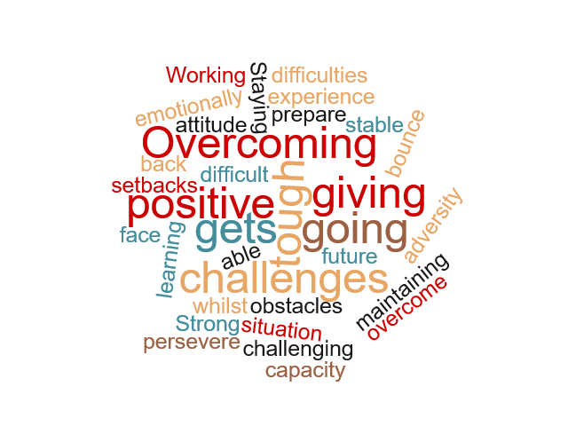

Slide 9
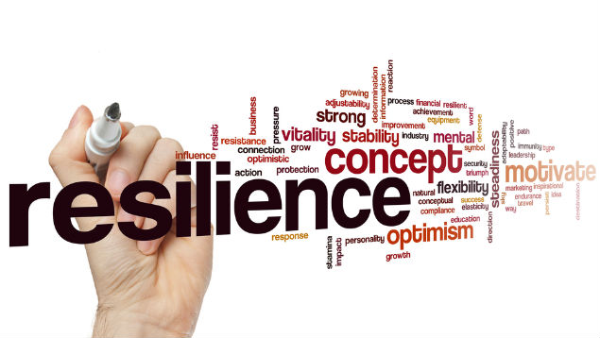

Slide 10
- if you want them to engage with resilience it's often powerful to ask what it is like when they feel resilient, and what it is like when they are not.
Definitions often miss that out and it's crucial. Indeed, one problem of offering definitions is that they often limit resilience and it means to be resilient; so if doing so I'd suggest finding very different definitions to keep options open.
The more someone owns their own feeling of what resilience means, feels like, the more powerful it is.
(will Medd, 2019)
Why should I learn about failure when I want to be a success? Coaching students to think differently about learning

Slide 11
Resilience is both a key graduate attribute and an integral part of any transitions framework as it enables students to better cope with the challenges that they will encounter on their own unique learning journey.
The term ‘resilience’ can be applied to both academic and social/personal aspects of the student journey and is often equated with ‘wellbeing’.
https://www.ed.ac.uk/institute-academic-development/learning-teaching/staff/levels/academic-transitions-toolkit/building-student-resilience-model/background-and-rationale

Slide 12
Friedland (2005) defines resilience as inferring hardiness, toughness, and resistance, along with—somewhat paradoxically—elasticity and flexibility. resilience is both multi-faceted and multi-leveled …

Slide 13
Abiola and Udofia (2011) discuss resilience in terms of inner strength, competence, optimism, flexibility, and the ability to cope effectively when faced with adversity […]
social support, and active coping increase people's ability to deal with life's challenges.

Slide 14
‘academic buoyancy’ (Martin and Marsh, 2008)
Growing confidence to overcome the problems that you face in your academic and personal life while at university
Foster a mindset that will encourage a positive response to setbacks, challenges and fear of failure

Slide 15
Activity 2a :
Setbacks: with your group discuss setbacks, personal and/or academic which you have had / WILL HAVE to face :
Workload, deadlines ?
presentations ?
Jobs and work placements, Cvs, interviews ?
Group projects ?
Sports teams ?
Social life at uni and outside
More sensitive, personal stuff…?
Studying and working abroad ?

Slide 16
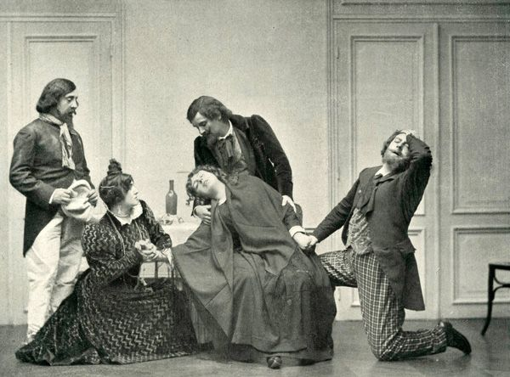
Activity 2b, TIME TO INDULGE YOUR INNER DRAMA QUEEN:
Pick a setback/ situation and imagine the worst possible scenario…
Pick a setback/ situation and imagine the best possible scenario…

Slide 17

Really ?????

Slide 18
ACTIVITY 2B:
HOW WOULD YOU realistically DEAL WITH THESE SITUATIONS, within the university framework?
(2017-18 + 2018-19) Not the best of responses
Support from other people in your life.
Tap on your Ability to accept yourself for who you really are.
trust Your confidence in your ability to cope with adversity.
How good you are at communicating and interacting with others in times of stress ?
How good you are at facing challenging problems in life and solving them systematically.
Ability to cope with your emotions in the face of adversity.
https://positivepsychologyprogram.com/resilience-activities-worksheets/#exercises-resilience

Slide 19
We tend to think of resilient people as those who are unaffected by the challenges of life, who take a setback with a smile and laugh in the face of their obstacles. But this is not resilience
You may be thinking “I’m not resilient at all –look at how I’ve struggled to get back up!”
If you’re thinking any of this, then you are probably a resilient person already
you have struggled, you have waded through a tide of difficulty (be they academic, social or personal) – and you have “survived” and moved on !
https://positivepsychologyprogram.com/resilience-activities-worksheets/

Slide 20
Resilience is both an outcome and a process (pooley & cohen, 2010)
STUDY SMART, MANAGE YOUR TIME EFFICIENTLY, PLAN AHEAD, SET YOURSELF REALISTIC GOALS, don’t be afraid to ask for help, talk to YOUR TUTORS, TALK TO OTHER STUDENTS, know what support is available ….
EAT WELL, EXERCISE REGULARLY, sleep AND REST ENOUGH, have centres of interest outside university……

Slide 21
my sense is everyone knows that more sleep, food, exercise etc. is important.
How often do we do those things?
Sometimes pointing it out creates another 'should' and we often don't respond well to shoulds.
So I'd tend to ask people what they identify they want to do - what they value, and ask them to identify small actions they can take towards it.

Slide 22
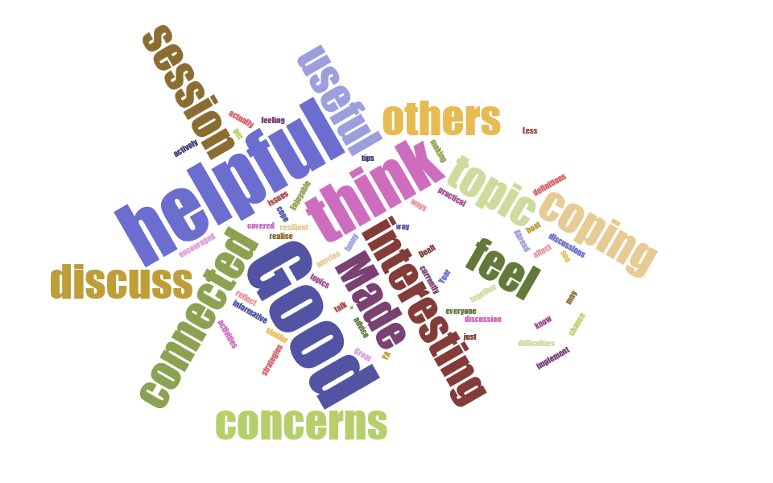

Slide 23
Bibliography:
Abiola T., Udofia O. (2011). Psychometric assessment of the Wagnild and Young's resilience scale in Kano, Nigeria. BMC Res. Notes 4:509. 10.1186/1756-0500-4-509
Brookfield, S. (2005) Becoming a Critically Reflective Teacher, San-Francisco: Jossey-Bass
Cassidy, S. (2015). Resilience Building in Students: The Role of Academic Self-Efficacy. Front. Psychol., 27 November 2015
Friedland N. (2005). Introduction – The ‘elusive’ concept of social resilience, in The Concept of Social Resilience, eds Friedland N., Arian A., Kirschnbaum A., Karin A., Fleischer N., editors. (Haifa: The Technion. Samuel Neaman; Institute, 7–10.
Denovan, a.& macaskill (2016), stress and subjective well-being among first year uk undergraduate students, Springer Science+Business Media, LLC
Lanir, L. (2010) ‘Foreign language learning difficulties’, Modern English Teacher, no 19, 69-72
Martin, J. Marsh, H.B. Academic resilience and academic buoyancy: multidimensional and hierarchical conceptual framing of causes, correlates and cognate constructs, Oxford Review of Education, 35:3, 353-370
Nation, I.S.P. and Macalister, J. (2010) Language Curriculum Design, New York: Routledge
Pooley J., Cohen L. (2010). Resilience: a definition in context. Aust. Commun. Psychol. 22, 30–37.
Ungar, M. (2012.).The Social Ecology of Resilience, A Handbook of Theory and Practice,10.1 Springer Science+Business Media, LLC

