Slide 1
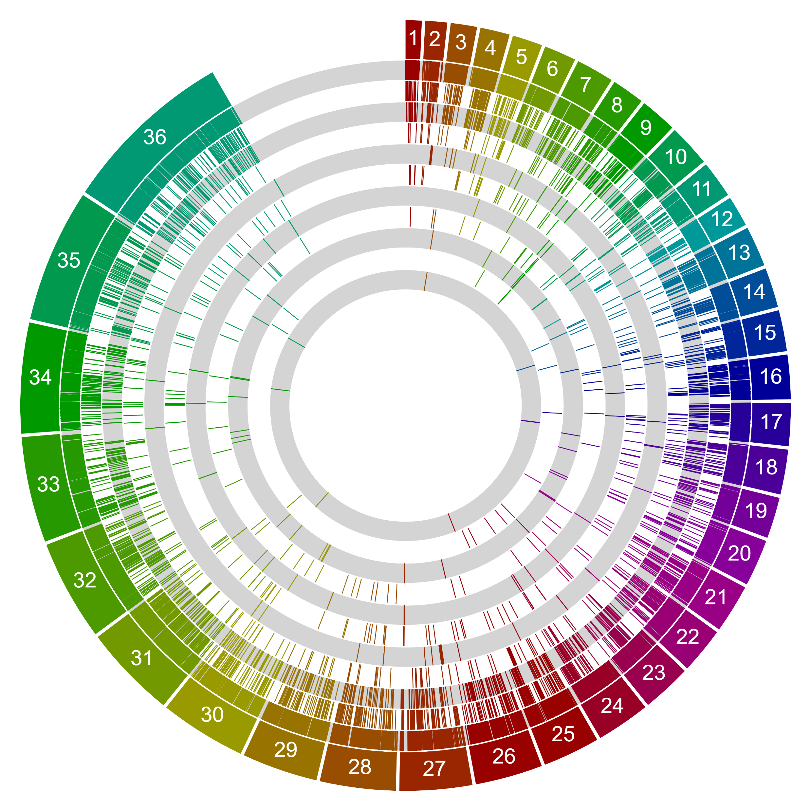
L. (M.) martiniquensis LV760;LSCM1
Chromosome
1
2
3
4
5
6
7
8
9
10
11
Simple repeats (micro-satellites)
Low complexity repeats
DNA repeat elements (DNA)
Long terminal repeat elements (LTR)
Unknown
Long interspersed nuclear elements (LINE)
RNA repeats (rRNA/tRNA/snRNA)
Rolling Circle repeats (RC)
Satellite repeats
Short interspersed nuclear elements (SINE)
Retroposon

Slide 2
L. (M.) martiniquensis LV760;LSCM1
Total repeats = 2.50% (853,680 bp)

Slide 3

L. (M.) orientalis LV768;LSCM4
Chromosome
1
2
3
4
5
6
7
8
9
10
11
Simple repeats (micro-satellites)
Low complexity repeats
DNA repeat elements (DNA)
Long terminal repeat elements (LTR)
Long interspersed nuclear elements (LINE)
Unknown
RNA repeats (rRNA/tRNA/snRNA)
Satellite repeats
Rolling Circle repeats (RC)
Short interspersed nuclear elements (SINE)
Retroposon

Slide 4
L. (M.) orientalis LV768;LSCM4
Total repeats = 2.50% (853,680 bp)

Slide 5

L. (M.) enriettii LV763;CUR178
Chromosome
1
2
3
4
5
6
7
8
9
10
11
Simple repeats (micro-satellites)
Low complexity repeats
DNA repeat elements (DNA)
Long terminal repeat elements (LTR)
Long interspersed nuclear elements (LINE)
Unknown
RNA repeats (rRNA/tRNA/snRNA)
Satellite repeats
Rolling Circle repeats (RC)
Short interspersed nuclear elements (SINE)
Retroposon

Slide 6
L. (M.) enriettii LV763;CUR178
Total repeats = 2.73% (932,724 bp)

Slide 7

L. (M.) sp. Ghana LV757;GH5
Chromosome
1
2
3
4
5
6
7
8
9
10
11
Simple repeats (micro-satellites)
Low complexity repeats
DNA repeat elements (DNA)
Long terminal repeat elements (LTR)
Long interspersed nuclear elements (LINE)
Unknown
RNA repeats (rRNA/tRNA/snRNA)
Satellite repeats
Rolling Circle repeats (RC)
Short interspersed nuclear elements (SINE)
Retroposon

Slide 8
L. (M.) sp. Ghana LV757;GH5
Total repeats = 2.39% (859,444 bp)

Slide 9

L. (M.) sp. Namibia LV425;253
Chromosome
1
2
3
4
5
6
7
8
9
10
11
Simple repeats (micro-satellites)
Low complexity repeats
DNA repeat elements (DNA)
Long terminal repeat elements (LTR)
Long interspersed nuclear elements (LINE)
Unknown
RNA repeats (rRNA/tRNA/snRNA)
Satellite repeats
Rolling Circle repeats (RC)
Short interspersed nuclear elements (SINE)
Retroposon

Slide 10
L. (M.) sp. Namibia LV425;253
Total repeats = 2.61% (889,889 bp)

Slide 11
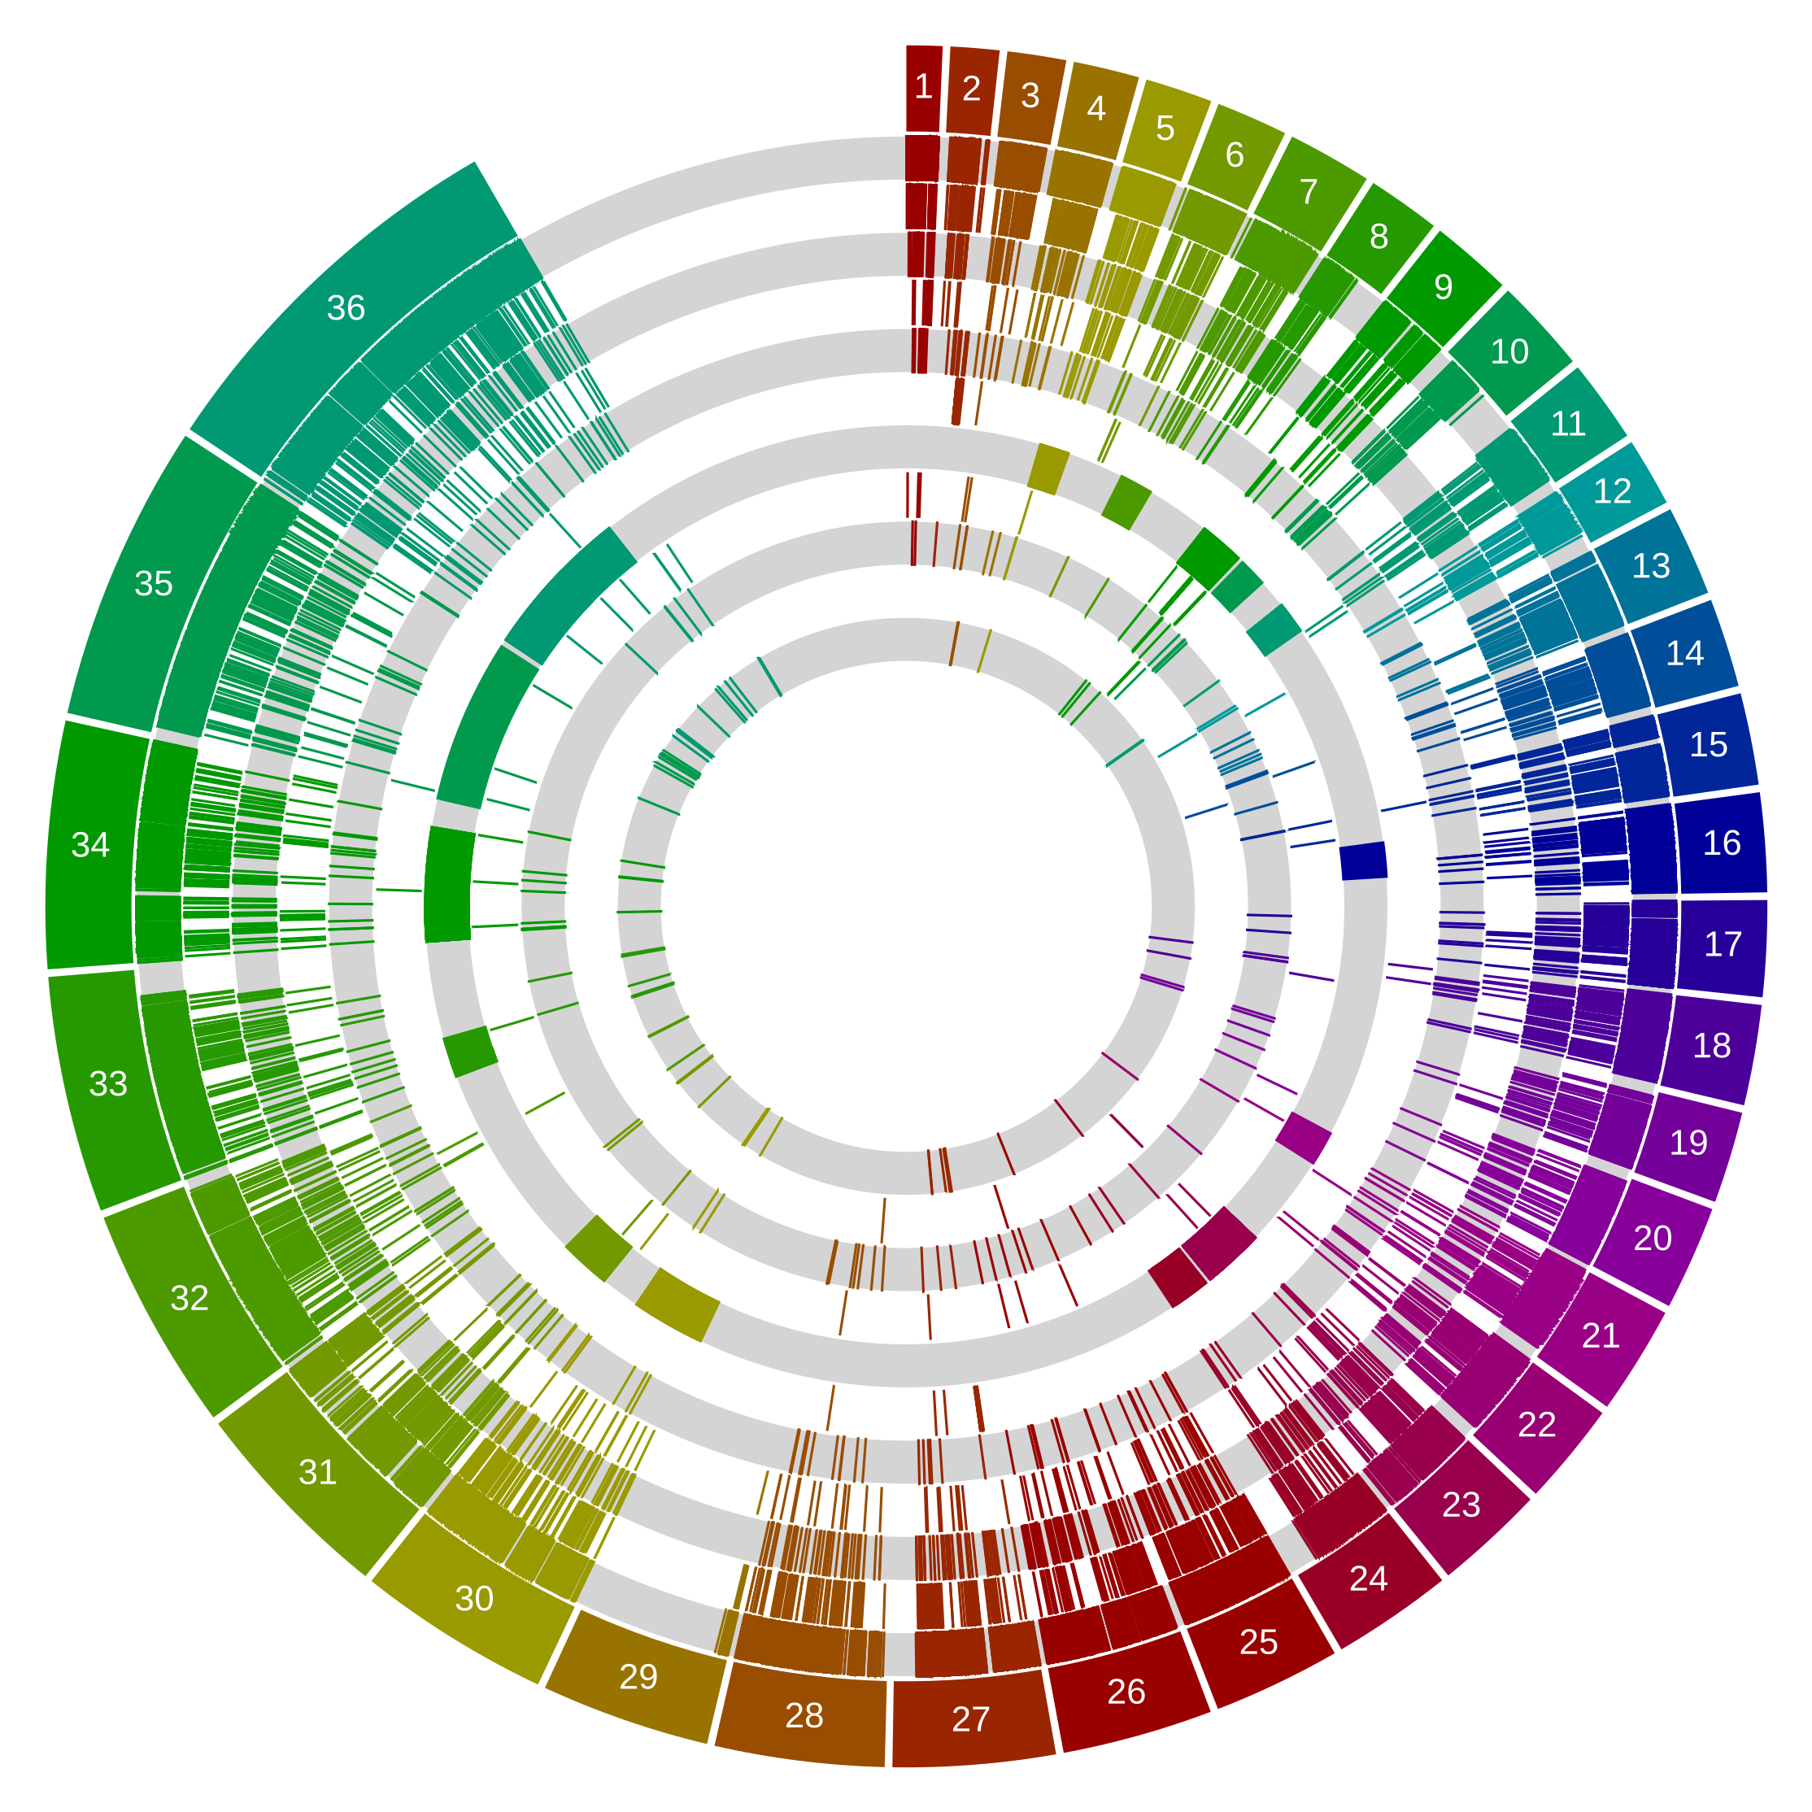
Porcisia hertigi LV43;C119
Chromosome
1
2
3
4
5
6
7
8
9
10
11
Simple repeats (micro-satellites)
Low complexity repeats
DNA repeat elements (DNA)
Long terminal repeat elements (LTR)
Long interspersed nuclear elements (LINE)
Unknown
RNA repeats (rRNA/tRNA/snRNA)
Satellite repeats
Rolling Circle repeats (RC)
Short interspersed nuclear elements (SINE)
Retroposon

Slide 12
Porcisia hertigi LV43;C119
Total repeats = 4.03% (1,378,096 ​bp)

Slide 13
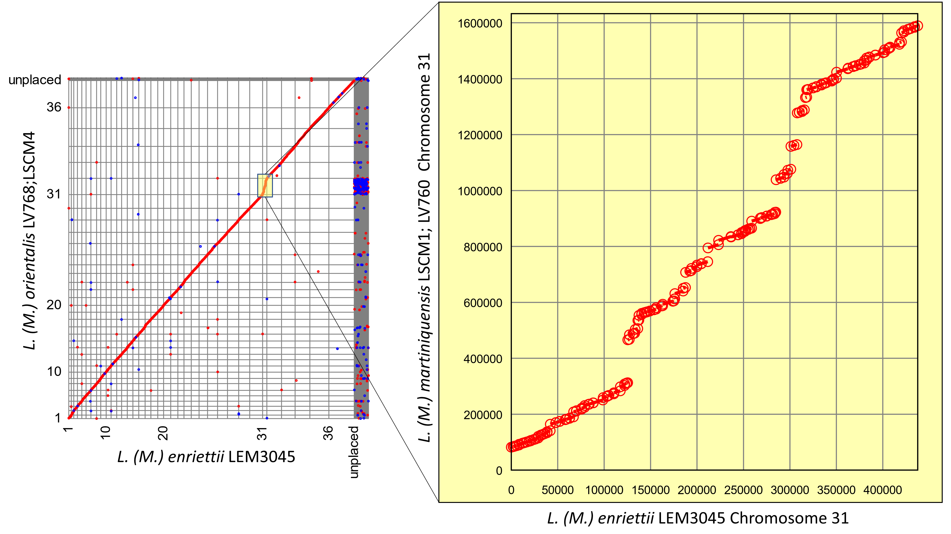

Slide 14
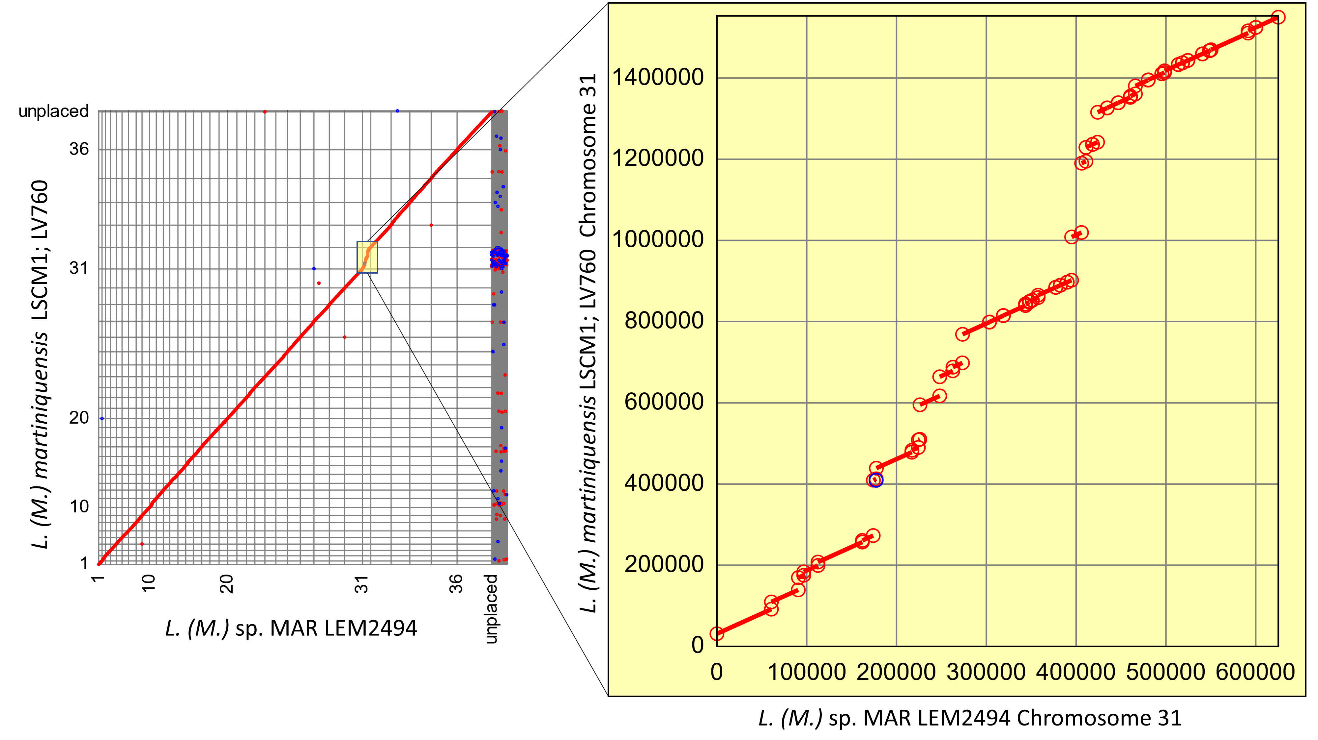

Slide 15
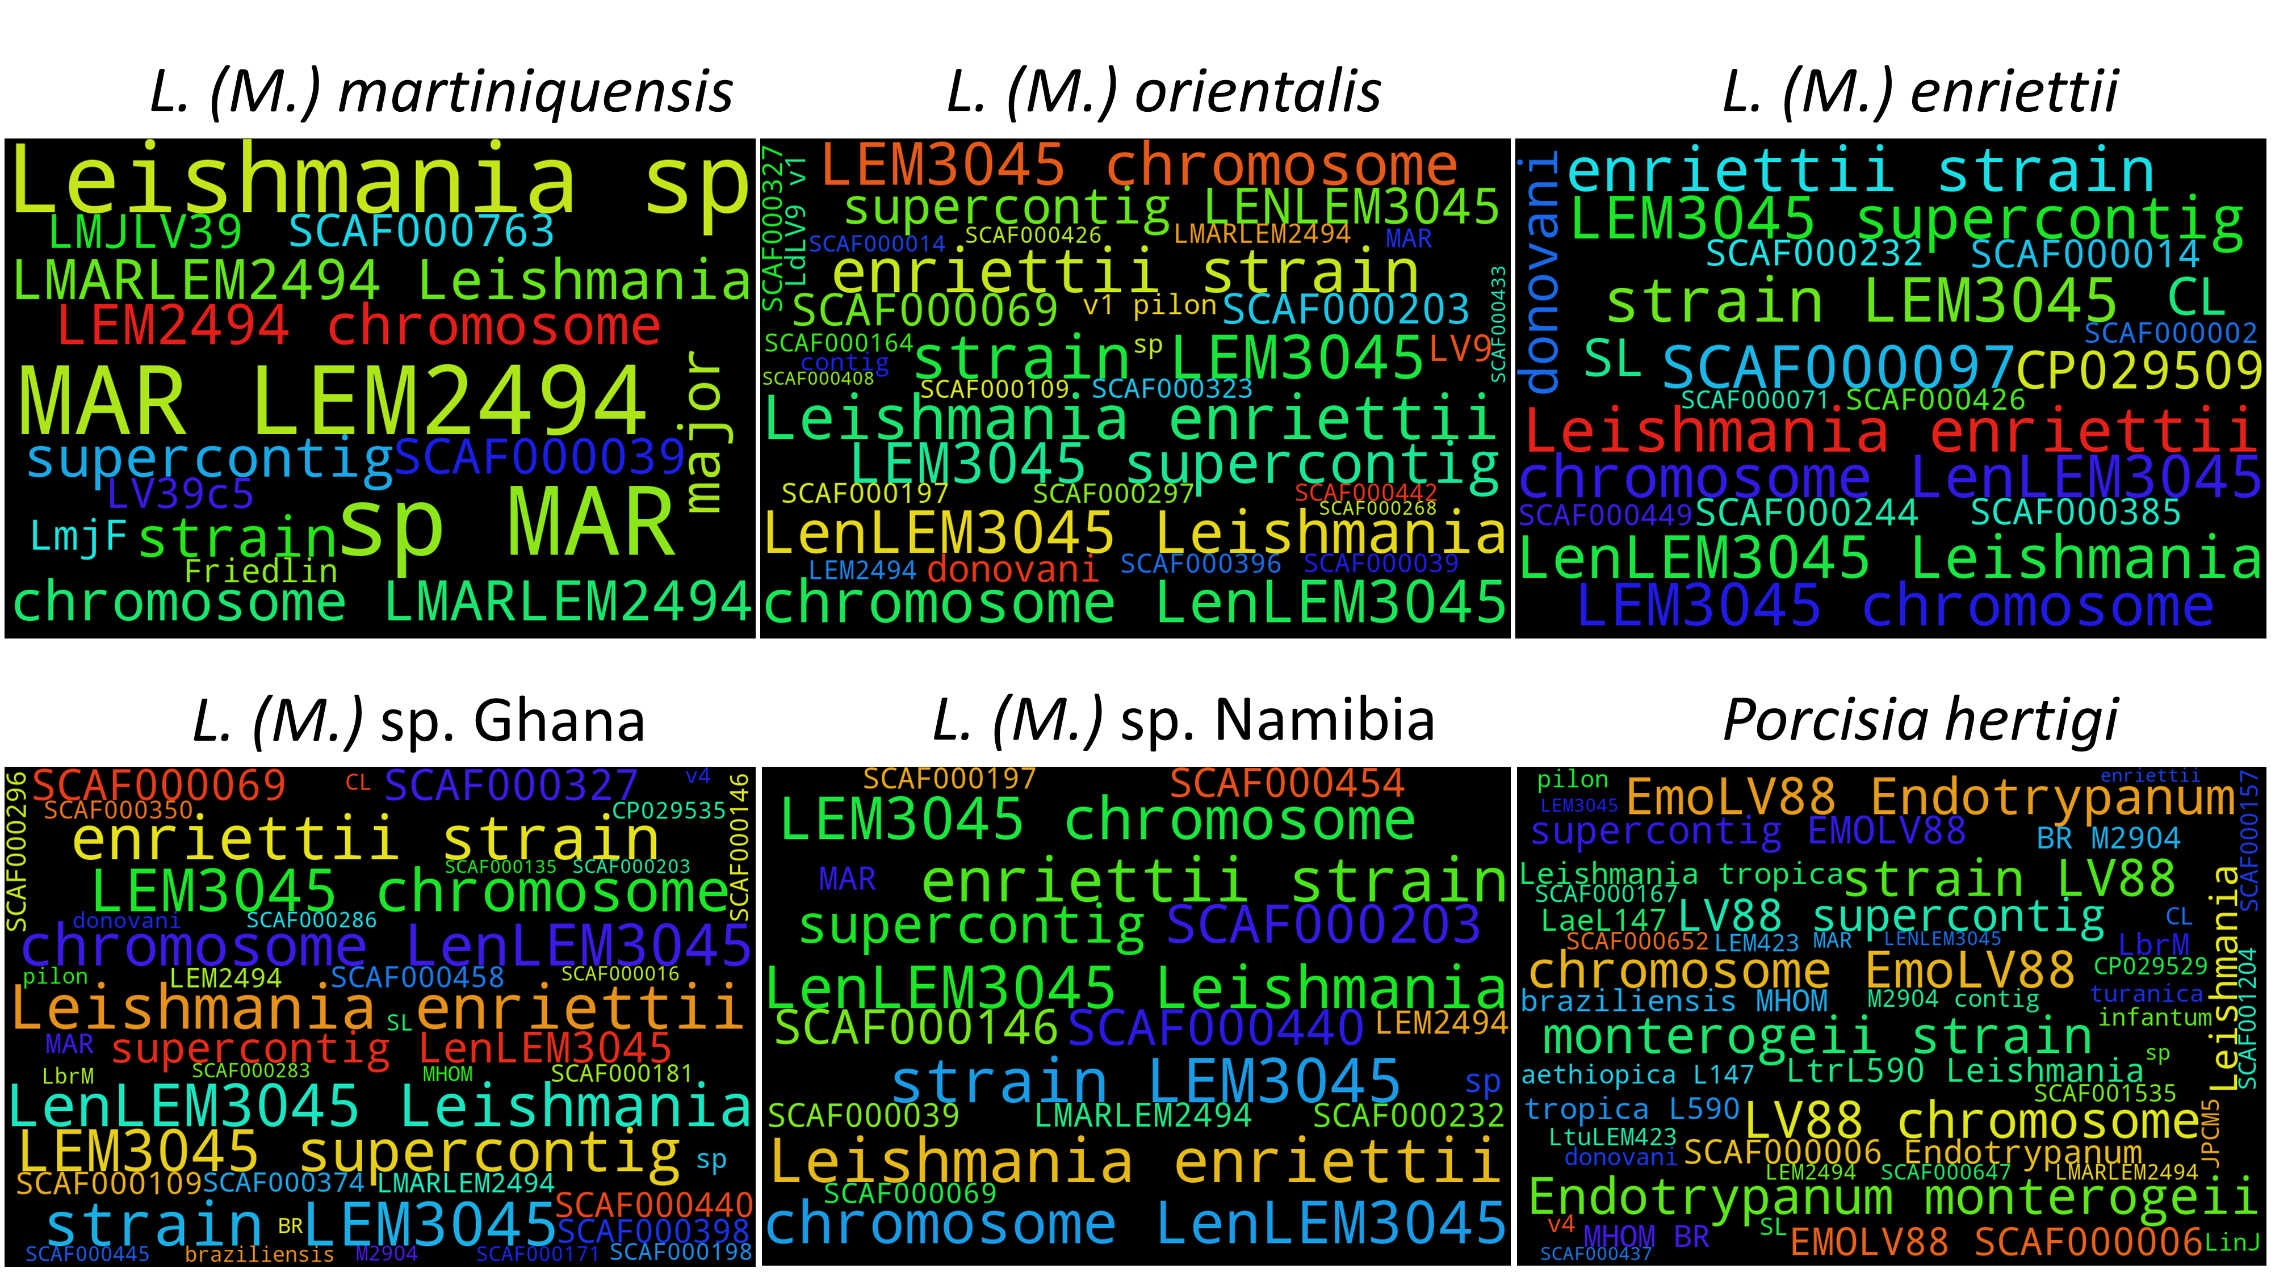

Slide 16
