Slide 1

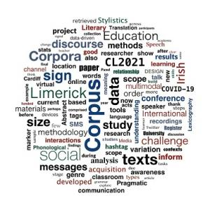

Evaluating the effectiveness of indirect data-driven learning in second language writing error correction: A pilot study report
Corpus Linguistics Conference
2021
Fangzhou Zhu (Noah)
Notes:
LANCASTER UNIVERSITY POWERPOINT TEMPLATES
These PowerPoint templates are for use by all Lancaster University staff. Please see below for further information regarding the use of these templates. Should you have any further queries, please contact the marketing team via marketing-services@lancaster.ac.uk
Template slide 3: Insert a new slide
If you need to insert a new slide, from the ‘home’ toolbar, click on ‘new slide’ and select from the templates the style you require from the dropdown box.
Template slide 4: Typing new text and copying text from another document
New text should be typed over the text in the appropriate template. Copy and pasting text from another document will result in changing the style of the typography and layout. This is unavoidable as it is part of the Microsoft software. We appreciate that in sometimes you will need to copy text from another document into this template. Once you have pasted the existing text into the template, you will need to change the formatting so that they typefaces, sizes, colour, line spacing and alignment are consistent with the rest of the template.
Template slide 5: Inserting images
There are three choices of templates with images already inserted. Please use the template with the relevant image size and positioning. To insert an image, please go to ‘insert’ then ‘picture’ and find your image, highlight it and ‘insert’. Resize the image and position as per the example template.
Template slide 6: Text boxes
If a text box is deleted, either insert a new slide (using the appropriate template) or go to another slide and copy a text box. To select a text box for copying, please click on the outer edge of the text box so that the line goes solid (not dashed). Right click your mouse and select ‘copy’, then go back and ‘paste’ it into the slide where the text box is missing which should paste into the correct position on the slide.
Template slide 7: Other information
Typefaces, sizes and colours
All copy is Calibri.
Slide title copy throughout:
Size: 36 point
Colour Lancaster University red: (RGB) R: 181 G: 18 B: 27 (recent colours on PowerPoint)
Small copy on first and last slide:
Size: 16 point
Colour grey: (RGB) R: 102 G: 102 B: 102 (recent colours on PowerPoint)
Sub-headings:
Size: 24 point – italics
Colour grey: (RGB) R: 102 G: 102 B: 102 (recent colours on PowerPoint)
Bullets copy and body copy:
Size: 24 point (see below for a further option)
Colour grey: (RGB) R: 102 G: 102 B: 102 (recent colours on PowerPoint)
It isn’t advisable to have too much text on a slide, however on rare occasions it may be necessary, therefore there is a slide using 20 point bullet pointed text.
Line spacing and alignment
Single line spacing (apart from the main headings which is ‘exactly 35 point’)
All text is aligned left
Slide title options
There are two options for titles on the slides – one line or two lines for longer titles. Ideally, the one line title should be used, however on rare occasions a two line title maybe needed.

Slide 2
Contents:
A brief introduction of DDL
Research background
Research questions
Methods
Pilot study results
Main study plan

Slide 3
What is DDL?
A series of exploratory learning activities via searching the corpus (Johns, 1990).
“(A) a corpus that contains thousands of authentic text samples can greatly enhance a learner’s exposure to naturally occurring language and offer a vast linguistic resource” (Quinn, 2015, p.165)
DDL reflects a series of theories (O'Keeffe, 2020):
Learning Theories:
Constructivism (knowledge co-construction)
Social-Cultural Theory (scaffolding)
SLA Theories: Attention, Noticing and Exposure

Slide 4
What is DDL?
Key points from the literature
Direct DDL VS Indirect DDL (Yoon and Jo, 2014)
Indirect DDL: higher correction rate, suitable for beginners
Direct DDL: more motivation, more exploration
Treatable Types of Errors (Chen & Flowerdew, 2015)
Lexico-grammatical errors (sentence-level)
Discourse-level errors (structure, hedging)
Feedback for DDL-mediated Error Correction (Crosthwaite, Storch & Schweinberger,2020) “Less is more”: indirect feedback (highlighting)
Learner’s Perception of DDL (Yoon and Hirvela’s, 2004)
Side A: effective, inductive, personalised, inspirational……
Side B: time-consuming, comprehension difficulties, inappropriate attempts……

Slide 5
Pilot Study Background
EFL learners in China, even in higher education, still make massive lexico-grammatical errors (especially errors of articles, prepositions, verbs and collocations) in their writing (see Jichun, 2015; Zhan, 2015; Zhao, 2015);
Teaching activities were disrupted, and teachers were seeking effective after-class activities during COVID-19 pandemic (Gao & Zhang, 2020);
DDL was not widely used for EFL writing class because of education culture (Lin & Lee, 2015). Local research was either too specific (focusing on limited linguistic features) or outcome-oriented (lacking connection with SLA theories that in-service teachers are familiar with).

Slide 6
Research Questions
To what extent did students correct the errors of articles, prepositions, verbs and word choice under the condition of using typical reference resources (e.g., textbook, dictionaries), DDL material, and the combination of two, in their online English writing assignments? (Outcome)
What is the interaction between feedback, reference resources and student error correction behaviour across these three conditions? (Process)
What are the teacher and students’ perceptions the usefulness of DDL-mediated error correction? (Attitude)

Slide 7


Participants
Second-year English major students in a Chinese university. They are going to prepare for an English language proficiency test called "Test for English Major—— Band 4" (TEM-4), in which the writing task is considered as a difficult part
By using convenient sampling, four students, as well as their teacher of Comprehensive English module, were contacted to participate in this study.

Slide 8
Procedures
Round 1 (Typical Material)
Round 2 (DDL)
Round 3 (DDL + Typical Material)
Online Questionnaire
Stimulated Recall & Teacher Interview
Writing
Submission
Feedback
(Round 1)
Revision & Resubmission
Spreadsheet Record
Feedback with DDL mediation
(Round 2 &3)

Slide 9
Error Correction Spreadsheet
Example image
Error Correction Spreadsheet
Error type interpretation
Sequence of referencing
Most useful referencing resource
Final correction

Slide 10
Procedures
Round 1 (Typical Material)
Round 2 (DDL)
Round 3 (DDL + Typical Material)
Online Questionnaire
Stimulated Recall & Teacher Interview
Writing
Submission
Feedback
(Round 1)
Revision & Resubmission
Spreadsheet Record
Feedback with DDL mediation
(Round 2 &3)

Slide 11
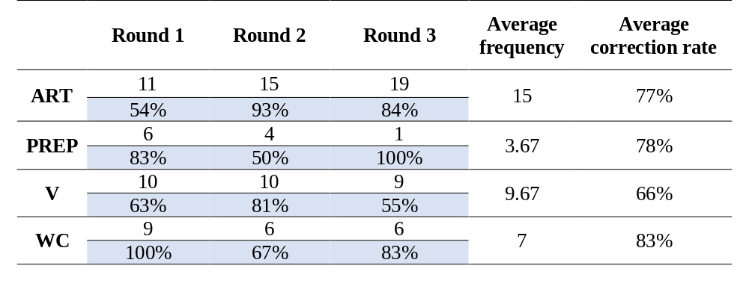
Results:
Outcome
*ART = article error; PREP = preposition error; V = verb error; WC = word collocation error

Slide 12
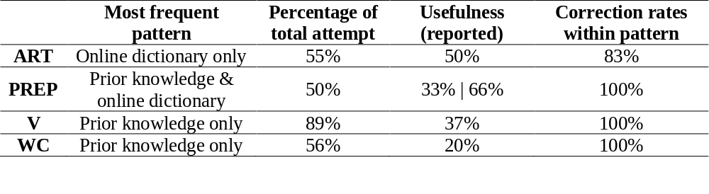
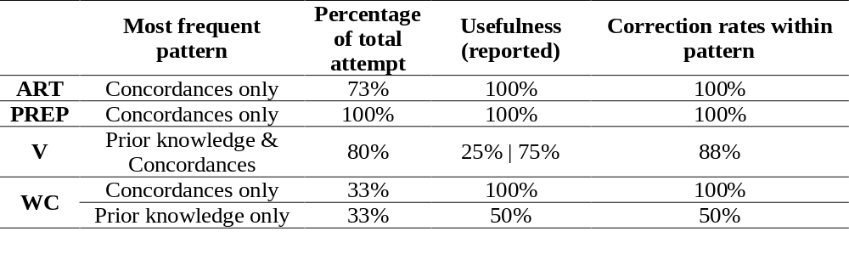
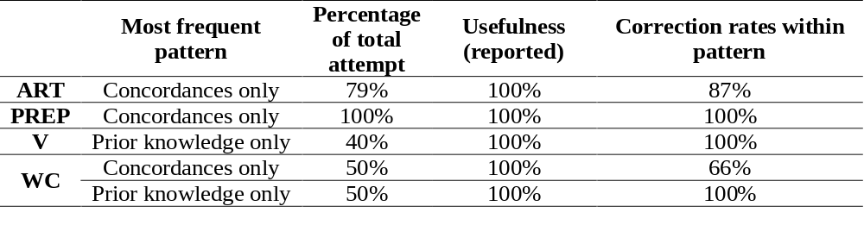
Results:
Referencing Pattern

Slide 13
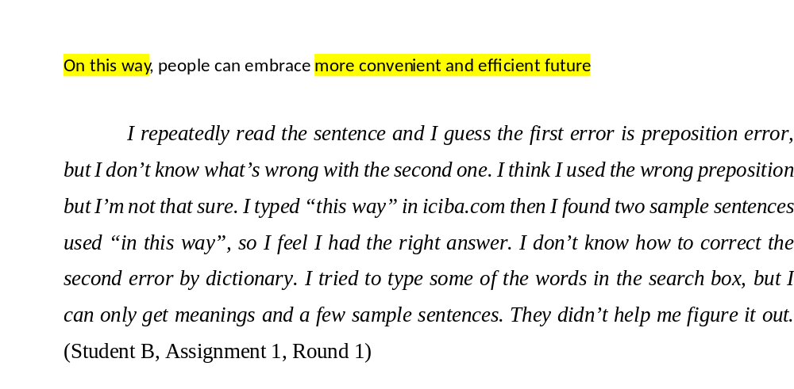
Results:
Error Correction Process (No DDL)
Multiple attempts
Weak evidence
Meaning-oriented

Slide 14
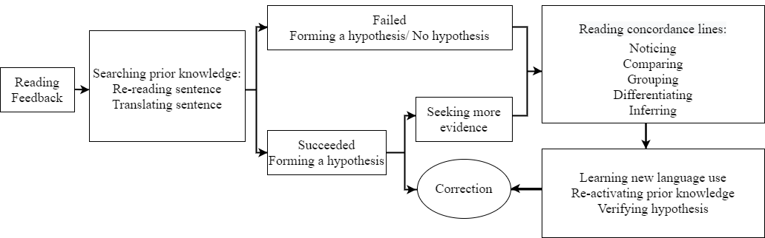
Results:
Error Correction Process (With DDL)
Less attempts
Strong (purposeful) evidence
Highlighting both structure and meaning

Slide 15
Results:
Questionnaire
The online experience of EFL writing with DDL mediation was highly efficient to promote self-learning.
Highlighting feedback played an important role for error type recognition and facilitated further consultation of referencing material;
If it is possible, students want to learn more about DDL for EFL learning purposes;
Segmented sentences and unfamiliar lexis used in them added to the difficulties in understanding and interpreting concordances;
Occasionally, the feedback without enough context or limited number of concordances made students struggle with error type interpretation and correction.

Slide 16
Results:
Teacher Interview
The teacher perceived DDL-mediated error correction as a positive activity for promoting student-oriented learning and improving students’ writing accuracy.
The teacher showed willingness to learn more about DDL and apply it in her future teaching practice;
The teacher emphasised the importance of providing indirect feedback.
Most of the Chinese EFL teachers have limited knowledge and practice of DDL;
The teacher worried about the time-consuming process of preparing concordances for students;
Compared to other typical referencing material, concordances could be a useful alternative resource for students to learn language knowledge but could not be the total replacement because both teachers and students had difficulties in accessing high-quality corpora in China.

Slide 17
Further Direction
Quantitative analysis based on a larger population
Activity | Participants | DDL Focus (Types of errors)
Task 3&5 | Group A | word choice, article
 | Group B | verb, preposition
Task 4&6 | Group B | word choice, article
 | Group A | verb, preposition
 | Word choice, article | Verb, preposition
Group A | Intervention group | Control group
Group B | Control group | Intervention group

Slide 18
Further Direction
DDL material design and development
Are concordances too specific/narrow for students to correct their lexico-grammatical errors?
Do concordances have similar and multiple functions just like other referencing resources? (online dictionaries, translation websites)
DDL material designed for providing general lexico-grammatical knowledge explanation and practice.
Offering a broader range of information (meaning and usage) about targeted error types.

Slide 19
References
Chen, M., & Flowerdew, J. (2018). A critical review of research and practice in data-driven learning (DDL) in the academic writing classroom. International Journal of Corpus Linguistics, 23(3), 335-369.
Chen, M., Flowerdew, J., & Anthony, L. (2019). Introducing in-service English language teachers to data-driven learning for academic writing. System, 87, 102148.
Crosthwaite, P., Storch, N., & Schweinberger, M. (2020). Less is more? The impact of written corrective feedback on corpus-assisted L2 error resolution. Journal of Second Language Writing, 49, 100729.
Gao, L. X., & Zhang, L. J. (2020). Teacher learning in difficult times: Examining foreign language teachers’ cognitions about online teaching to tide over COVID-19. Frontiers in Psychology, 11, 2396.
Johns, T. (1990). From printout to handout: Grammar and vocabulary teaching in the context of data-driven learning. CALL Austria, 10, 14–34.
Jichun, P. (2015). A corpus-based study on errors in writing committed by Chinese students. Linguistics and Literature Studies, 3(5), 254-258.
Lin, M. H., & Lee, J. Y. (2015). Data-driven learning: Changing the teaching of grammar in EFL classes. Elt Journal, 69(3), 264-274.
O'Keeffe, A. (2020). Data-driven learning–a call for a broader research gaze. Language Teaching, 1–14.
Quinn, C. (2015). Training L2 writers to reference corpora as a self-correction tool. ELT Journal, 69(2), 165–177.
Yoon, H., & Hirvela, A. (2004). ESL student attitudes toward corpus use in L2 writing. Journal of Second Language Writing, 13(4), 257-283.
Yoon, H., & Jo, J. (2014). Direct and indirect access to corpora: An exploratory case study comparing students’ error correction and learning strategy use in L2 writing. Language Learning & Technology, 18(1), 96-117.
Zhan, H. (2015). Frequent errors in Chinese EFL learners’ topic-based writings. English Language Teaching, 8(5), 72.
Zhao, L. (2015). A corpus-based investigation on Mongolian students’ writing in English. Studies in Literature and Language, 11(6), 35-39.

Slide 20



Thank you!
Linguistics and English Language
Lancaster University
County South
LA1 4YL
Lancaster
E-mail: f.zhu@lancaster.ac.uk
Fangzhou Zhu
(Noah)
Notes:
LANCASTER UNIVERSITY POWERPOINT TEMPLATES
These PowerPoint templates are for use by all Lancaster University staff. Please see below for further information regarding the use of these templates. Should you have any further queries, please contact the marketing team via marketing-services@lancaster.ac.uk
Template slide 3: Insert a new slide
If you need to insert a new slide, from the ‘home’ toolbar, click on ‘new slide’ and select from the templates the style you require from the dropdown box.
Template slide 4: Typing new text and copying text from another document
New text should be typed over the text in the appropriate template. Copy and pasting text from another document will result in changing the style of the typography and layout. This is unavoidable as it is part of the Microsoft software. We appreciate that in sometimes you will need to copy text from another document into this template. Once you have pasted the existing text into the template, you will need to change the formatting so that they typefaces, sizes, colour, line spacing and alignment are consistent with the rest of the template.
Template slide 5: Inserting images
There are three choices of templates with images already inserted. Please use the template with the relevant image size and positioning. To insert an image, please go to ‘insert’ then ‘picture’ and find your image, highlight it and ‘insert’. Resize the image and position as per the example template.
Template slide 6: Text boxes
If a text box is deleted, either insert a new slide (using the appropriate template) or go to another slide and copy a text box. To select a text box for copying, please click on the outer edge of the text box so that the line goes solid (not dashed). Right click your mouse and select ‘copy’, then go back and ‘paste’ it into the slide where the text box is missing which should paste into the correct position on the slide.
Template slide 7: Other information
Typefaces, sizes and colours
All copy is Calibri.
Slide title copy throughout:
Size: 36 point
Colour Lancaster University red: (RGB) R: 181 G: 18 B: 27 (recent colours on PowerPoint)
Small copy on first and last slide:
Size: 16 point
Colour grey: (RGB) R: 102 G: 102 B: 102 (recent colours on PowerPoint)
Sub-headings:
Size: 24 point – italics
Colour grey: (RGB) R: 102 G: 102 B: 102 (recent colours on PowerPoint)
Bullets copy and body copy:
Size: 24 point (see below for a further option)
Colour grey: (RGB) R: 102 G: 102 B: 102 (recent colours on PowerPoint)
It isn’t advisable to have too much text on a slide, however on rare occasions it may be necessary, therefore there is a slide using 20 point bullet pointed text.
Line spacing and alignment
Single line spacing (apart from the main headings which is ‘exactly 35 point’)
All text is aligned left
Slide title options
There are two options for titles on the slides – one line or two lines for longer titles. Ideally, the one line title should be used, however on rare occasions a two line title maybe needed.

