Slide 1
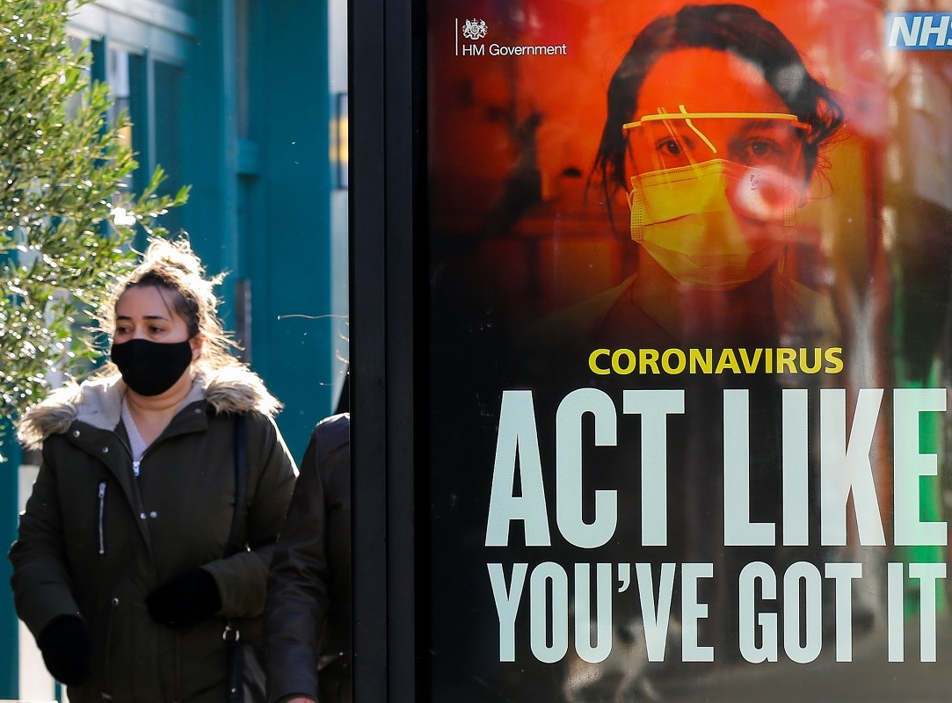

Nudging and pushing, shoving and catching:
Pandemocracy, social safety nets, and the politics of fear
Dan Degerman
University of Bristol
Matthew Johnson
Lancaster University
Matthew Flinders
University of Sheffield

Slide 2
Overview
[RQ1. Is it possible to characterize a dominant pre-pandemic conceptualization of the role of the state and the individual in relation to major social challenges?
RQ2. To what extent did the pandemic challenge that dominant conceptualization in terms of both theory and practice?
RQ3. Has Covid revealed the existence of structurally embedded structural inequalities to the extent that new more radical state-led ‘safety nets’ might now be considered as part of a new post-pandemocratic settlement?]

Slide 3
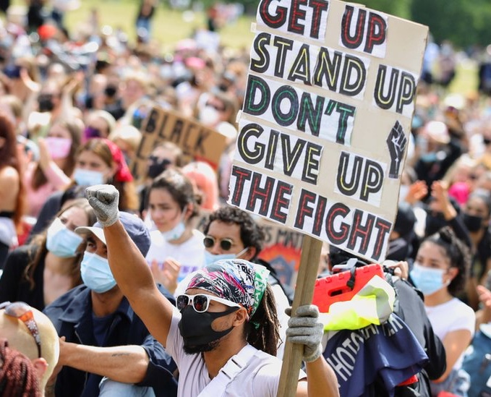

Pre-pandemic politics
[text]

Slide 4
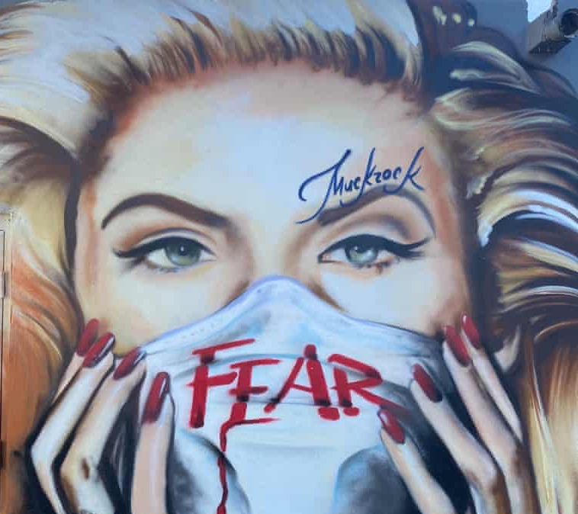
Pandemic politics
[Text]

Slide 5

Post-pandemic politics
[Text]

Slide 6
Conclusions
[text]

