Slide 1
Universal Basic Income:
Expert Testimony
Matthew Johnson
Professor of Politics & Policy, Lancaster University
m.johnson@lancaster.ac.uk

Slide 2
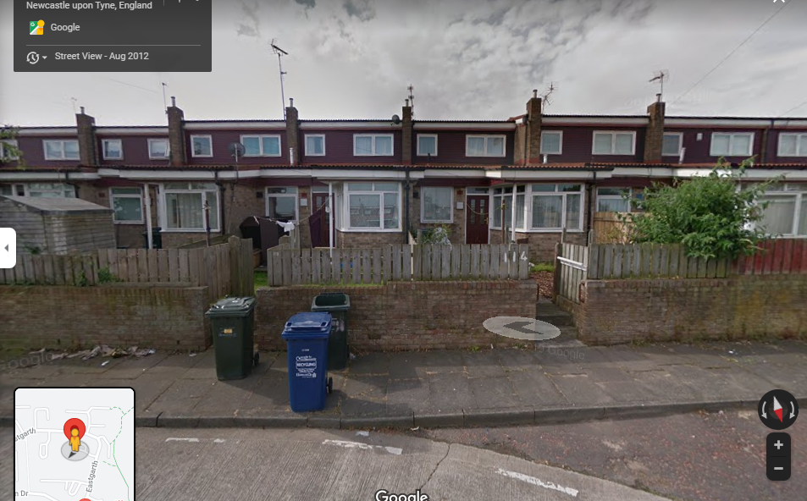
What knowledge is relevant to the enquiry?
Professional and abstract
Personal and embedded
The need to separate virtue from direct institutional action

Slide 3

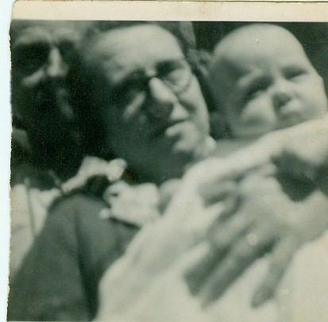
Transgenerational lapsing

Slide 4
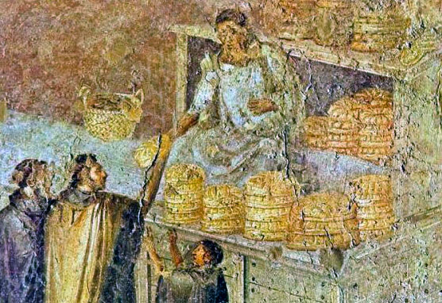
Cura Annonae

Slide 5

The reality of work
Alienation
Poverty
Hopelessness
Myth of dignity

Slide 6
A living pension and a rejoinder to lapsing
The need to avoid domination
Separation of roles of Church and State
Church provides security for souls and champions security for bodies
State provides security for bodies by implementing UBI as a living pension
Pope Francis’ work in calling for such support is one reason for my wife wishing our children to be raised Catholic

