Slide 1
Assessing the Application of Knowledge
Dr Dawn Goodwin and Dr Laura Machin
Lancaster Medical School

Slide 2
The Situation at
Lancaster Medical School
Past 7 years delivered Liverpool Medical School
Humanities and Social and Behavioural Sciences assessed via multiple choice and short answer questions
Differences between LVP and Lancs MBChB programme
  No. of students
  New curriculum
PBL across 4 year degree programme
  Health, Culture & Society (Sociology, Psychology & Research Methods)
  Professional Practice, Values, & Ethics (Medical Professionalism, Ethics, Law & History)

Slide 3
Assessment of Humanities, and Social and Behavioural Sciences
  Ensure doctors retain their humanistic attitudes = improved quality of care patients receive
  Variable inclusion in curriculum
  Assessment variable
Notes:
Notoriously problematic, little consensus on what constitutes the ‘best practice’

Slide 4
MCQs, SBAs, &
Short-Answer Questions
Disadvantages
Advantages
  Difficultly assessing depth and application of knowledge
  Reinforces a theoretical ‘medical school world’
  Divorced from real clinical encounters = lack of relevance for students
  Little or no exploration of the ‘shades of grey’
  Statistical reliability = ‘gold standard’
  Computer marked & highly prescriptive answers = Less demanding on staff time
Notes:
Notoriously problematic, little consensus on what constitutes the ‘best practice’

Slide 5
Essays
Advantages
Disadvantages
  Well-suited to analytical and critical thinking
  Increased demand on staff time
  Limited breadth of assessment
  Marking subjectivity = unreliability
Notes:
Notoriously problematic, little consensus on what constitutes the ‘best practice’

Slide 6
Our Aims
Compromise between essay and MCQs
Greater assessment of depth and application of knowledge
Reduced reliance on rote learning
Avoid abstraction of concepts
Closely aligned with the PBL pedagogical strategy
  Encourage students to view HCS & PPVE as intertwined, and appreciate how each theme enhances understanding of the other

Slide 7
Introducing Scenario Based Assessment
2 scenarios
8 sets of questions worth 10 marks each
Scenarios and questions sets based upon PBL learning objectives from HCS and PPVE
  E.g. describe the concept of medicalisation (HCS) or Discuss the role of clinical guidelines in hospital practice and consider the implications of not following them (PPVE)
Scenarios are written in a way that illustrates the concepts or issues addressed in the learning objectives

Slide 8
Introducing Scenario Based Assessment
Questions require the students to engage with the scenario, identify how and where aspects of a concept or topic are illustrated, and to discuss their knowledge of these topics
Answers are in the form of a ‘modified essay answer’ or ‘extended short answer’
The GP opts not to follow the clinical guidelines. Discuss the roles of clinical guidelines and doctors’ judgement in clinical practice (4 marks) (yr 2)
Identify 4 aspects of this scenario that illustrate features of the concept of medicalisation (4 marks) and discuss these points with reference to definitions of medicalisation (6 marks) (yr 1)

Slide 9
Scenario Based Assessment: The Process
Question writing
Question marking
  Collaborative process
  Subject specialists
  Quality assurance
  Subject specialists
  Experience of UG medical education
  Doubled marked & moderated
  Acceptable alternative answers

Slide 10
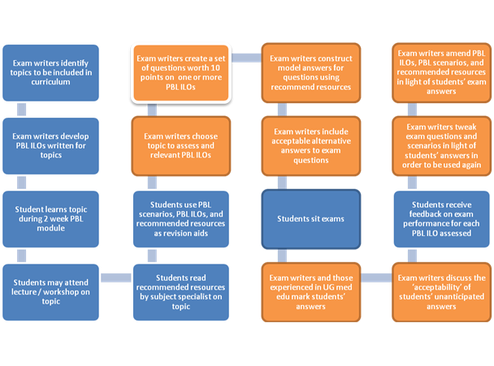

Slide 11
What We Learnt: Pilot
Effectively assess students’ understanding and interpretation, rather than recall of rote learning
Length of time of exam
  Reduced number of sets of questions asked
  Shorter scenarios
Structure of questions
  Structured vs. loose & 1 mark per item of knowledge
Level of difficulty
  Signifier of progression e.g. 1st yr mostly structured questions and the proportion of loosely-structured increases over the years
Recycling questions and scenarios

Slide 12
What We Learnt: Validity
  Face validity (compatibility with the curriculum’s educational philosophy)
  Content validity (assessing the content of the curriculum)
  Construct validity (ability to differentiate between groups with difference in ability)
Scenario Based Assessment replicates the PBL approach
Scenarios are written around the PBL learning objectives, and draw heavily on PBL recommended resources
Enables a more discerning picture of the variation of student knowledge and understanding

Slide 13
What We Learnt: Reliability
  Inter-rater reliability (consistency of examiner ratings)
  Inter-case reliability (consistency of student performance across cases)
    Adequate breadth of content sampling
    Sufficient testing time
Answers are marked with student identity blinded
Different markers are allocated different sets of questions to mark
Markers present in large room to facilitate discussion of unanticipated answers
PBL topics sampled rather than PBL learning objectives (yr 1, 8-10 topics out of 44, across HCS & PPVE, in 11 PBL modules)

Slide 14
Going Forward
Continue with scenario based assessment
  Reliability, validity, feasibility and educational impact of scenario based assessment (Fewtrell, 2011)
  Students changed their approach to PBL, independent learning, and exam preparation
  Avoids assessing ‘trivial’ knowledge (GMC, 2011)
  Expectation of alternative answers during student feedback sessions prepares students for the ambiguity and uncertainty they will experience in clinical practice
  Students are encouraged to consider that a variety of appropriate responses exist, and they are required to justify their answer, as they would in clinical practice

