Slide 1
Project Introduction:
Space Weather Impacts on the UK Railway Network
C.J. Patterson & J.A Wild
SWIGS Annual Workshop 2021

Slide 2
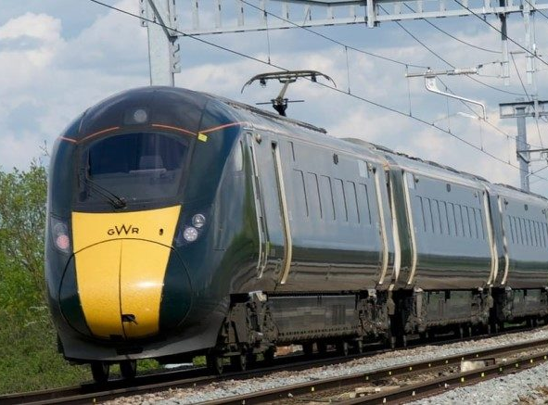
Space Weather and Railways
Space weather can adversely affect many ground-based systems, including railways
Signalling system failures
(Eroshenko et al., 2010; Wik et al., 2009)
Damage to locomotive on-board transformers (Atkins, 2014; Thaduri et al., 2020)
Interdependencies
Notes:
Signalling: track circuits on electrified networks; Russia and Sweden, other studies also in Canada and Finland.
Transformers: As is the case with power grids, quasi-DC currents flow through the OLE and into locomotive transformers.
Interdependencies: Power and communications that are affected by SW, such as the Global Navigation Satellite System (GNSS). I have recently found out that some of the newer trains use GPS to determine the amount of bank needed to turn a corner as this is highly location dependent.

Slide 3
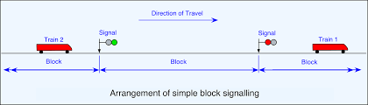
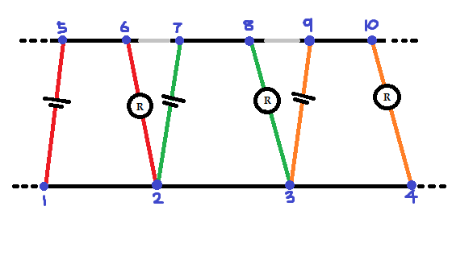
Railway Signalling – Track Circuits
Track Circuit Principles
Insulating rail joints (IRJs) separate railways into blocks
Track circuits detect current changes in their blocks
Geomagnetically induced currents can “confuse” these relays into displaying false signals
(Figure from Railway Technical Signalling - http://www.railway-technical.com/signalling/)
Electrified railway track circuits

Slide 4
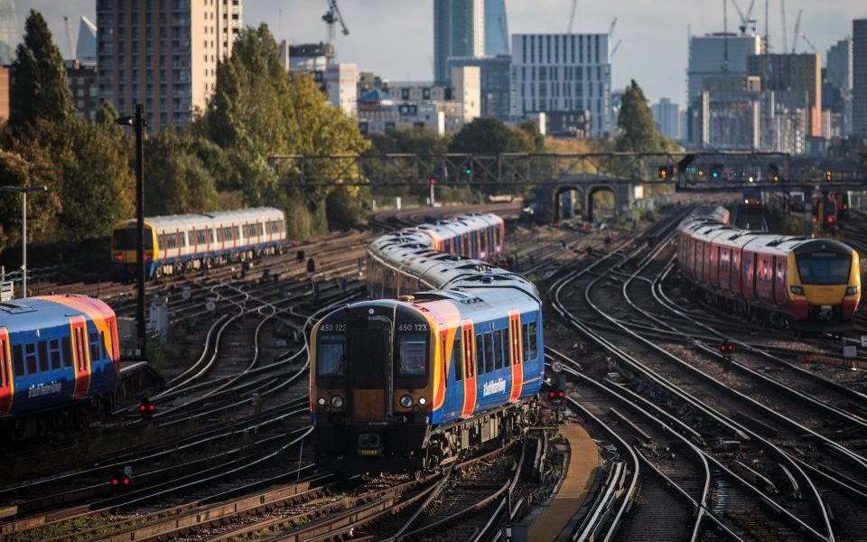
What we need to do before making model calculations for the UK
Step 1: Obtain the magnetic field disturbances
Step 2: Obtain UK ground conductivity values
Step 3: Estimate the geoelectric field
Notes:
Only after you’ve completed steps 1-3 can you make Boteler-style calculations for the UK context

Slide 5
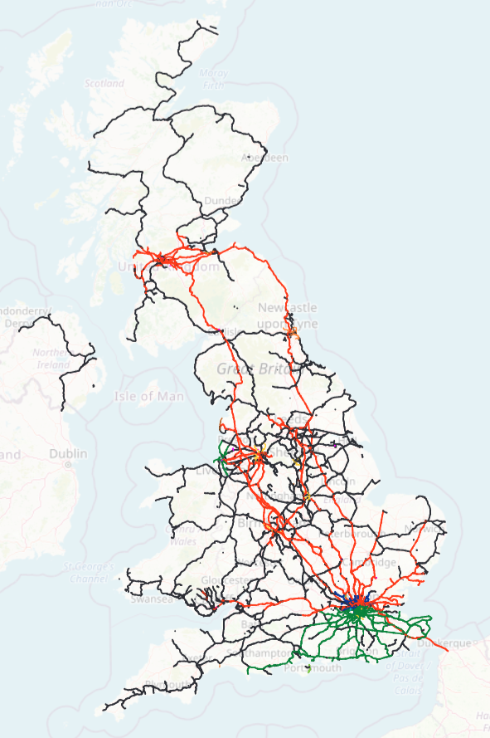
Step 1:
Obtaining the Magnetic Field Disturbances
The UK railway network is complex
Magnetometer stations are relatively far apart, meaning measurements are sparse
A method of interpolating the magnetic fields at the desired locations is needed
(Image from railwayhistory.org)

Slide 6
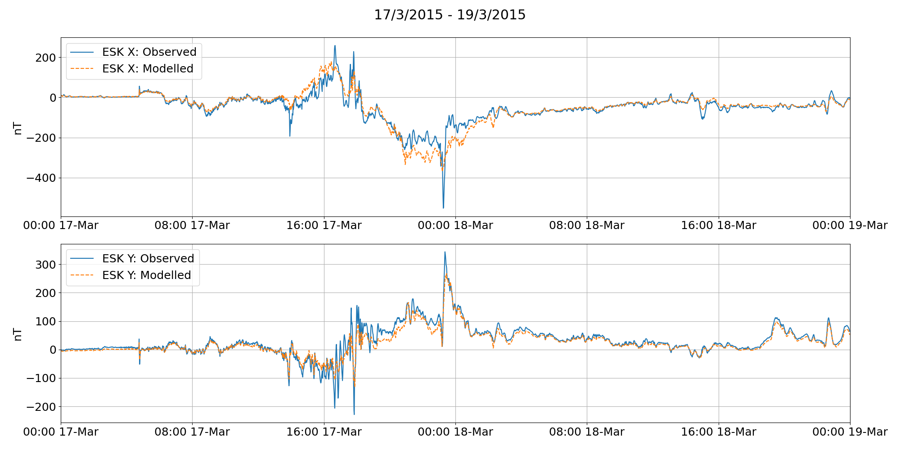
Step 1:
Obtaining the Magnetic Field Disturbances
Spherical Elementary Current System method
Well-established method, allowing us to obtain magnetic field values wherever we need them
Notes:
Step 1 complete

Slide 7
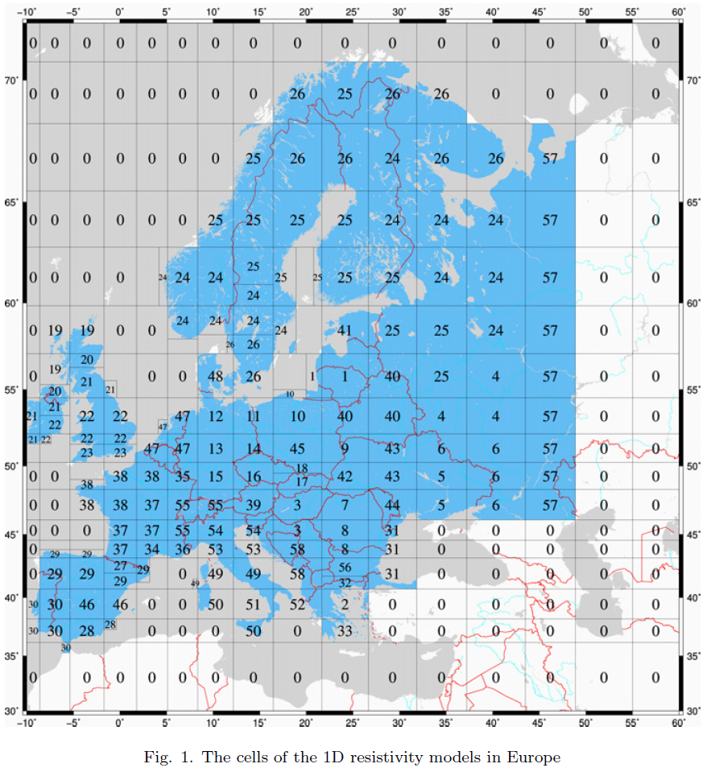
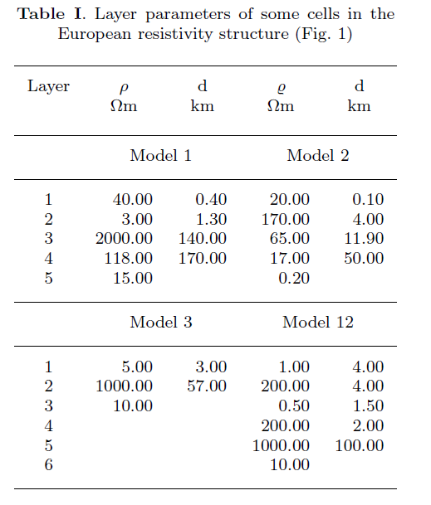
Step 2:
Obtaining the Conductivities
EURHOM model (Ádám 2012)
Gives values for resistivity layers across different regions of the UK
(Figures from Ádám 2012)
Notes:
Step 2 complete

Slide 8
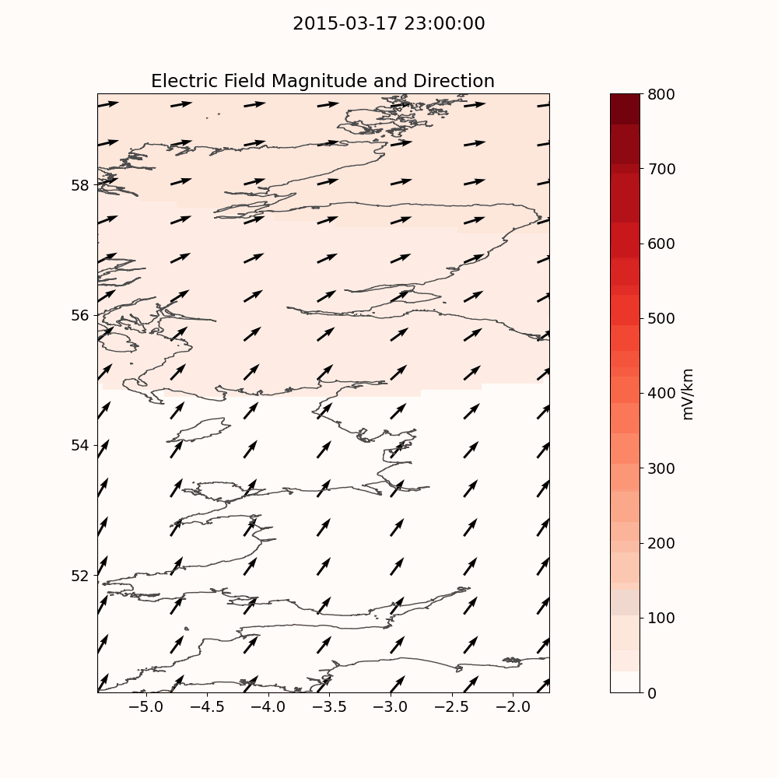
Step 3:
Estimating the Electric Field
Combining steps 1 and 2, we can obtain estimations for the electric field at any point across the UK

Slide 9
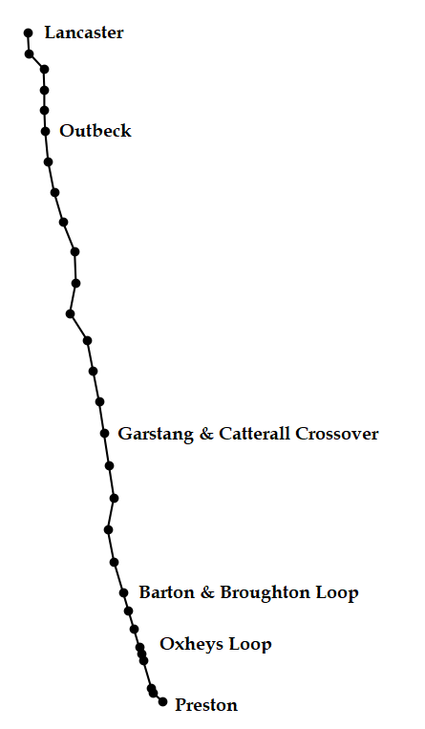
Railway modelling:
Setting up the network
Transmission line theory and nodal admittance matrices used to construct network model (Boteler, 2021)
Railway section with track circuit blocks of varying lengths and directions resembling the Preston – Lancaster stretch

Slide 10
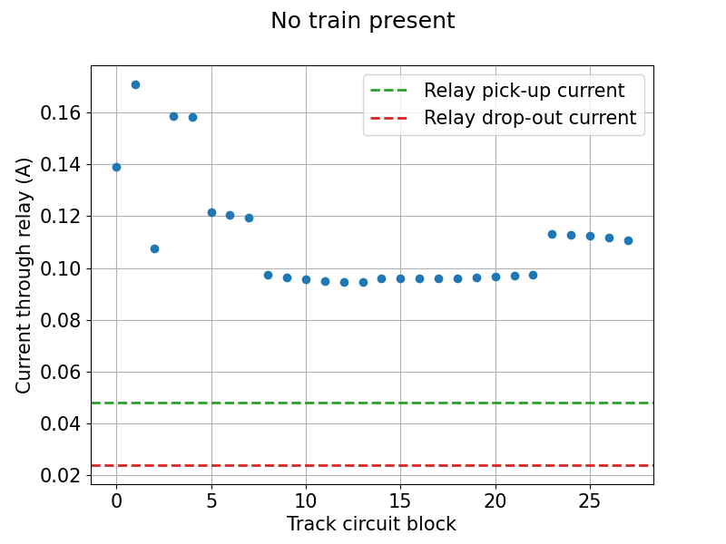
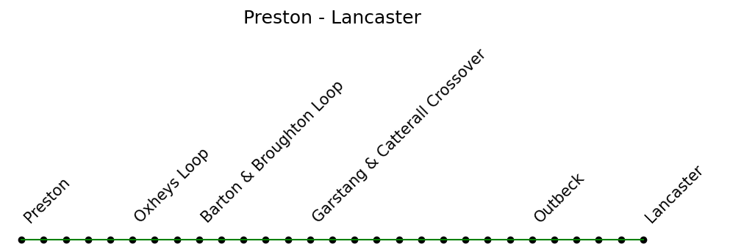
Railway modelling:
Results
Current across the track circuit relay in each block is deduced and compared with the normal operating parameters of the relay
If the current drops below the ‘relay drop-out current’, the relay will de-energise and display a red signal even though there is no train present
Ex = 0 V/km
Ey = 0 V/km

Slide 11
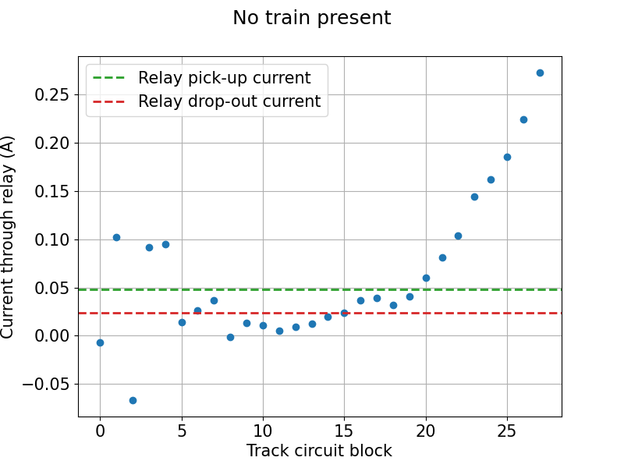
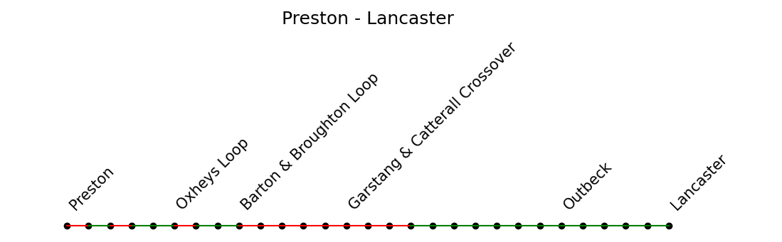
Railway modelling:
Results
Current across the track circuit relay in each block is deduced and compared with the normal operating parameters of the relay
If the current drops below the ‘relay drop-out current’, the relay will de-energise and display a red signal even though there is no train present
Ex = -2 V/km
Ey = 2 V/km

Slide 12
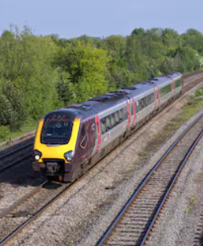
Further Work
Model sections of UK railway network using more realistic components and block lengths
  Possible collaboration with Network Rail
Analysis of measured track-side data taken by Atkins
  Currently delayed due to Covid-19 restrictions
Notes:
Network Rail are currently working on the ORS (Operation Route Section) model to aid the forecasting of hazards related to regular terrestrial weather, but as part of this they have compiled a detailed overview of the signalling systems and route blocks used across the UK.

Slide 13
Acknowledgements
[1] Boteler, D. H. (2021). “Modeling geomagnetic interference on railway signaling track circuits”, Space Weather, 19, e2020SW002609. https://doi.org/10.1029/2020SW002609.
[2] A. Ádám, E. Prácser, and V. Wesztergom. (2012). “Estimation of the electric resistivity distribution (EURHOM) in the European lithosphere in the frame of the EURISGIC WP2 project,’’ Acta Geodaetica et Geophysica Hungarica, vol. 47, no. 4, pp. 377–387, Dec. 2012
I would also like to acknowledge and give thanks to:
SuperMAG https://supermag.jhuapl.edu/info/?page=acknowledgement
This work was sponsored by STFC studentship
Contact Me: c.patterson2@lancaster.ac.uk

Slide 14
Supplementary Slides

Slide 15
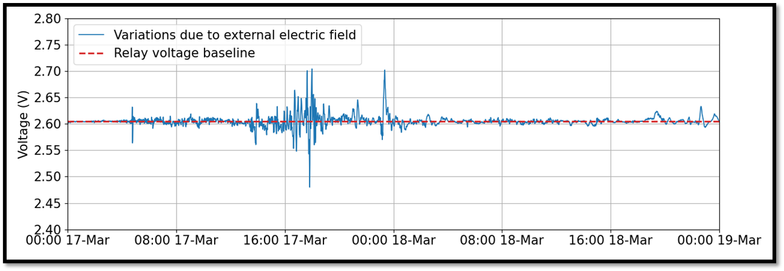
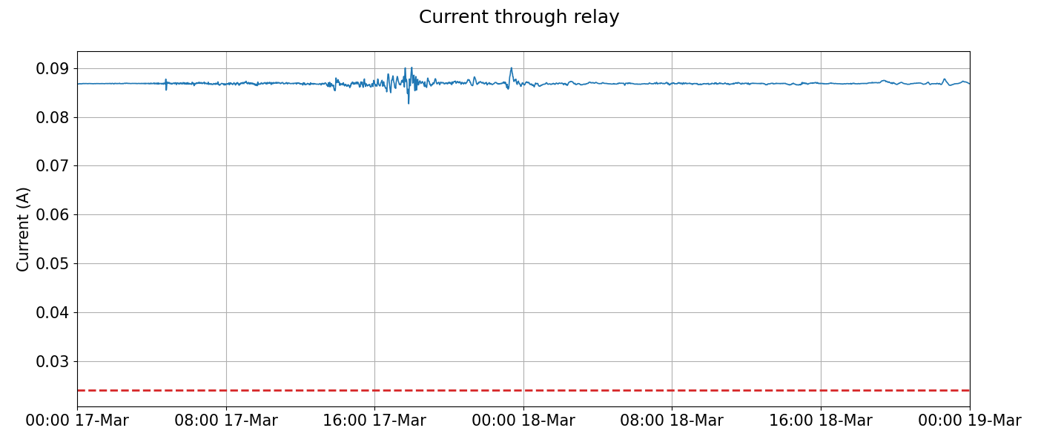
Example:
Applying storm time E-field to a relay
Top figure: shows the variations in relay voltage during the 2003 St Patrick’s Day storm
Bottom figure: shows the current across the relay during the storm, with the red dashed line indicating the level the current would need to drop below to cause a false signal
Notes:
Step 1 complete

