Slide 1


Getting the Brain into Gear
An Online Study
Elise Oosterhuis (e.oosterhuis@lancaster.ac.uk)
Supervisors: Dr. Helen Nuttall, Dr. Patrick May, Dr. Kate Slade
This Photo by Unknown Author is licensed under CC BY-NC
23/05/2021

Slide 2
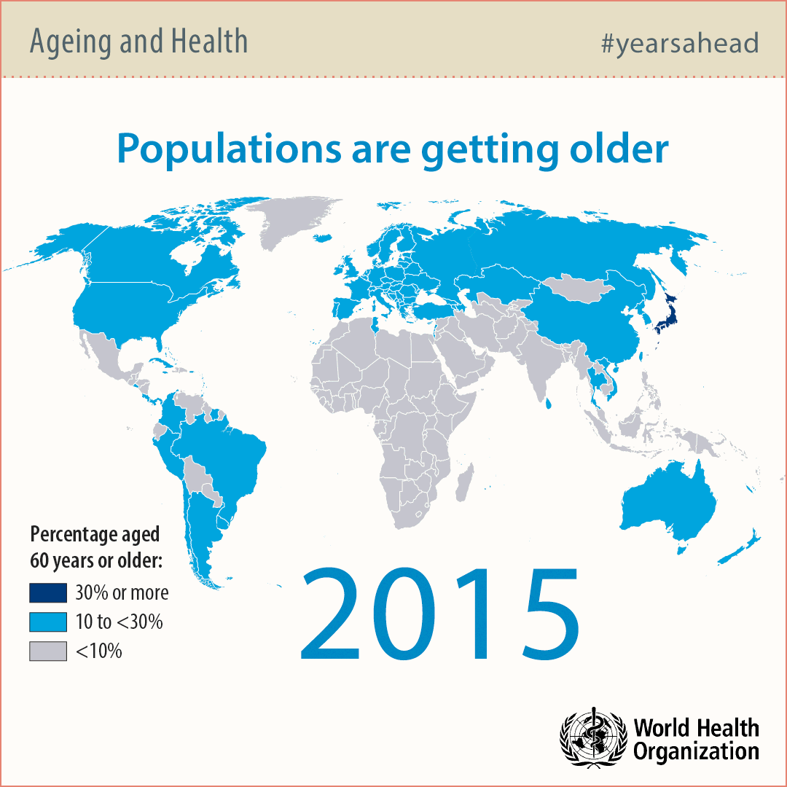



An ageing population
UK population aged 60 years or older¹
2017
2050
23.9%
31.5%
Cognitive decline² → word-finding difficulties³
Effects of lifestyle⁴
Why investigate cognitive decline and lifestyle in healthy older adults? ⁵
Source: Ageing and life course infographics, World Health Organization
United Nations (2020). World population ageing, 2019 highlights.
Salthouse (2010). Selective review of cognitive aging.
Kavé & Knafo-Noam (2015). Lifespan development of phonemic and semantic fluency: Universal increase, differential decrease
4. Livingston et al. (2020). Dementia prevention, intervention, and care
5. Wright (2016). Cognition, Language and Aging.
Notes:
Cognitive decline → not in all domains but in processing speed, attention, working memory, episodic memory, emotion, and language (not in e.g. vocabulary)
Word finding = accessing words from memory
Lifestyle → decreases changes of developing dementia + incl cogn and social activities
Why → Early neuropsychological markers of dementia and different ageing trajectories (healthy vs. dementia)

Slide 3



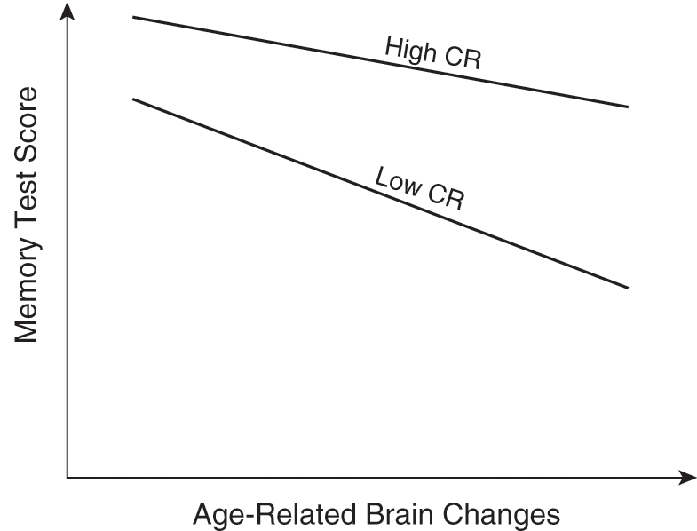


Cognitive Reserve - Effects of a healthy lifestyle
Education
Increased
Social Activities
Cognitive and Neural Flexibility
Cognitive Reserve
1
Cognitively Stimulating Activities
Physical Activities
Source: Varangis & Stern (2020). Cognitive Reserve.
1. Stern et al. (2020). Whitepaper: Defining and investigating cognitive reserve, brain reserve, and brain maintenance.
Notes:
CR can explain why some people are better able to compensate for age or disease-related cognitive decline
CR is accumulated through lifestyle choices and lifetime experiences.
→ Increased cognitive (i.e. cognitive strategies) and neural flexibility (i.e. brain networks). Neural flexibility → the brain communicates through networks of brain cells. CR is proposed to work by strengthening existing brain networks or the recruitment of alternative brain networks.
Low CR = faster cognitive decline in the face of age-related brain changes + earlier onset of dementia

Slide 4

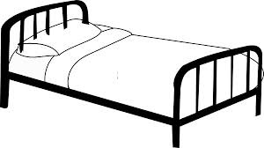


Investigating Word-Finding Difficulties
Bed
Picture Naming
  More difficulties with age
  Decline from ~50 years¹
Verbal Fluency
  Semantic, Action, Letter
  Decline from ~40 years²
Word Frequency³
Name as many animals in 1 minute
Cat, dog, bear, wolf, fox, horse, …
Verhaegen & Poncelet (2013). Changes in Naming and Semantic Abilities With Aging From 50 to 90 years.
Kavé & Knafo-Noam (2015). Lifespan development of phonemic and semantic fluency: Universal increase, differential decrease.
Gordon et al. (2018). Why do older adults have difficulty with semantic fluency?
Notes:
What do the results tell? → slower RTs = more effortful accessing from memory; low Acc = failing to access from memory
Earlier onset and greater decline for semantic fluency.
More common/frequent words are more easily accessed from memory
Verbal fluency could serve as neuropsychology markers for dementia (McDonnell et al., 2020)

Slide 5


The current study
COVID-19
How does Cognitive Reserve relate to word-finding difficulties?
How has the level of Cognitive Reserve changed due to COVID-19?
Hypothesis: Increase in word-finding difficulties with age, which is modulated by Cognitive Reserve.
This Photo by Unknown Author is licensed under CC BY
Notes:
What did I plan to do and how did I adapt it

Slide 6
Study design
Participants:
  18-30 years (N=30)
  40-55 years (N=30)
  65-80 years (N=30)
  Right-handed, monolingual speakers of British English
  Based on power calculations
Preregistered on aspredicted.org (https://aspredicted.org/b6we4.pdf)

Slide 7
Study Design
Online – Qualtrics (www.qualtrics.com) and Gorilla (www.gorilla.sc)
Cognitive Reserve Questionnaire
Verbal Fluency task
(semantic, action, and letter)
Picture naming
(objects and actions)
Control tasks
(processing speed, working memory, inhibition)
Cognitive Reserve Questionnaire
Verbal Fluency task
(semantic, action, and letter)
Picture naming
(objects and actions)
Control tasks
(processing speed, working memory, inhibition)
Notes:
CR → activities in the 3 months before covid-19 and the past three months (during covid)
Next, descriptives to give a general idea about the data → audio transcriptions and data processing still ongoing

Slide 8
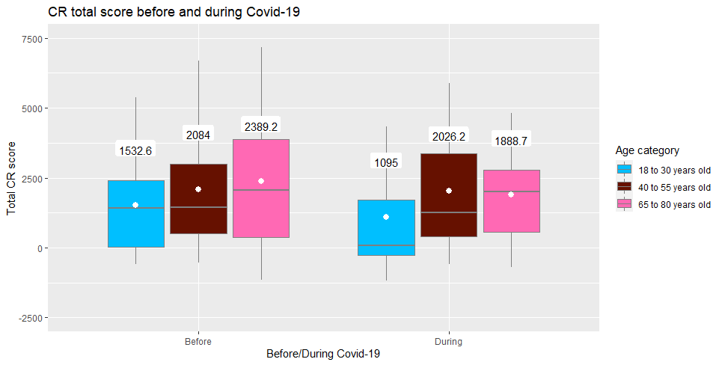
Descriptives – Cognitive Reserve
Participants
Young adults:
N= 30
Education = 14.9 years
Middle-aged adults:
N= 31
Education = 16.2 years
Older adults:
N=28
Education = 18 years
Notes:
Total is general activities (cog, prod, social) and physical activities

Slide 9
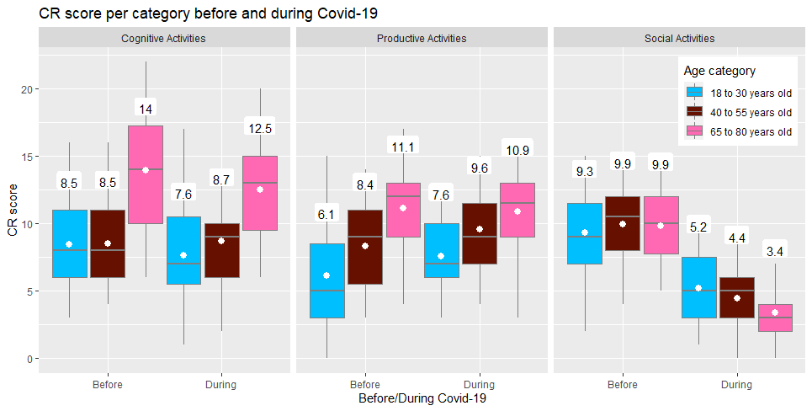
Descriptives – Cognitive Reserve
Notes:
Why is the x-axis so different?

Slide 10
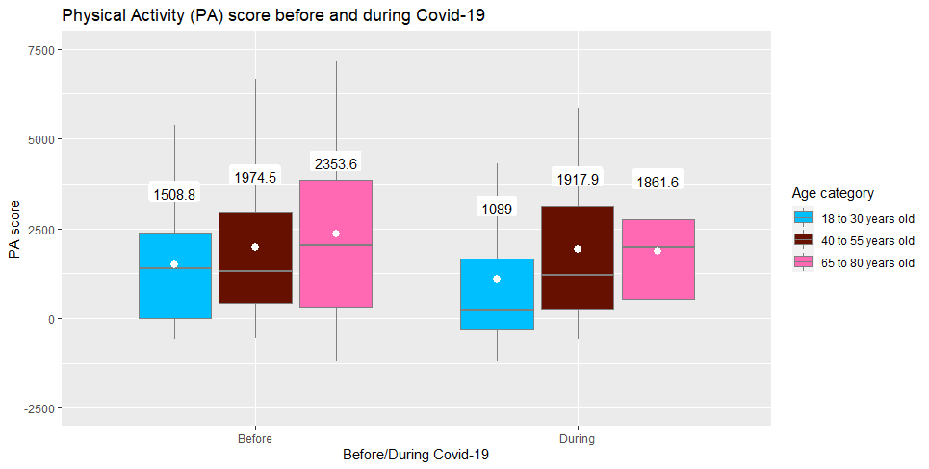
Descriptives – Cognitive Reserve

Slide 11
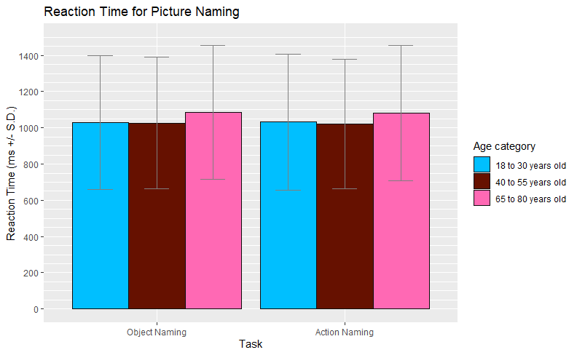
Descriptives – Picture Naming
Reaction Times in ms:
Objects:
Young: 1027.9 (369.5)
Middle: 1026.3 (362.9)
Older: 1085.6 (369.8)
Actions:
Young: 1031.9 (375.3)
Middle: 1020.4 (357.9)
Older: 1082.8 (372.9)
Notes:
Still in the process → audio transcriptions
Only correct responses + outliers removed (+/- 2.5 SDs from the mean, per age category, type (objects vs. verbs), and trial)
SDs between brackets

Slide 12
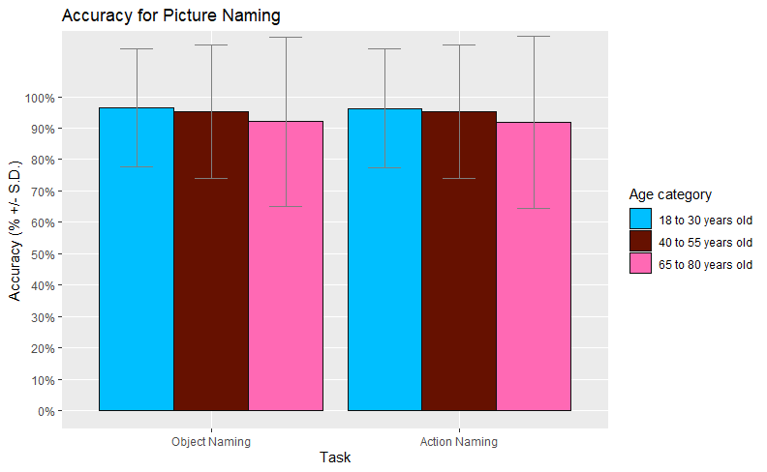
Descriptives – Picture Naming
Accuracy scores in %:
Objects:
Young: 96.4 (18.8)
Middle: 95.2 (21.4)
Older: 92.1 (26.9)
Actions:
Young: 96.3 (21.3)
Middle: 95.2 (21.3)
Older: 91.9 (27.3)

Slide 13
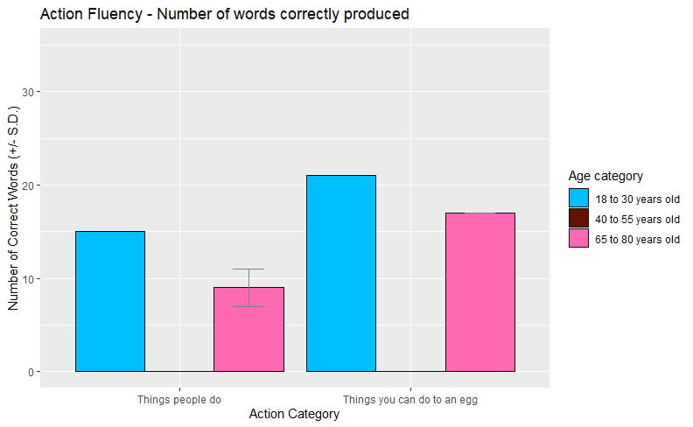
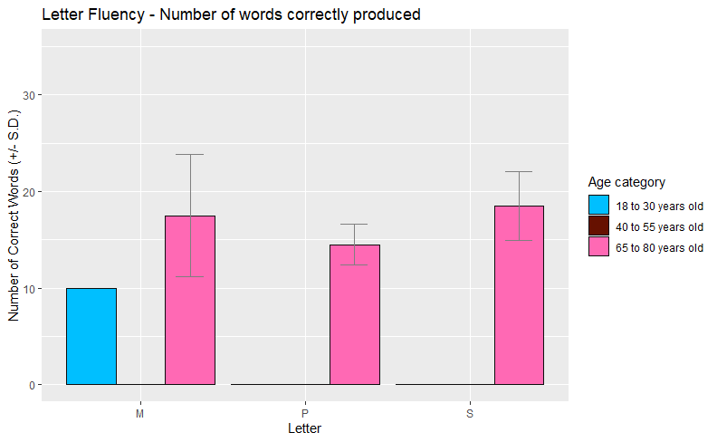
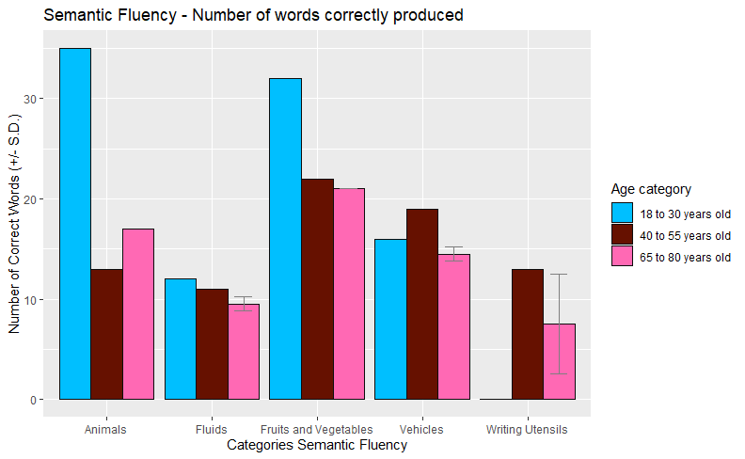
Descriptives – Verbal Fluency
Young adults:
Middle-aged adults:
Older adults:
N=1
N=1
N=2
Notes:
Very few data available yet → idea of how the data is broken down and of some of the data

Slide 14
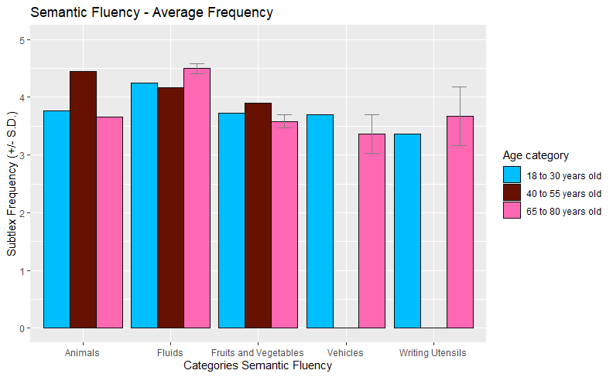
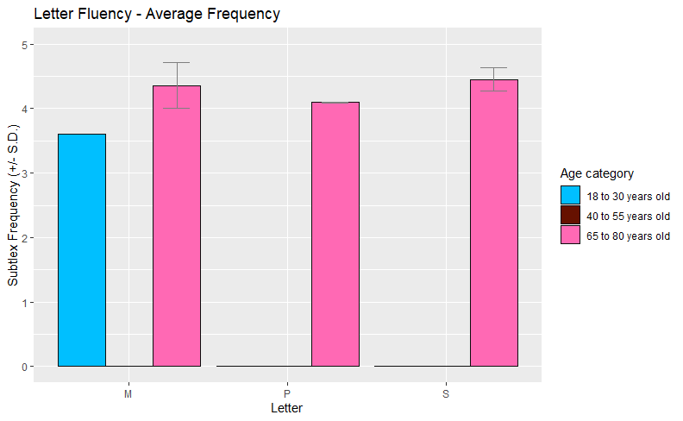
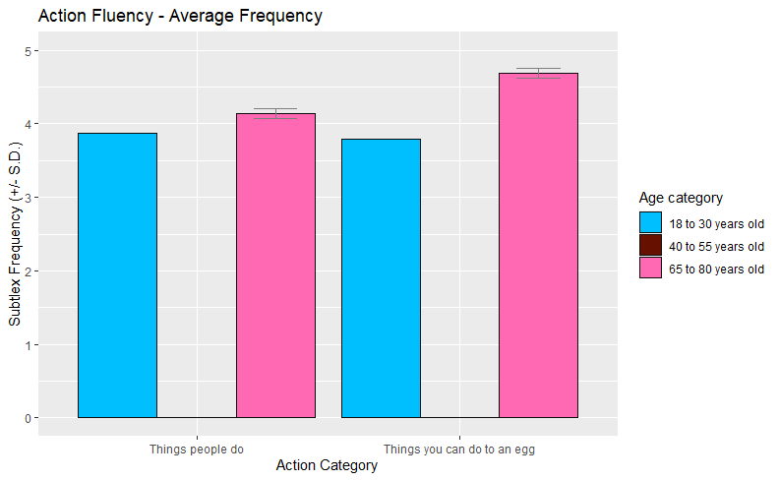
Descriptives – Verbal Fluency

Slide 15
Interim Summary
Total CR
Lower CR for social activities seems decreased for all age groups
Picture naming
  Reaction times
  Accuracy
Verbal Fluency
Notes:
Total CR → before and during Covid-19 seem quite similar
CR for social activities seems decreased for all age groups
Picture Naming RTs are quite similar between groups but older adults might be a bit slower; PN acc seems to decrease a bit with age
VF → Too little data to compare

Slide 16
Planned analyses
Linear mixed-effects modelling
Outcome variables:
  Picture naming accuracy and reaction time
  Verbal Fluency - Number of correctly produced words
  Verbal Fluency – Average frequency of the produced words per category
Predictors:
  Age-group
  Cognitive Reserve compound variable
  Interaction Cognitive Reserve*Age group
  Control measures (working memory; processing speed; inhibition)

Slide 17

Next steps
Secondary EEG analysis
This Photo by Unknown Author is licensed under CC BY-ND

Slide 18
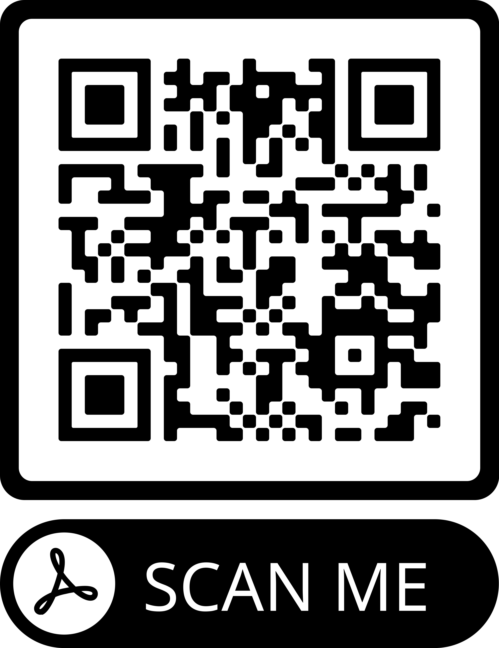
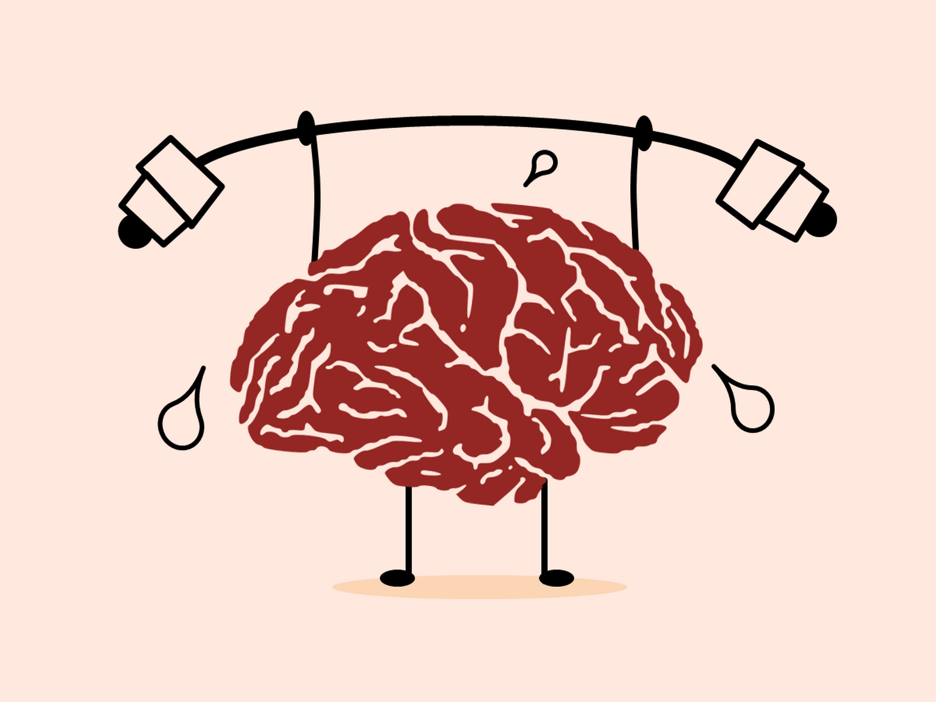
The end
References
A big shout-out to my supervisors and to all the members of the NoSA lab who supported this project in different ways
This Photo by Unknown Author is licensed under CC BY-SA
Email: e.oosterhuis@lancaster.ac.uk
Notes:
Thank you for listening +questions
QR code → references, including my email and the preregistration link

