Slide 1

“The English Sweat”
Causes & Discourses
Then (1475-1700) & Now (1808-2020)
Derek Gatherer
Faculty of Health & Medicine
Institute for Social Futures
Lancaster University
d.gatherer@lancaster.ac.uk

Slide 2
What do we know about the English Sweat?
43 articles in PubMed (1808-2020)
Principal source (in English) is John Caius’s Ephemera Britannica (1552)
Outbreaks in 1485, 1506, 1517, 1528 & 1551, for 3-5 months in the summer

Slide 3
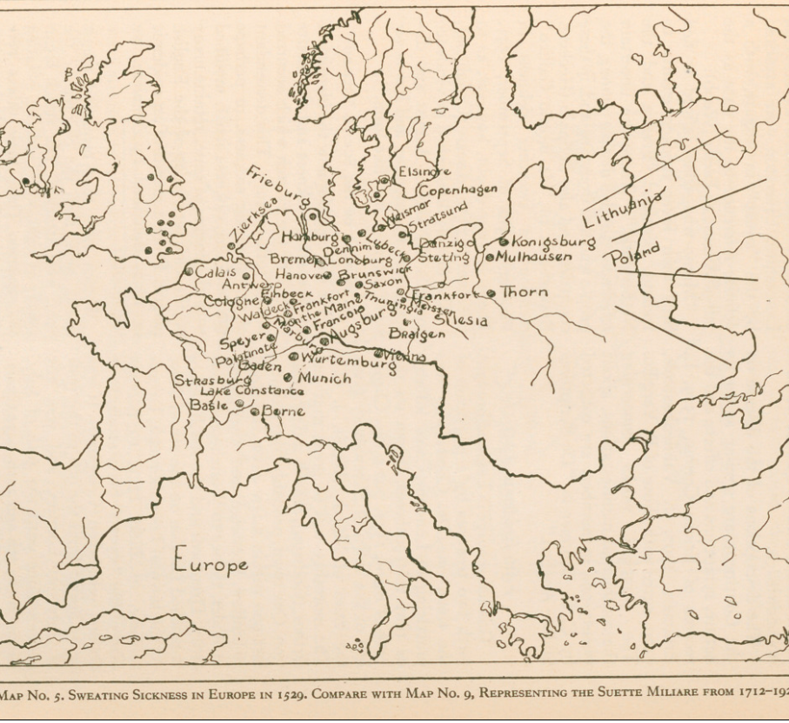
Shaw (1933)

Slide 4
Symptoms, as described by “Critical” (1808)
“a sense of a hot vapour running through the limbs”
“internal heat, unquenchable thirst, most profuse sweating”
“anxiety, restlessness, sickness, headache”
“delirium, drowsiness, death”
over in 15 hours, (or completely recovered by 24 hours)
Case fatality ratio = 99% (Vergilio 1508)
victims mostly middle-aged, healthy and rich

Slide 5
Theories on aetiology
Poisoning (1808)
Influenza (1889)
Typhus (1933)
Enterovirus (1991)
Arbovirus (1997)
Anthrax (2004)

Slide 6
The hantavirus theory
Thwaites et al 1997
Holmes 1998
Bridson 2001
Heyman et al (2014, 2018)

Slide 7
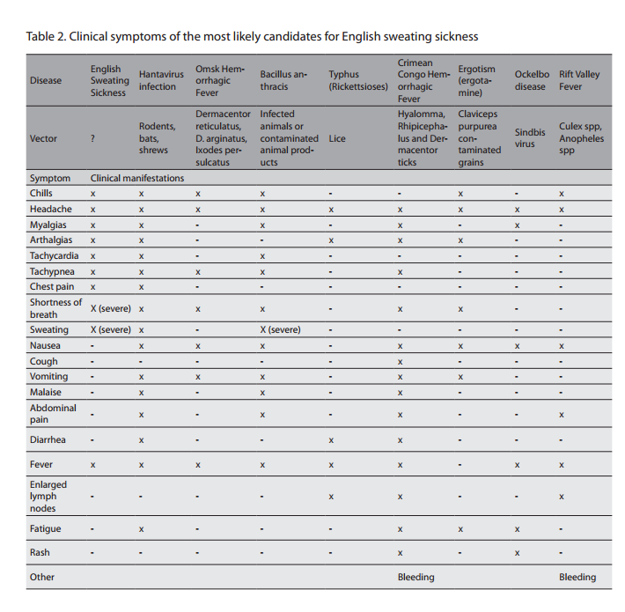
The Hantavirus theory
Heyman et al
(2018)

Slide 8
Why hantaviruses?
Symptom match (?)
Outbreaks in human precipitated by ecological events affecting rodent reservoir(s)
  Explains sporadic nature
  Fits (some) theories of social/economic/ecological change in early modern England
Previously used for ergot poisoning theories

Slide 9
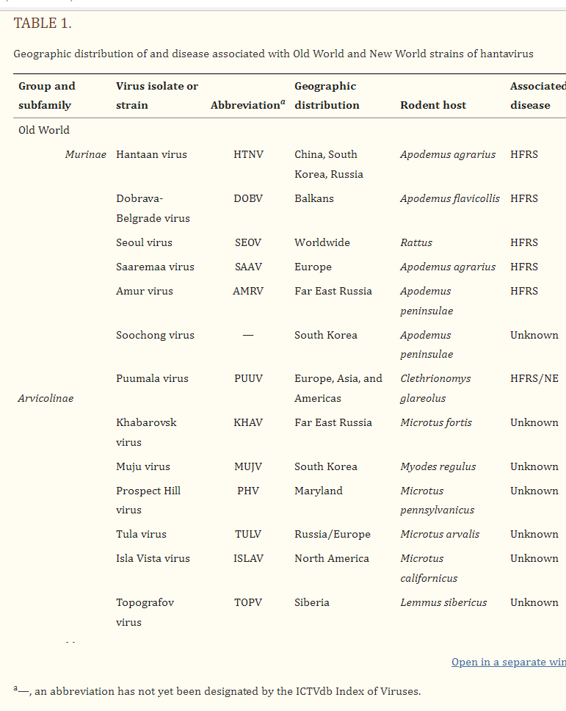
There are many known
hantaviruses – only the top half of this table is shown
(Jonsson et al 2010)

Slide 10
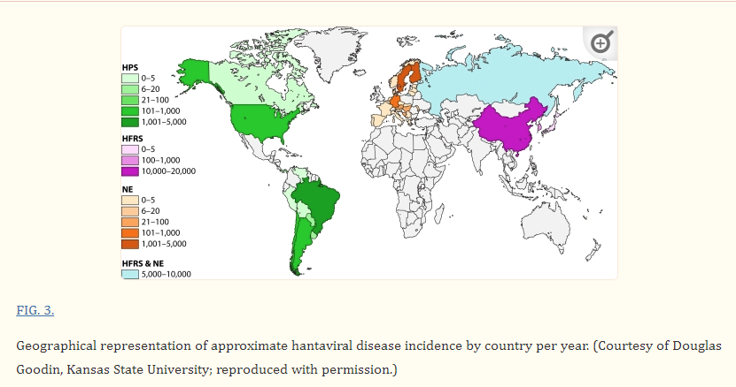
(Jonsson et al 2010)

Slide 11
(Jonsson et al 2010)

Slide 12
Revisionist theories
The disease was not new
The disease has been seen since (e.g. in the “Picardy sweat” “febbre miliare” of the 18th and 19th centuries)

Slide 13
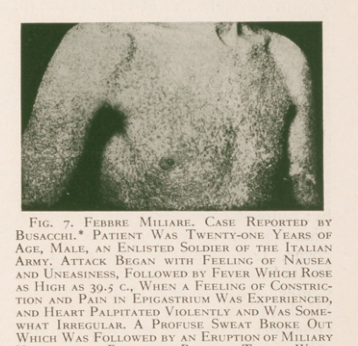
Revisionist theories
The disease was not new
The disease has been seen since (e.g. in the “Picardy sweat” “febbre miliare” of the 18th and 19th centuries)
In Busacchi 1917
rep. by Shaw (1933)

Slide 14
How did early authors discuss the Sweat?
Early English Books Online
1,202,214,511 words [44,422 texts]
“every book published in English prior to 1700”
48 matches in 30 texts for “English sweat”
31 matches in 26 texts for “sudor anglicus”
Extract using CQPweb (Andrew Hardie)
Analyse using #LancsBox (Vaclav Brezina)

Slide 15
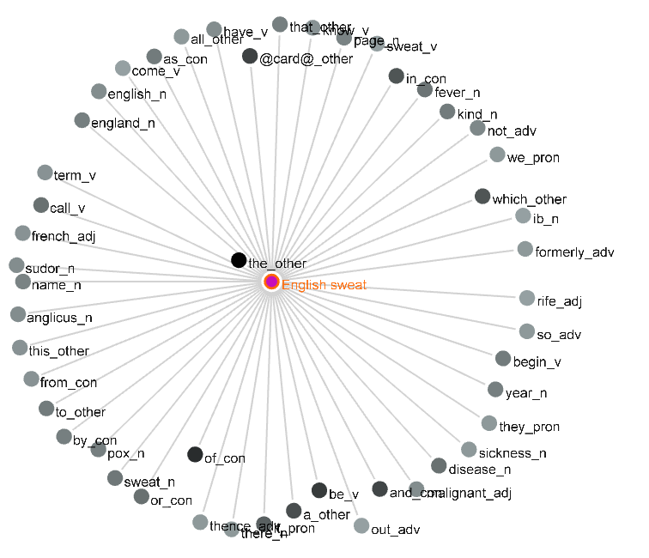

Slide 16
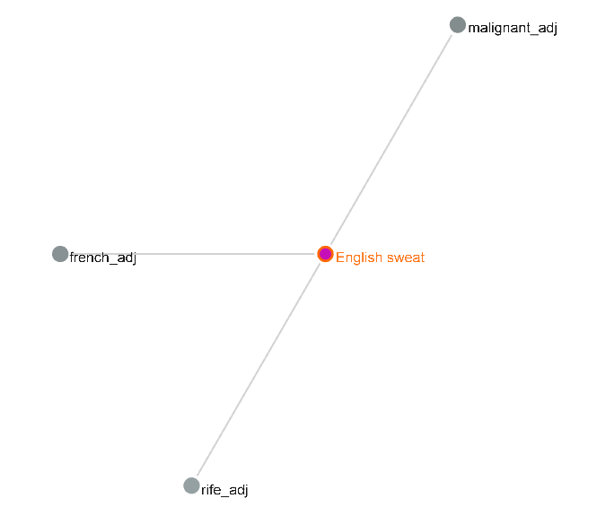

Slide 17
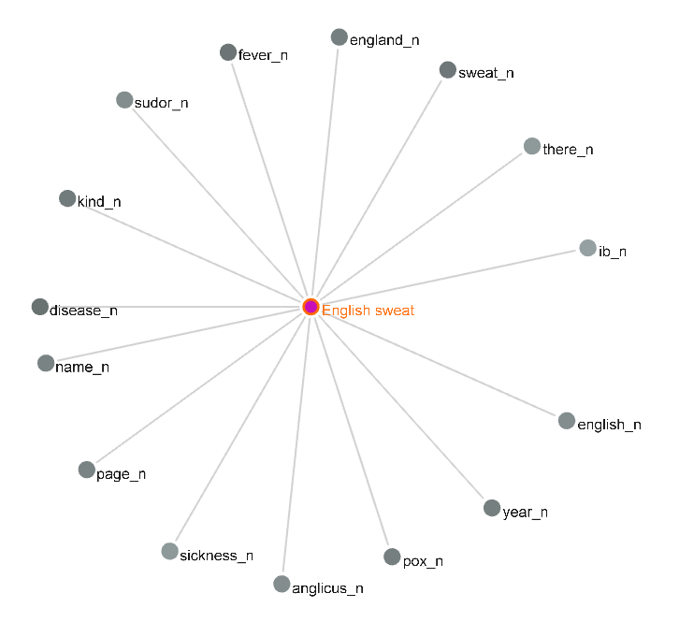

Slide 18
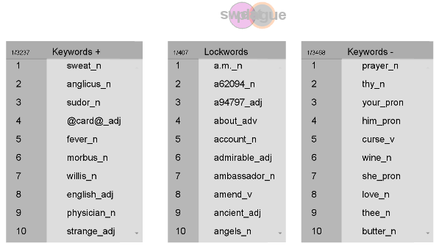
How does discussion of the Sweat differ to that of the Plague?

Slide 19
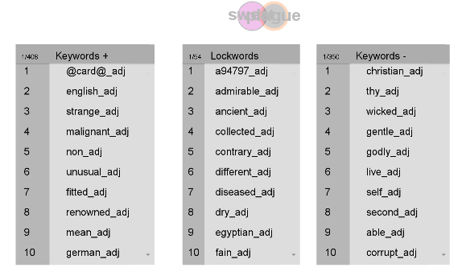

Slide 22
“Strange” occurs 21 times: strange diseases/murrains/plagues;
strange “engines, guns and ordinance”;
strange countries;
strange story;
strange symptoms

Slide 23
Tentative conclusions
The English Sweat was:
  New
  Terrifying
  Yet (perhaps) susceptible to medical treatment
  One element contributing to a general sense of disorientation (“future shock”) as the mediaeval English world (feudal, Catholic, oligarchical) transitioned into the early modern Tudor world (proto-capitalist, Protestant, absolutist)
  Will COVID-19 also mark a global pivot point?

Slide 24
Acknowledgments
Andrew Hardie for assistance with CQPweb
Vaclav Brezina for assistance with #LancsBox
Thank you for listening!

