Slide 1
Extreme Environments
LIRA Sandpit
16th November 2022
David Cheneler, theme lead
School of Engineering

Slide 2
Agenda
Welcome and scene setting
Introductions
Identification of areas of collaboration
Proposal ideas development
???
Profit

Slide 3
LIRA
Lancaster Intelligent, Robotic and Autonomous Systems Centre
https://www.lancaster.ac.uk/lira/
… a focal point for cutting-edge research into intelligent, autonomous and robotic systems bringing together world-leading expertise across Lancaster University aiming to advance this technology and its applications to the economy, society and the environment.

Slide 4
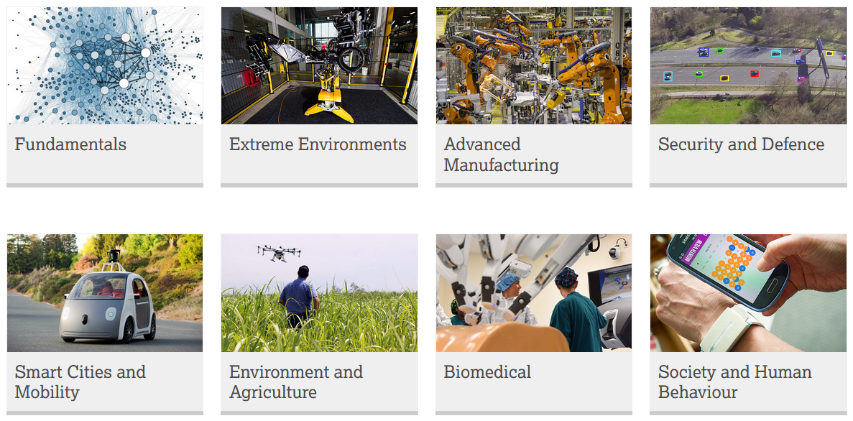
LIRA Research

Slide 5
Extreme Environments
Community developing intelligent systems (instrumentation, AI, robotics, etc.) that operate in extreme environments:
  Nuclear industry
  Space
  Extreme cold
  Volcanoes
  Chemical process plants, etc.

Slide 6
Calls
NERC: Pushing the frontiers of environmental science research (<£1M, 17th Jan 2023)
Innovate UK (UK Space Agency and STFC): Enabling Technologies Programme (£100k-£250k, April start)
Innovate UK (UK Space Agency): NavISP - Navigation Innovation Support Programme
UKRI to launch AI CDT
Civil nuclear research with Japan: phase 10 (£250k-£500, June 2023)
NERC urgency funding (open, £100k)

Slide 7
Tell us…
If you want to give a talk about your work
Or wish to host a speaker or event
Or need a collaborator or expert in particular area and need introductions/suggestions
Or have a journal/event/funding call you wish to promote
lira-admin@lancaster.ac.uk
d.cheneler@Lancaster.ac.uk

Slide 8
Chris Arridge
c.arridge@lancaster.ac.uk
Reader in Planetary Physics
particular interest in how to optimise usage of the limited data volume that can be returned from deep space missions.
New Horizons mission that performed a flyby of Pluto could return data at around 1 kbit/s (but only for about 8 hours per day when the spacecraft was above the horizon on Earth at a given Deep Space Antenna) and a typical (uncompressed) image might be somewhere in the region of 10000 kbit (or about 3 hours to downlink from the spacecraft to Earth).

Slide 9
Amber Leeson
a.leeson@lancaster.ac.uk
Reader in Glaciology, Data Science Institute
Interested in field based observations of ice sheet properties

Slide 10
Manus Hayne
m.hayne@lancaster.ac.uk
Professor of Physics
Interested in physics and applications of compound semiconductors materials and devices.
Actively seeking extreme environment applications, such as space and cyrogenic, for ULTRARAM memory technology

