Slide 1

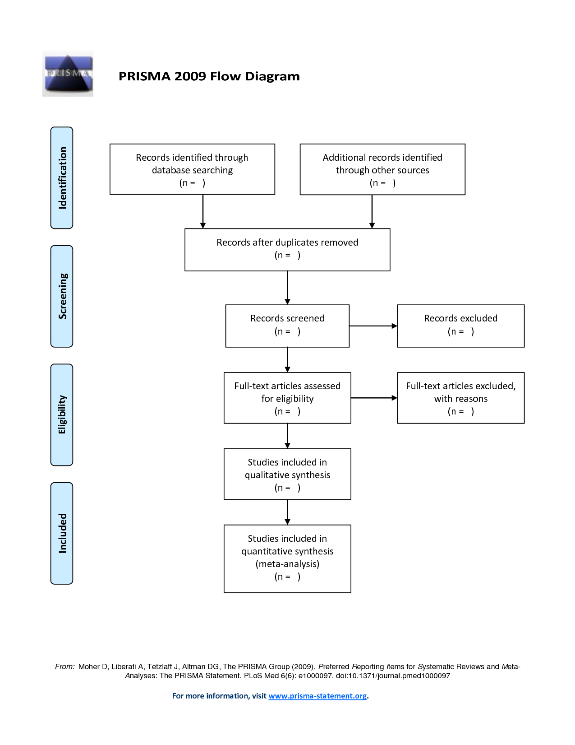



Building on Systematic Reviews: Past. Present and Future
John Barbrook - Faculty Librarian – Lancaster University Library
@stackingbooks

Slide 2
about
present: decolonising literature searching
Introduction: the argument for more work!
Our ongoing decolonising activities at Lancaster.
The Interconnectivity of systematic reviews and many topics.
future: ai methods?
past: systematic reviews
Systematic Review Support at Lancaster 2021-Now
Connecting the threads……..

Slide 3
The argument for more work!
Systematic Reviews, Decolonising the Curriculum and AI are the ‘Hot Topics’ in academic libraries.
At Lancaster, Faculty Librarians have led on introducing and championing Systematic Reviews and also in actively Decolonising Literature Searching leading to measurable service developments.
And combined with discussions around the impact of AI increasing throughout the sector, this presentation hopes to show that these topics are inter-connected and mutually beneficial.

Slide 4
Systematic Review Support
In Person Support
Researcher support
Offer 121 support for Systematic Reviews with Expert Librarians.
Offer support and advice for researchers. Co-authorship on papers.
Online guidance
New role
Provided online evidence-based Systematic Review guidance, videos and pathways
Creative Commons licenced and linked to from other Universities and the NHS
New Information Specialist Role, case made by the impact of the Library Systematic Review support
Team shadowing
Sharing skills and knowledge with other members of the team
Conversations Series
Regular speakers, available to all. Award winning too!

Slide 5
Decolonising
guidance
embedding
Evidence-based Decolonised Searching Living LibGuide.
Created with researchers an ‘Elevator Pitch’ for decolonising.
Teaching is ‘Decolonised by Default’. And we Introduced decolonised searching in schools EPQ guidance and NHS Searching Guidance
Partnered with academics to embed Decolonising in teaching
resources
Overton.io and Policy Commons added to the collections including open access resources.
research
Advising on including decolonised resources and methods in search strategies.
Role of the librarian
engagement
Attending decolonising networks, and provided a series of conference talks, podcasts and blog posts and workshops.
Librarians involved as experts at implementing decolonised methods. Decolonising from the ground up.

Slide 6
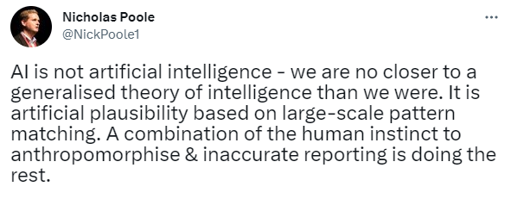
Generative AI
Support not supplant
Efficiency Savings
Investigation of the use of AI in libraries, especially around methodologies such as Systematic Reviews
Investigating where AI can be used to automate or speed up literature research, without impacting quality.
Additional needs
AI Methods working group
Discussing where AI can support students with additional needs.
Contact Kay Kempers k.a.kempers@leedsbeckett.ac.uk

Slide 7
Connecting the threads

Slide 8
Systematic Review + Decolonising
Internal/external validity
impact
In a multi-cultural world, systematic reviews that are more ‘externally valid’ and usable by different groups
By including a worldwide search, and including key decolonised topics such as religion and ethnic groups, a local review becomes usable worldwide Increasing impact.
Truly sensitive searching
Highly Sensitive Searching might miss significant evidence from the Global South, which is published as Open Access or as Grey Literature?
Can it be called Sensitive if it doesn’t include these?
Moral imperative
Research funding is more available in the Global North. Should we be producing more Systematic Reviews in the Global North, on Global South topics, and including Global South researchers?

Slide 9
Systematic Review + AI
Benchmarking
Search strategy production
AI led SRs could be used for benchmarking time taken, to better evidence funding bids
Benchmarking could also be used for forming research teams, identifying where limiting by English only would introduce bias, and highlighting significant search returns in multi-disciplinary databases.
Highly Sensitive Search Strategies systems, trained on Expert AI models, no more terrible searches and The future of AI librarianship?
Priority screening
Screening software, where reviewers switch to a machine learning model, and then stop when irrelevant. Can be reported since Prisma 2020
Gap reviews
Automatic AI SR models could be run independently, 24/7, identifying literature gaps, passing on any findings for human mediated reviews.
Additional needs
AI Tools could support students with additional needs, taking literature reviews to systematic reviews.

Slide 10

Systematic review + decolonising + ai
Machine translation
Racist AI
Can AI be Racist when trained on ‘Global North’ datasets/models?
An awareness of decolonising can ensure that AI adoption enables equality rather than embeds inequity.
The Original ‘Use Case Scenario’ for AI. From the Cochrane Handbook:
“Removing language restrictions in English language databases is not a good substitute for searching non-English language journals and databases.”
Adoption of the automatic machine translation of papers could be slow, but a combination of priority screening with AI models trained with Global South researchers would be invaluable.
benchmarking for review teams
Running sensitive searches with AI Systems can not only benchmark for screening time, but highlight the need to search for non-English resources, and need for a native language expert.

Slide 11
Conclusion
Decolonising Literature Searching can show a significant impact with Systematic Reviews, yet combined with emergent generative AI systems the impact can be multiplied.
Looking at these topics not as an individual workstream, but in parallel will bring many applicable use cases
The overall benefits will be sector wide, with AI increasing the adoption and automation of systematic reviews, while Decolonising will impact on the validity of reviews in the UK and worldwide.
Librarians have a Key Role as information experts, evaluating, guiding and implementing these developments shrewdly.

Slide 12

SOME NOT SO LIGHT READING DECOLONISING
Researchers from global south under-represented in development research
https://www.nature.com/articles/d41586-021-02549-9
Decolonising Literature Searching – Lancaster University
Home - Decolonising Literature Searching - LibGuides at Lancaster University
Recalibrating the scope of scholarly publishing: A modest step in a vast decolonization process
Recalibrating the scope of scholarly publishing: A modest step in a vast decolonization process | Quantitative Science Studies | MIT Press
Beyond Web of Science and Scopus there is already an open bibliodiverse world of research – We ignore it at our peril
https://blogs.lse.ac.uk/impactofsocialsciences/2023/02/07/beyond-web-of-science-and-scopus-there-is-already-an-open-bibliodiverse-world-of-research-we-ignore-it-at-our-peril/
Using Overton to decolonise research
https://blog.overton.io/using-overton-to-decolonise-research
Systematic Review Conversations Series: Decolonising of Grey Literature
https://www.youtube.com/watch?v=eVDYPoDE9Q8&t=1649s

Slide 13
SOME NOT SO LIGHT READING – GENERATIVE AI
JISC Generative AI Primer
https://nationalcentreforai.jiscinvolve.org/wp/2023/05/11/generative-ai-primer/
Are ChatGPT and large language models “the answer” to bringing us closer to systematic review automation?
https://systematicreviewsjournal.biomedcentral.com/articles/10.1186/s13643-023-02243-z
Priority Screening for Systematic Reviews: All you need to know
https://farhadinfo.medium.com/priority-screening-for-systematic-reviews-all-you-need-to-know-7decfd8dcaa8
AI Is Steeped in Big Tech’s ‘Digital Colonialism’
https://www.wired.co.uk/article/abeba-birhane-ai-datasets
Publication or Language Bias
https://training.cochrane.org/handbook/current/chapter-04

