Slide 1

Digging Deep: Securing Grants for African-Focused Research and Engagement

Slide 2
Event Schedule
Time Slot | Speaker | Topic
2:00 – 2:05 pm | Dr Nkechikwu Azinge-Egbiri Lecturer, School of Law, Lancaster University | Introductions
2: 05 – 2:15 pm | Dr Zanele Nyoni-Wood Lecturer, School of Law, Lancaster University. | Introductions: Lancaster University African Research Hub (LUARH)
2:17 – 2:30 pm | Professor Sharifah Sekalala Professor of Global Health Law, University of Warwick. | Thriving in Research (Grant success – opportunities and challenges): An African’s Perspective.
2:33 – 2:46 pm | Professor Charlotte Baker Professor of French and Critical Disability Studies, Lancaster University. @DrCABaker | Succeeding in Grant Applications, Publishing and Engaging Impactfully.
2:48 – 3:00 pm | Dr Akanimo Odon, Head of African Strategic Partnership – Lancaster University. @AkanOdon | Securing Grants for Collaborative Research and Engagements (between the UK and Africa).
3:00 – 3:20 pm 10 mins | Q/A
3:25 – 3:30pm | Closing Remarks: Dr Salid Yakubu Salifu

Slide 3
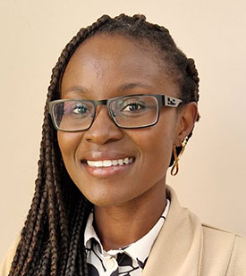
DR. Zanele Wood
Co-Director
LU Africa Research Hub (LUARH)

Slide 4
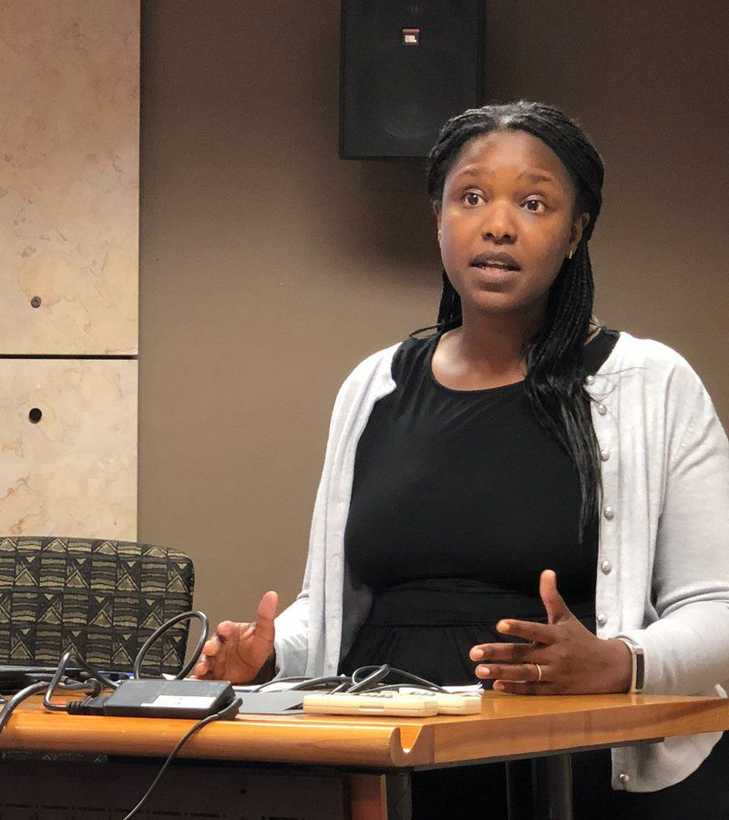
Prof. Sharifah sekalala
Prof. of Global health law
University of Warwick

Slide 5
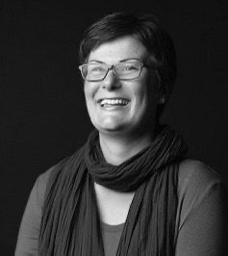
Prof. Charlotte Baker
Prof. of French & Critical Disability Studies.
Lancaster University

Slide 6
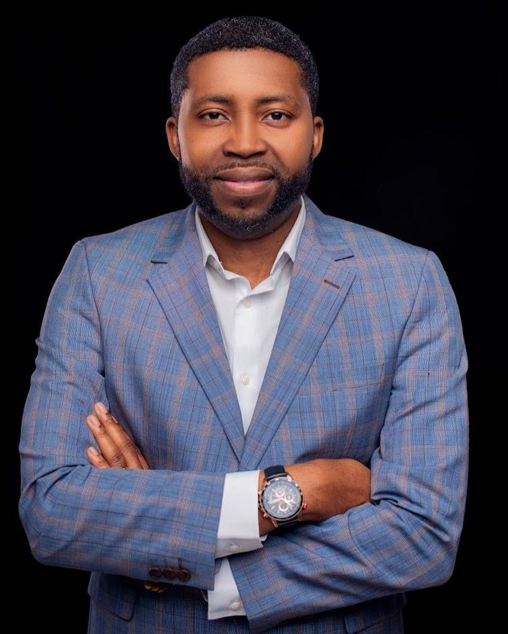
Dr Akanimo Odon
Head of African Strategic Partnership
Lancaster University.

Slide 7


Q/A Session

Slide 8

Feedback Form
https://forms.office.com/e/22KXd1Rr8p
Notes:
https://forms.office.com/e/22KXd1Rr8p

Slide 9
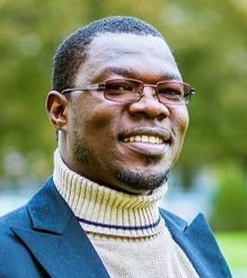
Dr Yakubu Salifu
Co-Director
LU Africa Research Hub (LUARH)

