Slide 1



iCOP 2.0: Using AI to Detect New/Previously Unknown CSAM in Southeast Asia

Slide 2

UK University partnership
University of Bristol & Lancaster University
Academic research project funded by UN End Violence Against Children Fund
Combine strategic research with State-of-the-Art tool development
Non-profit → tools will be shared with law enforcement partners by the end of 2023
Software developed in collaboration with our ASEAN focused Advisory Group

Slide 3
iCOP Advisory Group
Law Enforcement
INTERPOL
Australian Centre to Counter Child Exploitation
Thai Department of Special Investigations
Cambodian Computer Forensics Bureau
NGO’s
Unicef ASEAN
UNODC
IJM (Philippines)
CSAM Detection Tool Development
Child Rescue Coalition
Pathfinder Labs (New Zealand)

Slide 4
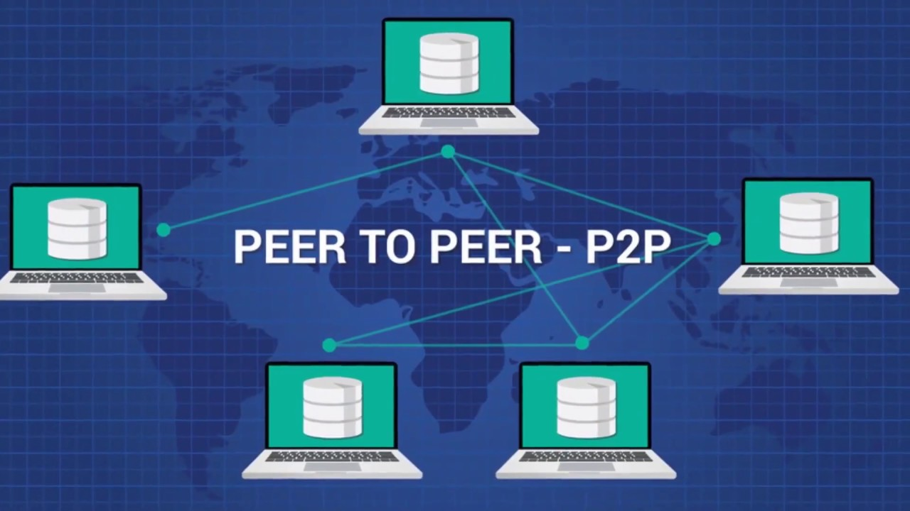
The iCOP Project
Focus on P2P networks (e.g. Gnutella)
  Computing devices use P2P environment to connect with each other over the Internet
  The direct connection allows each device to share files without requiring the assistance of a remote server
  Often misused by offenders for file piracy (e.g. music, films) and to share harmful content such as CSAM
  P2P file sharing has been identified by LE globally as one of the most common methods of accessing and sharing CSAM for a very long time

Slide 5

The iCOP Project: Phase 1
Funded by the European Safer Internet Programme (2010 – 2014)
Survey and interviews with law enforcement specialists:
  Focus on safeguarding children
  → victim identification
  Overwhelmed by results of known CSAM circulating for months/years
  New CSAM → better chance to identify & safeguard victims and arrest offenders

Slide 6
The iCOP Project: Phase 1 (2)
Detecting new or previously unknown CSAM requires an AI-supported approach
(semi-)automatic video and image analysis techniques to investigate a file’s content
downloading all files circulating on a P2P network for media analysis is impossible
an automatic filtering system to identify potential CSAM files based on filenames

Slide 7
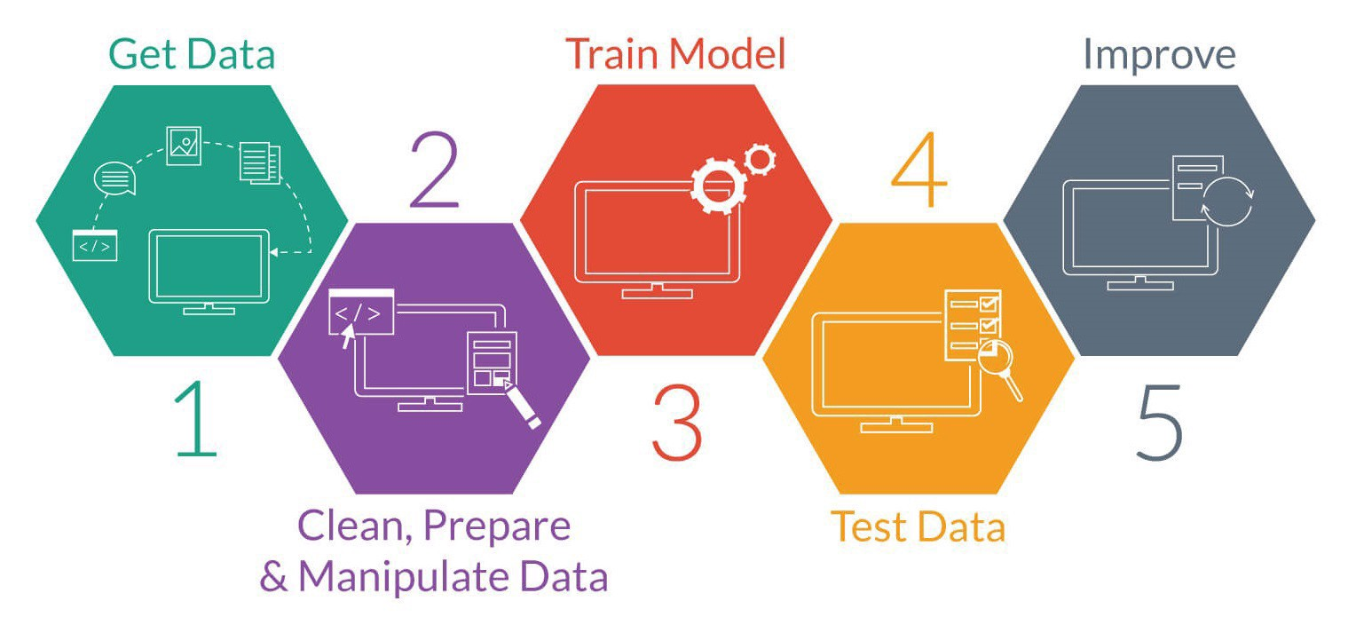
Building an AI Model

Slide 8
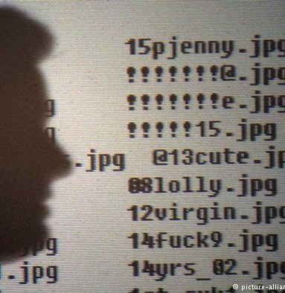
Filename analysis
Goal: automatically detect files potentially containing CSAM
Offenders try to evade detection
→ secret keywords, linguistic noise
Method:
  Remove all non alphanumeric characters
  Identify certain classes of words (next slide → explicit!)
  AI model flags suspicious files based on training on actual CSAM-related filenames

Slide 9
Filename analysis (2)
Word classes:
CSAM keywords: hussyfan, pthc, raygold…
Child and gender references: boy, junge, underage…
Explicit terms: sexy, undress, naked…
Relationships: uncle, mother, papa…
Other terms: shower, amateur, school…
Age references + number < 16: yearold, yr, an…

Slide 10
Filename analysis (3)
Character n-grams:
Also n-grams of 2, 3, and 4 characters to allow for unknown terms, acronyms and noise: ch, hi, il, ld… chi, hil, ild… chil, hild…
Example:
Original filename | ptl0lita12yo.jpeg
2-grams | pt tl l0 0l li it ta a1 12 2y yo
3-grams | ptl tl0 l0l 0li lit ita ta1 a12 12y 2yo
4-grams | ptl0 tl0l l0li 0lit lita ita1 ta12 a12y 12yo

Slide 11
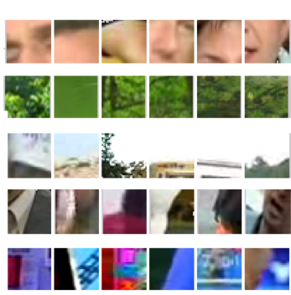


iCOP Media Analysis
Visual words
Skin features
Audio words

Slide 12

iCOP Tool Architecture
P2P Monitor → e.g. Gnutella
Hash value database of known CSAM → provided by law enforcement, e.g. ICSE database
→ for flagging known CSAM, not analysing
2 AI components:
  Filename analyser → flagging suspicious filenames
  e.g. 12yo l0lita silky white panties.jpg
  Image & video analyser → validating CSAM content
User interface to show results to investigators

Slide 13
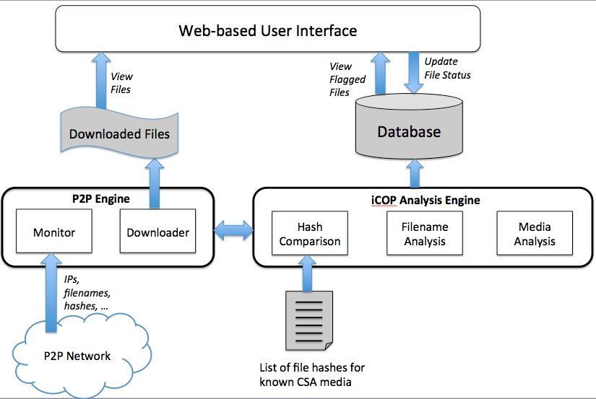
iCOP Tool Architecture (2)
Results Phase 1
(EU-UK):
False positive rates:
  Images 7.9%
  Videos 4.3%
Tested at INTERPOL, France

Slide 14
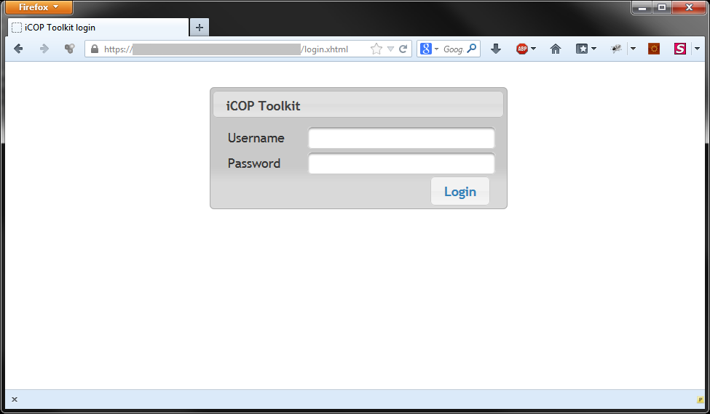
Web app login

Slide 15
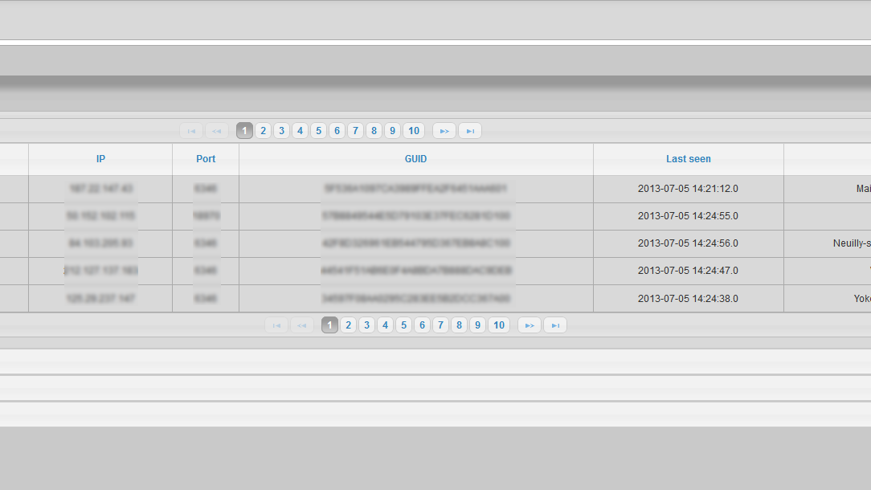
Dashboard

Slide 16
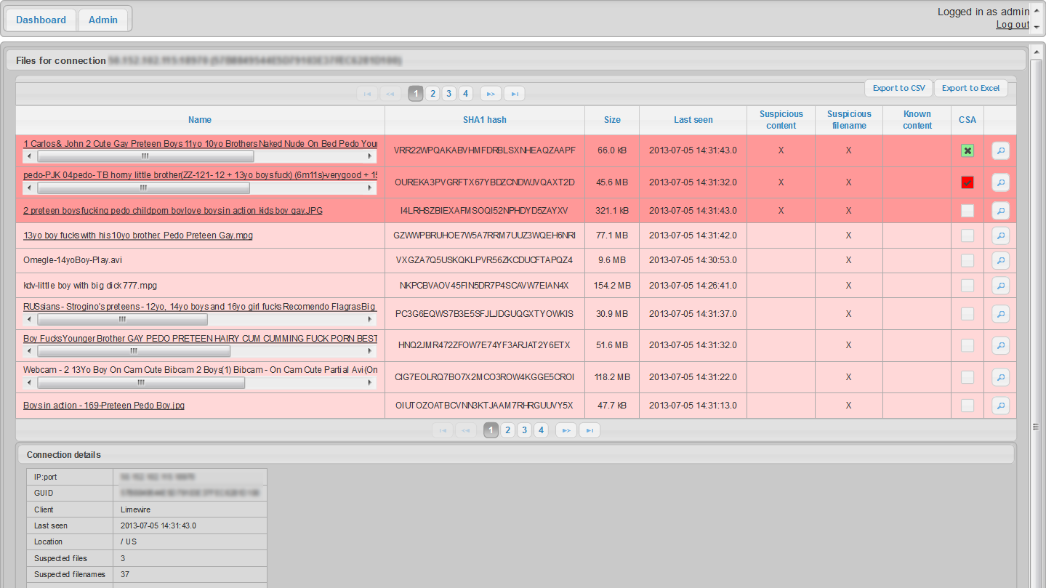
Files per connection

Slide 17
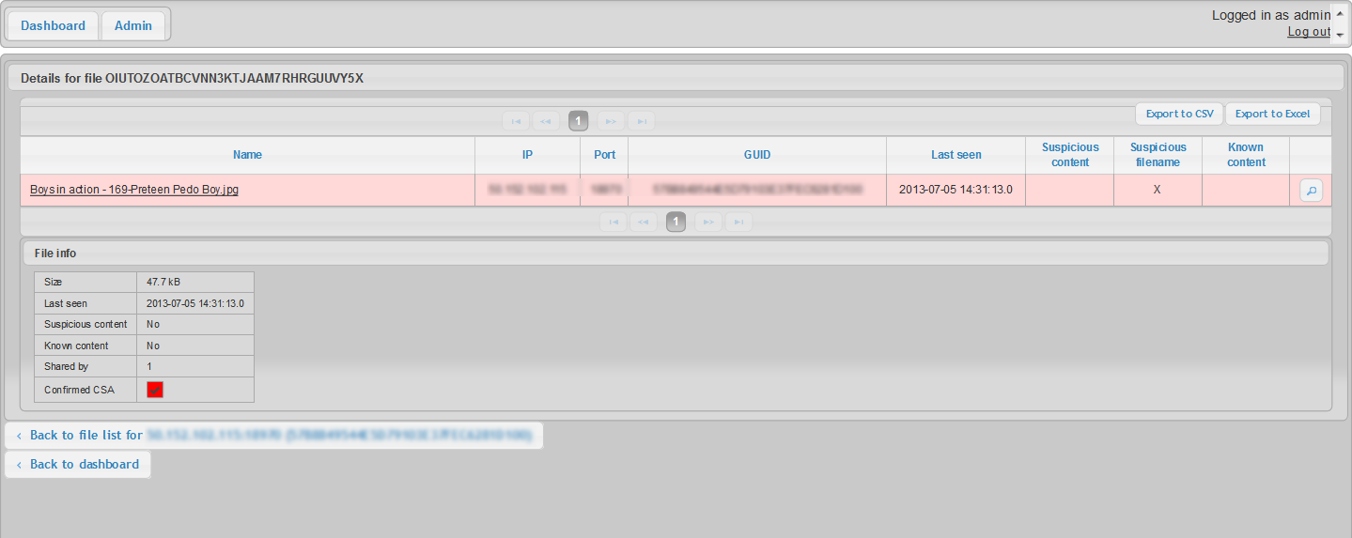
Info per file

Slide 18
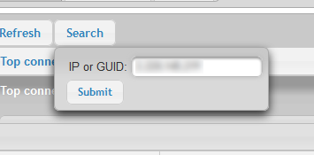
Search for sharer

Slide 19
The iCOP Project: Phase 2
UNODC Regional Conference on Effective Responses to Online Child Exploitation in Southeast Asia, Bangkok, 2017
ASEAN feedback:
  Great willingness to address the issue
  However, current CSAM-detection tools used in the region:
    cannot detect new/previously unknown media
    do not work for ASEAN victims
    E.g. PhotoDNA, CPS

Slide 20
The iCOP Project: Phase 2 (2)
Rapid Evidence Assessment (REA) in the ASEAN region
Build an ASEAN filename analysis component
Enhance the AI media component of the iCOP toolkit to enable detection of Asian victims

Slide 21

Enhancement in Filename Analysis
Build an ASEAN CSAM-related keyword list that includes, e.g., Thai, Khmer, Filipino, Malay, Indonesian, Burmese and Vietnamese
Enhance iCOP’s filename classifier to include ASEAN languages, but also e.g., Mandarin, Russian, Japanese
Warning: explicit CSAM keywords

Slide 22
CSAM-related Keywords
Data Collection:
From iCOP stage 1 (INTERPOL)
Thai keywords (DSI)
Filipino keywords (IJM)
Keyword Extraction
NLP tools trained for text analysis of Asian languages
Multilingual language models

Slide 23
CSAM-related Keywords (2)
Key Challenges:
Keyword extraction from CSAM-related filenames
→ very short text samples
Existing tools (e.g. developed by Meta/Facebook) are not trained on child abusive content
Goal: use iCOP to train new models or finetune existing models

Slide 24
CSAM-related Keywords (3)
Evaluation:
In collaboration with AG partners
Example:
Potential keyword (Thai) | Automated Translation | Feedback from Law Enforcement
กินเด็ก | Eat children | Have sex with underage persons
ขายคลิปช่วยตัวเอง | selling self-help clips | Selling of self-masturbation clips

Slide 25
Filename Analysis
Results of iCOP filename classifier (Phase 1) on
new dataset of ASEAN filenames (285K)
  Adjusted original scripts for handling Asian language characters
  Model trained on EU – UK filenames
  (iCOP stage 1)
  CSAM: 76.1% → 10.4%
  This result confirms that AI-supported tools need to be (re)trained to enable deployment in Southeast Asia
  → “bias” in AI-supported tools

Slide 26
Filename Analysis (2)
Two potential models (iCOP - stage 2) are ready for testing:
  Finetune multilingual language models by training on ASEAN filenames
    Existing models are trained on non-offensive content
    Presence of “secret keywords”, linguistic noise in filenames
  Automated translation of non-English filenames to English as an intermediary step
    how much does it slow down the real-life analysis?
    Non-English filenames often contain clear linguistic clues
    → detection bias in industry?
    For example: “ទារក ក្មេងស្រី cumshot” –
    Translated: “baby girl cumshot”

Slide 27

Media Classification
  Key Challenges
  1. Early Action/Activity Prediction
  The confidence in prediction increases with more proportions of a video
  For video streaming, this problem becomes even more critical
  → early decisions can result in interventions

Slide 28
Media Classification (2)
  Key Challenges
  1. Current approach (iCOP Phase 2) relies on joint training of multiple early predictors → together make decisions on ongoing actions

Slide 29
Media Classification (3)
  Key Challenges
  2. Video quality
  poor lighting or resolution
  partially anonymized videos where faces (or other parts of the body) are blurred
  iCOP AG: audio is often indicative of the ongoing activities in a video

Slide 30
Media Classification (4)
Using audio to filter videos
screen audio inputs for audio that indicates an activity, such as CSAM activities
PlayItBack approach: re-plays potentially suspicious parts of a long audio to better understand its content
Two pipelines for training video and audio datasets are currently ready for testing

Slide 31


Conclusions
AI-supported tools match/outperform human performance
  fraction of time
  no human limitations
  consistent performance
Final decisions should always be made by human experts → never 100% accurate
We need your help → collaboration between researchers and law enforcement experts in the field is essential:
  Datasets & training
  Expertise
  Evaluation

Slide 32
Conclusions (2)
Clear potential of using AI to support online child protection investigations
However, there is more to it than performance (false positive rate, accuracy, etc.):
  Call to action for a proper evaluation of CSAM detection tools:
    Bias in training datasets leads to non-detection of certain ethnicities, age groups, gender groups
    Transparancy of the models → essential to increase the likelihood of a successful prosecution
    Privacy & security of potential victims and non-offensive P2P users
    Prevention of misuse or circumvention of the technology
Current work: building a human-centric evaluation framework for online child protection tools

Slide 33
Conclusions (3)
We would like to kindly invite Cambodian law enforcement specialists to collaborate with us:
  Please contact us: claudia.peersman@bristol.ac.uk
  Expertise, toolkit training and testing (as soon as possible)
  We offer: free user training (October – November – December 2023)
Reports
A Rapid Evidence Assessment of Technical Tools for the Detection and Disruption of Child Sexual Abuse Media (CSAM) and CSAM Offenders in The ASEAN Region
Corinne May-Chahal*, Awais Rashid, Claudia Peersman, Maggie Brennan, Emma Mills, Peidong Mei, John Barbrook
https://research-information.bris.ac.uk/en/publications/a-rapid-evidence-assessment-of-technical-tools-for-the-detection-
iCOP: live forensics to reveal previously unknown criminal media on P2P networks
Peersman, C., Schulze, C., Rashid, A., Brennan, M. & Fischer, C. 09/2016 In : Digital Investigation. 18, p. 50-64, 15 p.

Slide 34
Thank you
c.may-chahal@lancaster.ac.uk
claudia.peersman@bristol.ac.uk

