Slide 1
Prediction of Fuel Debris Location in Fukushima Nuclear Power Plant using Machine Learning
Dr Saed Alrawash
Lancaster University, UK
24 October 2024
Oct. 20 to 24, 2024 Palais des Congrès - Paris SNA + MC 2024 Joint International Conference on Supercomputing in Nuclear Applications + Monte Carlo
Authors: Saed Alrawash, Matthew Hale, Barry Lennox, Malcolm Joyce, Andrew West, Minoru Watanabe, Zhongming Zhang, Michael Aspinall

Slide 2
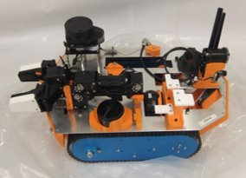
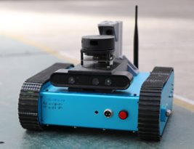
Background & Motivation
RHINO project focuses on developing robust, radiation-hardened robotics for inspecting high-radiation environments
  Equipped with diamond-based radiation detector for real-time radiation monitoring as the robot navigates radioactive zone
What makes RHINO different?
  Continuous radiation tracking allows RHINO to retreat from dangerous areas before reaching critical damage
  Designed to operate in highly radioactive areas like Fukushima melted core
RHINO : Radiation Hardened robotics for remote INspectiOn

Slide 3
My Role in the RHINO project
Focus on Neutron Detection
  Developing a neutron detection system with a diamond detector to assist in fuel debris retrieval
  Enhancing neutron detection to locate the neutron source within the fuel debris in Fukushima Daiichi Nuclear Power Plants
Objective:
Accurately locate neutron source distribution, critical for efficient debris removal, using a diamond detector
Collaboration:
  Working with experts in robotics from University of Manchester, and electronics from Okayama University

Slide 4
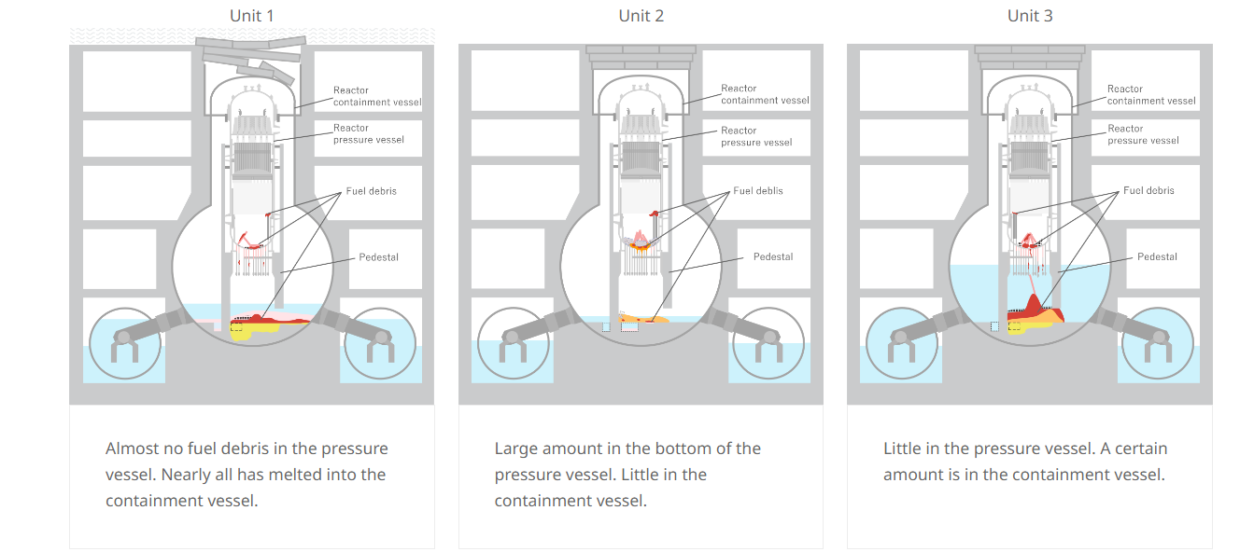
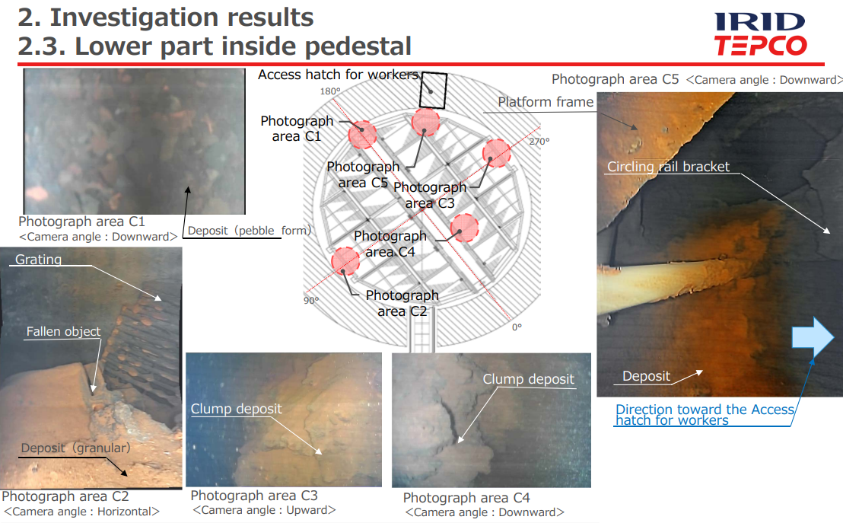
Fukushima Primary Containment Vessel Internal Investigation
https://www.tepco.co.jp/en/hd/decommission/progress/retrieval/index-e.html

Slide 5
Neutron Vs Gamma Detectors?
It is difficult to confirm the distribution of the fuel debris using γ-rays detection due to contamination of ¹³⁷Cs.
Possible ways:
  γ-rays unique to fuel debris by using sensor has high energy resolution, comes from actinides that emits >1MeV
  other way: detect the spontaneous neutrons fission(mainly from ²⁴⁴Cm (98%))
  hence, we chose neutron detector

Slide 6

Why Choose Diamond Detector
1
  Radiation-resistance
2
  High-temperature resistance
3
  Small size
4
  High energy resolution
4
  Fast response neutron detection
4
  Gamma rejection

Slide 7
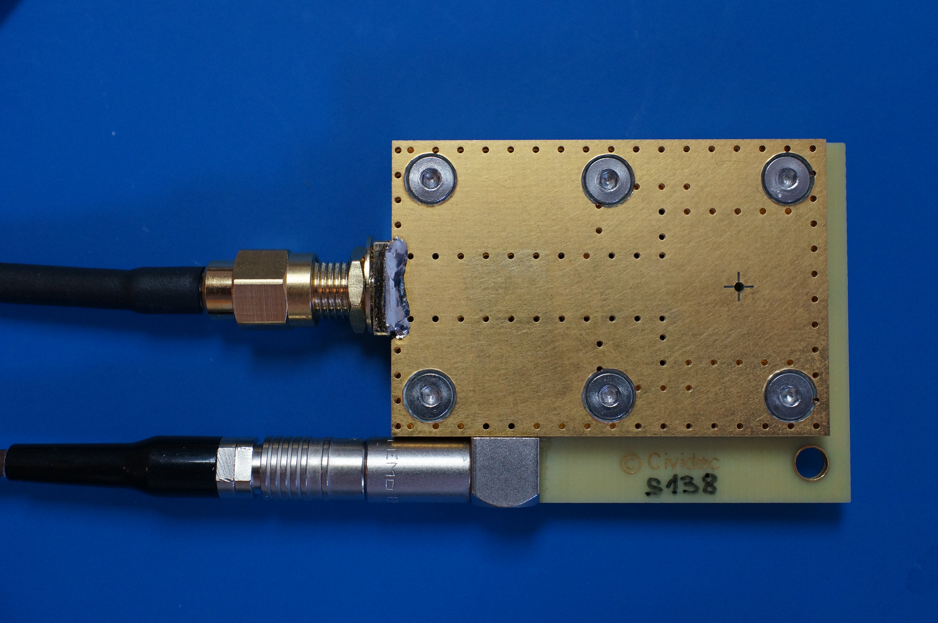

Lancaster Diamond Detector
Thermal-Neutron Diamond Detector
Substrate material | sCVD diamond
Substrate thickness | 500 µm
Active area: | diameter 3 mm
Thermal neutron converter | 6Li(95% enriched)
Sensor size: | 4.5 mm x 4.5 mm
Nominal bias voltage: | 120 V
Housing size | 44 mm x 47 mm x 5 mm
www.cividec.at
developed for efficient thermal-neutron flux monitoring
high neutron detection rates up to 1 MHz

Slide 8
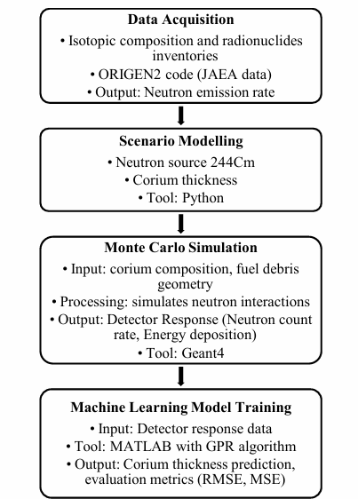


Methodology Overview
Monte Carlo Simulations
Geant4
Real-World Data Collection
Machine Learning Training
The High-End Computing (HEC) Cluster Lancaster University offers 14,000 cores
Unknown fuel debris composition
Diamond detector response
Data acquisition system
Trained Machine Learning algorithm
Neutron source
location

Slide 9
Radionuclides Inventory
Corium Composition
Uranium dioxide (UO2)
Zircaloy cladding (ZrO2)
Mass Estimation
MELCOR accident code
MAAP accident code
Radionuclide Inventory
Japan Atomic Energy Agency (JAEA) using ORIGEN2
Provides mass, radioactivity, and neutron/photon emission rate
Control rods (B4C)
Concrete and stainless steel
Identified Cm-244 as the primary neutron source
Neutron Emission source
Cm-244
Emission rate
1.6 x 10^6 n/g/s
Corium in pedestal area
Geant4 simulations

Slide 10
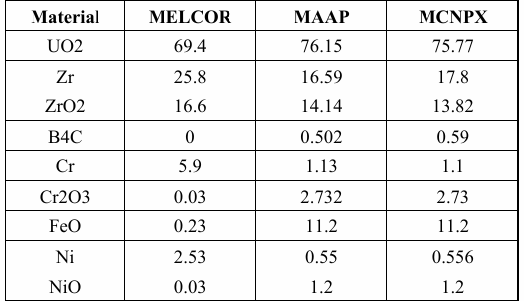
Geant4 MC Simulation
Table 1. The inventory of corium mixture components after 10 years of the accident, as simulated by MELCOR, MAAP, and MCNPX models (tons)
Neutron Source Cm-244
Diamond detector
Corium mixture including fissile nuclides
A. A. Badawi et al., "An investigation of corium in Fukushima Daiichi Unit-1 accident,"
Simulation Setup: Geant4 calculates neutron interactions, total energy deposition, and neutron count rates.
Computation: 1800 simulations with varying corium thicknesses performed using Lancaster University’s HEC cluster.

Slide 11
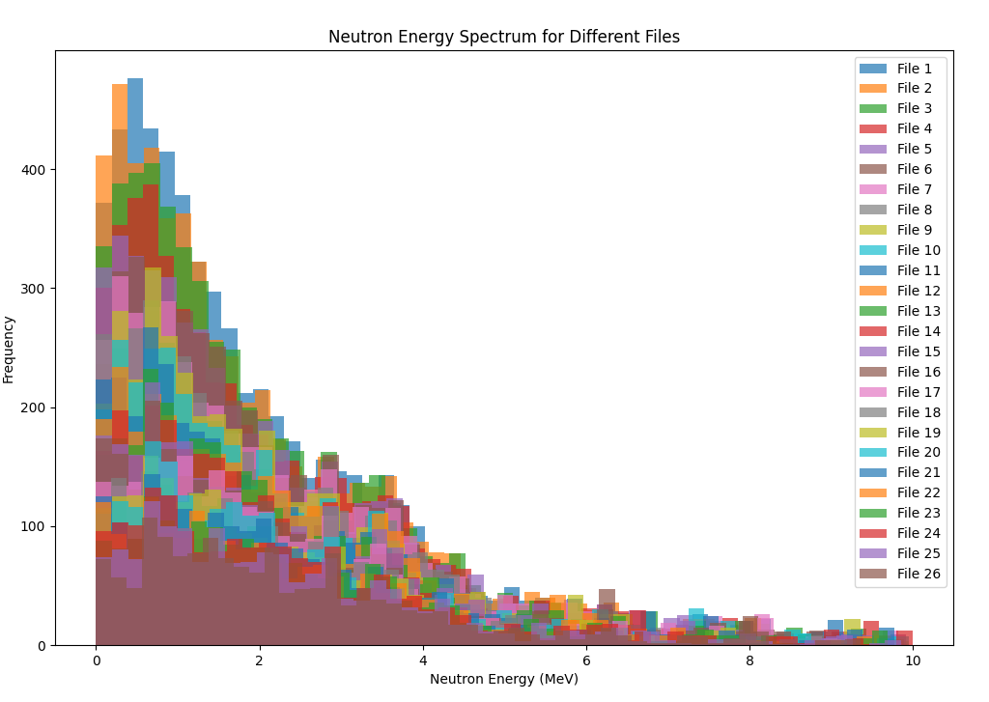
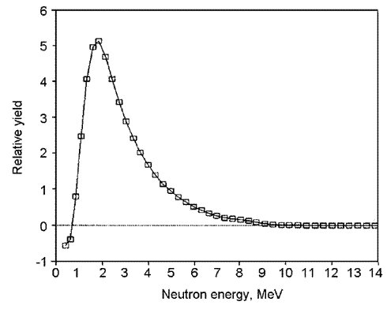
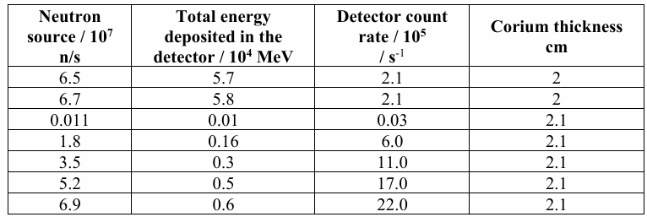
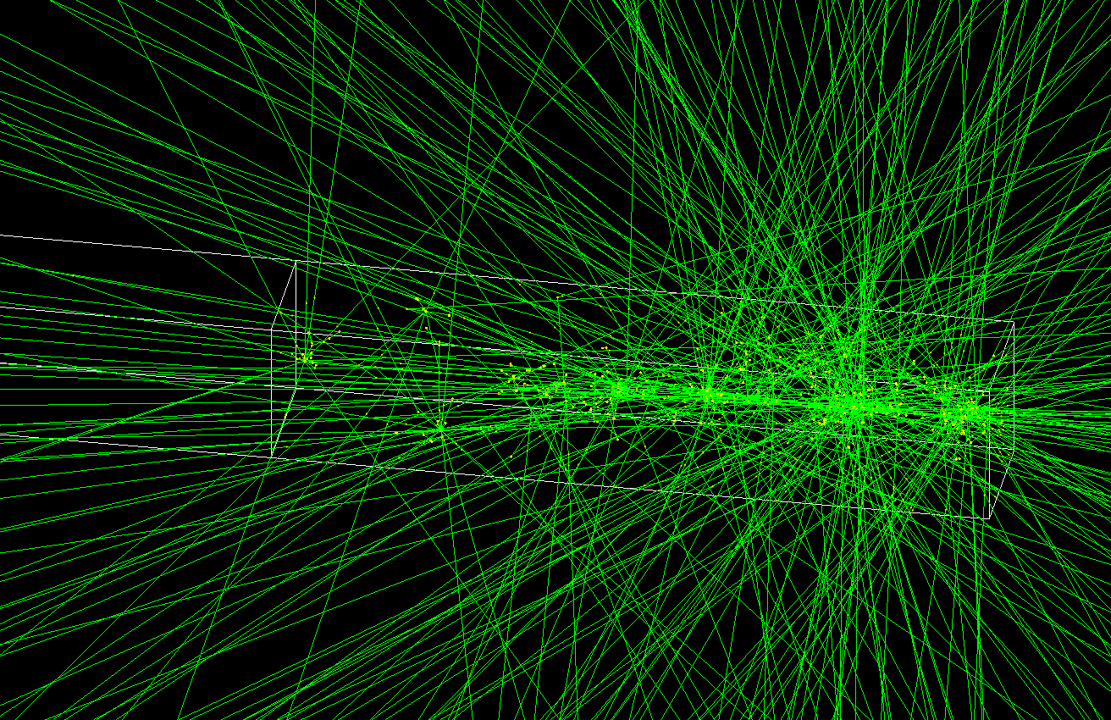
Results: Dataset & Simulated Energy Spectrum
Table 2. Example of the 1800 dataset used to train the ML model, including neutron source intensity, total energy deposited in the detector, detector count rate, and corium thickness.
Simulated Neutron energy spectrum of Cf252 neutron source using Geant4
Mao, R., Zhang, L., & Zhu, R.-Y. (2023). "Fast Neutron Induced Nuclear Counter Effect in Hamamatsu Silicon PIN Diodes and APDs."
3D neutron interaction in Geant4
Corium thickness: “0-5 cm”

Slide 12
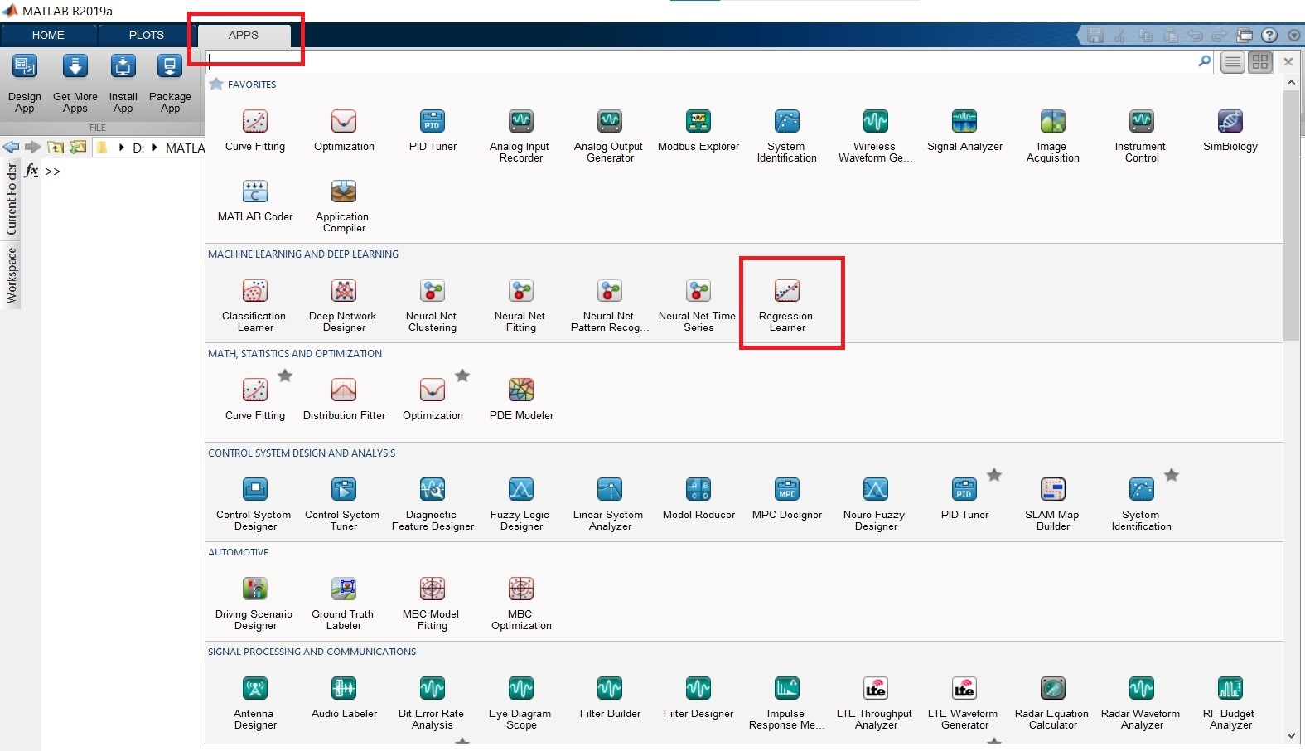
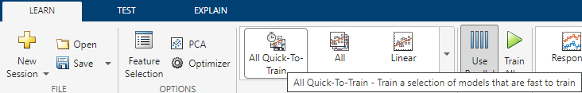

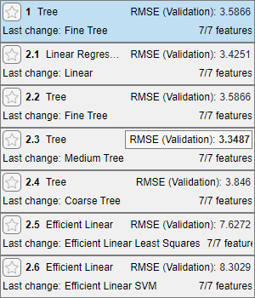
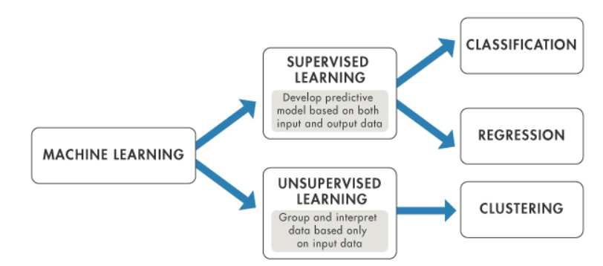
Machine Learning Model (MATLAB Toolbox)
Regression is a statistical technique used to determine the relationship between a dependent variable and one or more independent variables
MATLAB provides a user-friendly, interactive platform for training regression models
The Regression Learner App supports various models including:
  Linear Regression
  Regression Trees
  Gaussian Process Regression (GPR)
  Support Vector Machines (SVM)
  Tree-based Ensembles

Slide 13
Model Used
These learners were evaluated based on their prediction accuracy and Mean Squared Error (MSE)
Nuclides Inventory (JAEA, ORIGEN2)
Neutron emission rate emission rate
Weight
Corium thickness
Pedestal
Python
Detector Response
Total Energy Deposition
Count rate
Big dataset
Python: data extraction
Machine Learning Dataset
MATLAB Regression Learner models
Model used: Optimisable Gaussian Process Regression (GPR)
Why GPR?: Lowest MSE and Its ability to model complex relationships between input variables (neutron intensity, count rate) and the target variable (corium thickness)
Training Process: Dataset generated from simulations, model training using MATLAB

Slide 14
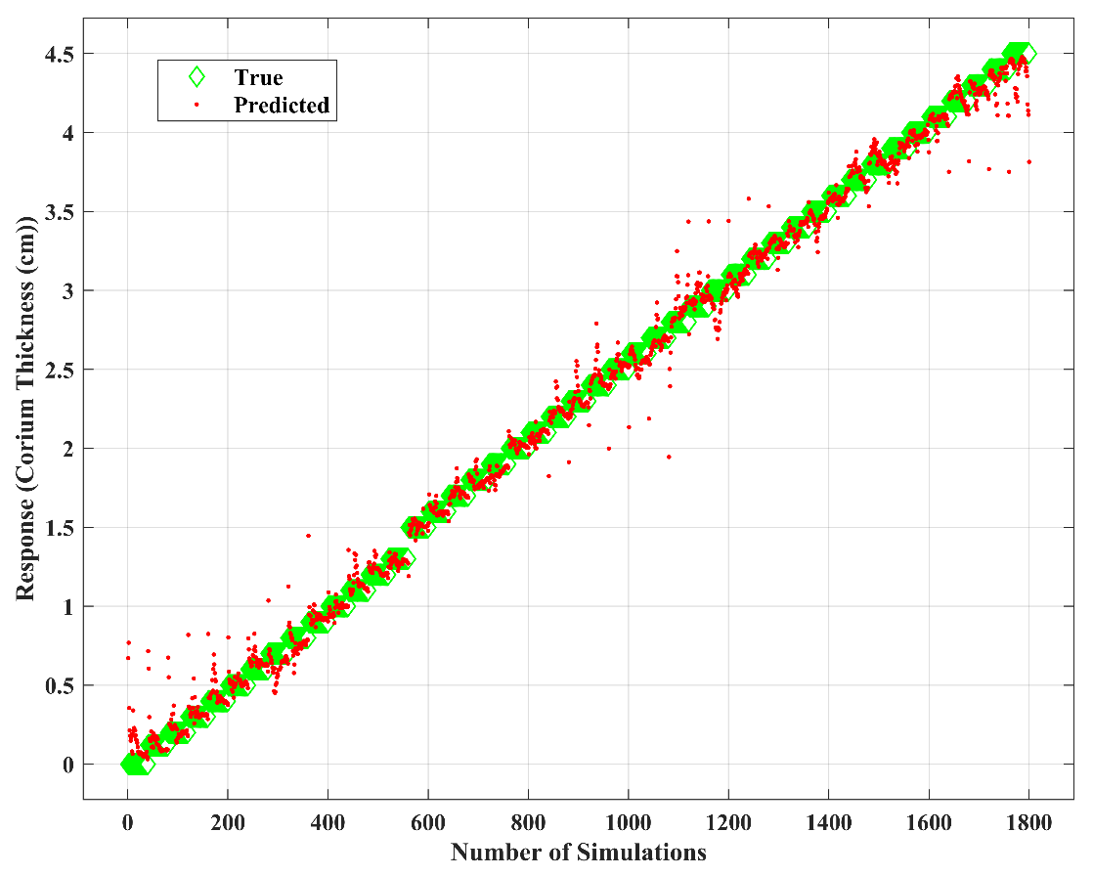
Results – Response Plot &Model Performance
Table 3. The optimization parameters and results of the GPR training model
Parameter | Value
Model | Optimizable GPR
Kernel function | Nonisotropic Exponential
RMSE (Validation) | 0.098685
MSE (Validation) | 0.009738
Prediction speed | 41000 obs/sec
Optimiser | Bayesian optimisation
The response plot of GPR training results generated from the Gaussian Process Regression (GPR) training process. The x-axis represents the record number (simulation record), corresponding to the total observations, while the y-axis denotes corium thickness in centimetres (cm)

Slide 15
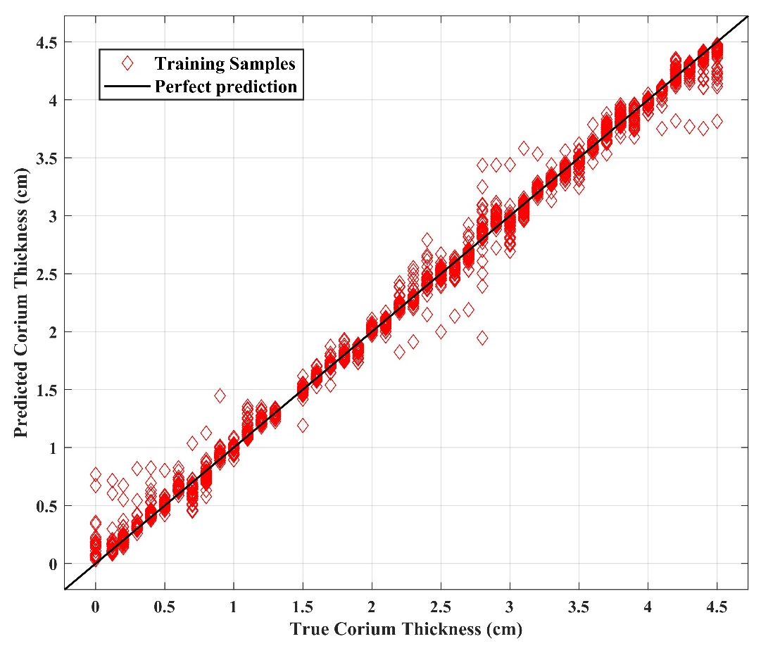
Results: Scatter Plot
Fig. 3. Scatter plot of True and Predicted Corium Thickness Values, displaying the training points alongside a line representing perfect prediction. The x-axis denotes true thickness values (in cm), while the y-axis represents corresponding predicted values
This figure depicts the comparison between true and predicted corium thickness values

Slide 16
Conclusion
Machine learning combined with neutron detection and simulations shows great promise in accurately predicting the location of fuel debris
This approach could pave the way for safer, faster nuclear decommissioning efforts worldwide

Slide 17
Thank you for attending, any questions?

