Slide 1
RHINO: Radiation Hardened robotics for remote INspectiOn
10 October 2024
Dr Saed Alrawash
Lancaster University

Slide 2
Content
Work Plan Review
Diamond detector response
Future Work

Slide 3
Project Overview (RHINO)
RHINO is pioneering a new generation of radiation-resistant robots:
  Simplified, robust design focused on surviving extreme environments, not just performing complex tasks
  Equipped with diamond-based radiation detector for real-time radiation monitoring as the robot navigates radioactive zone
What makes RHINO different?
  Continuous radiation tracking allows RHINO to retreat from dangerous areas before reaching critical damage
  Designed to operate in highly radioactive areas like Fukushima melted core

Slide 4
My Role in the RHINO project
Focus on Neutron Detection
  Developing a diamond detector specifically for neutron radiation monitoring
Collaboration:
  Working with experts in robotics from University of Manchester, and electronics from Okayama University

Slide 5
Overview
It is difficult to confirm the distribution of the fuel debris using γ-rays detection due to contamination of ¹³⁷Cs.
Possible ways:
  γ-rays unique to fuel debris by using sensor has high energy resolution, comes from actinides that emits >1MeV
  other way: detect the spontaneous neutrons fission(mainly from ²⁴⁴Cm (98%))
  hence we chose neutron detector

Slide 6
Work Plan Overview
Monte Carlo Simulations
Real-World Data Collection
Machine Learning Training
Unknown fuel debris composition
Diamond detector response
Data acquisition system
Trained Machine Learning algorithm
Fuel material Identification

Slide 7
Why Choose Diamond Detector
1
Radiation-resistance
2
High-temperature resistance
3
Small size
4
High energy resolution
4
Fast response neutron detection
4
Gamma rejection

Slide 8
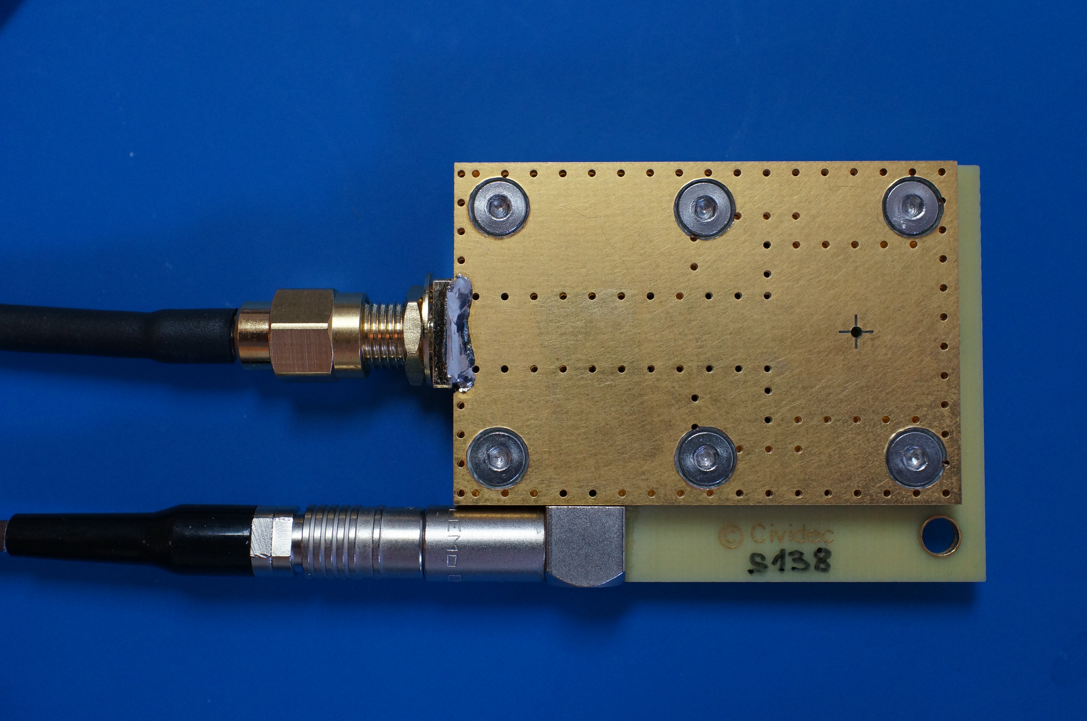

Lancaster diamond detector
Thermal-Neutron Diamond Detector
Substrate material | sCVD diamond
Substrate thickness | 500 µm
Active area: | diameter 3 mm
Thermal neutron converter | 6Li(95% enriched)
Sensor size: | 4.5 mm x 4.5 mm
Nominal bias voltage: | 120 V
Housing size | 44 mm x 47 mm x 5 mm
www.cividec.at
developed for efficient thermal-neutron flux monitoring
high neutron detection rates up to 1 MHz

Slide 9
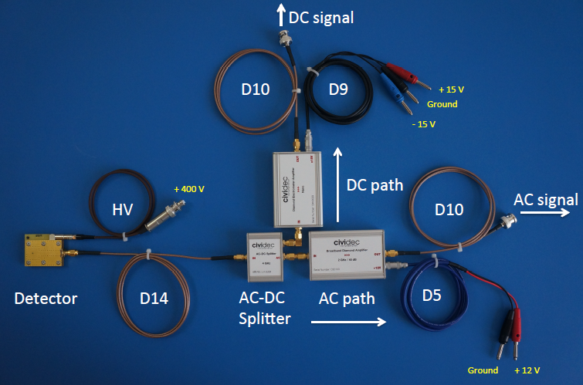
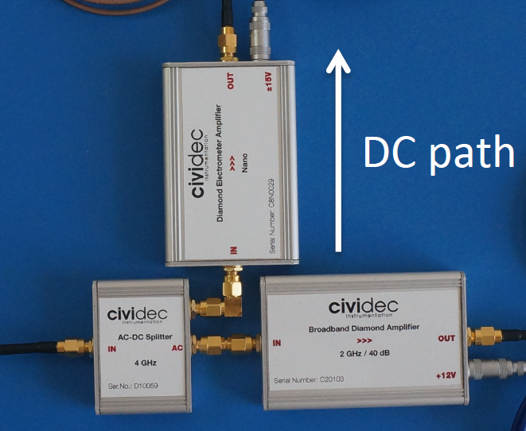
Measurement setup
Calibration done at the manufacturer with alpha particle of 5 MeV
The detector current pulse has 7.2 ns FWHM, and the amplitude of 75 mV
Calibration with thermal neutrons with clear peaks of the alpha and He

Slide 10
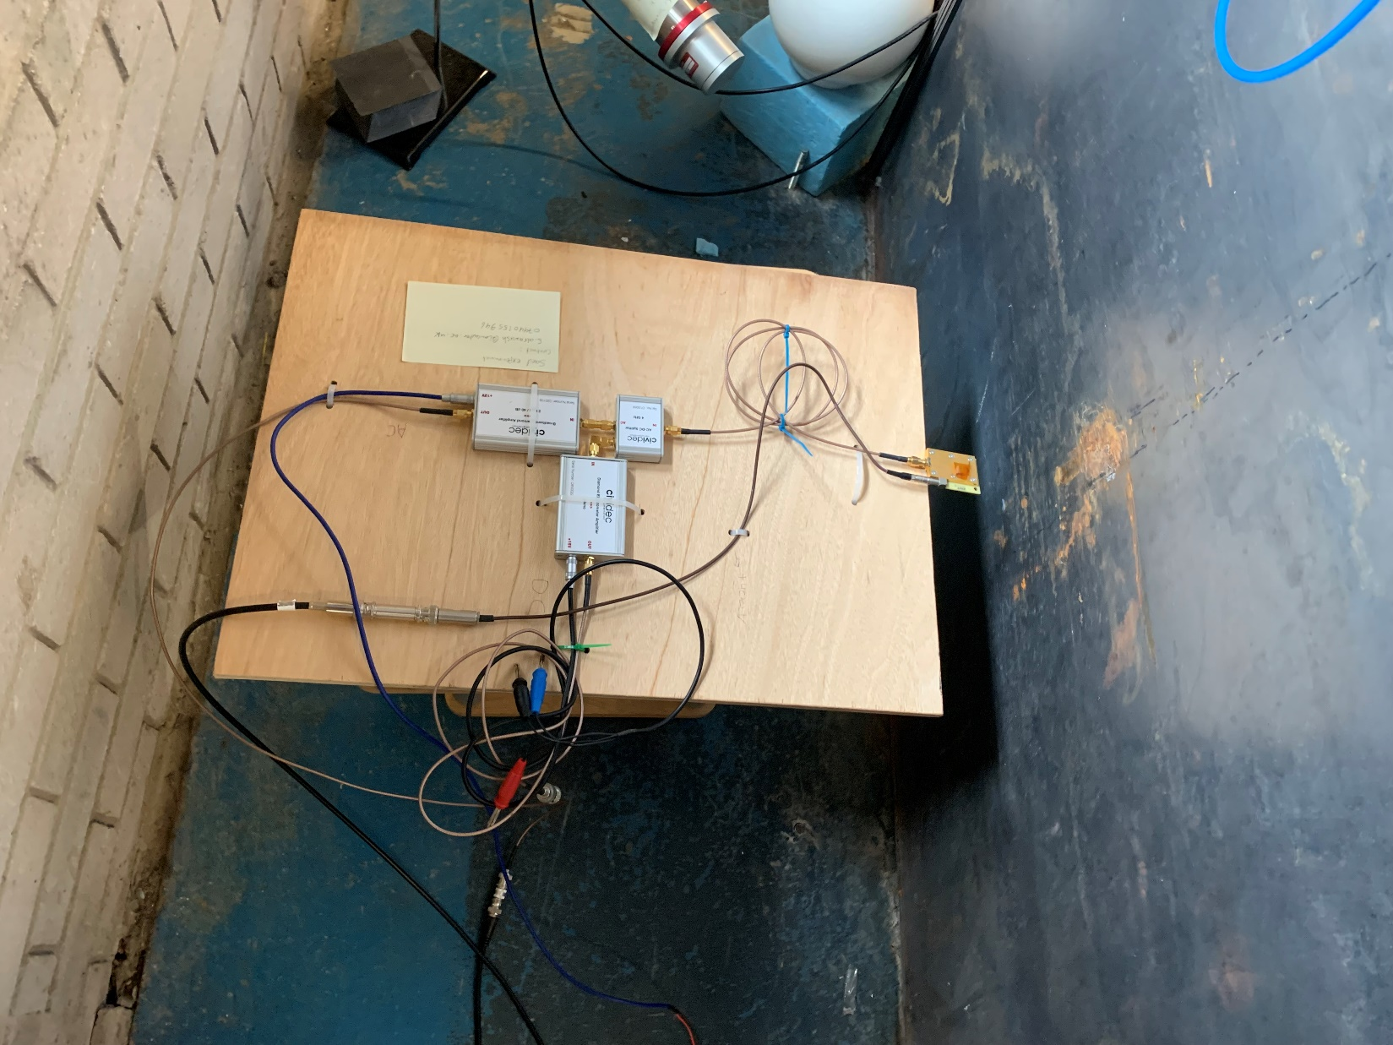
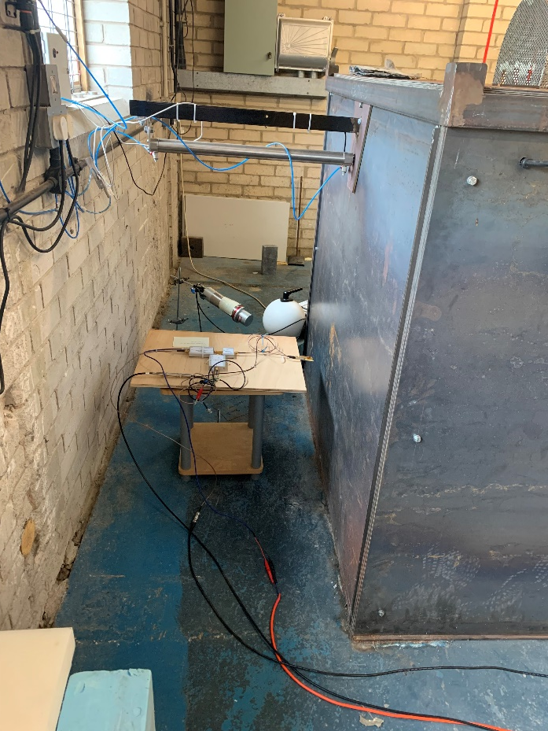
LU Diamond Detector Set up

Slide 11
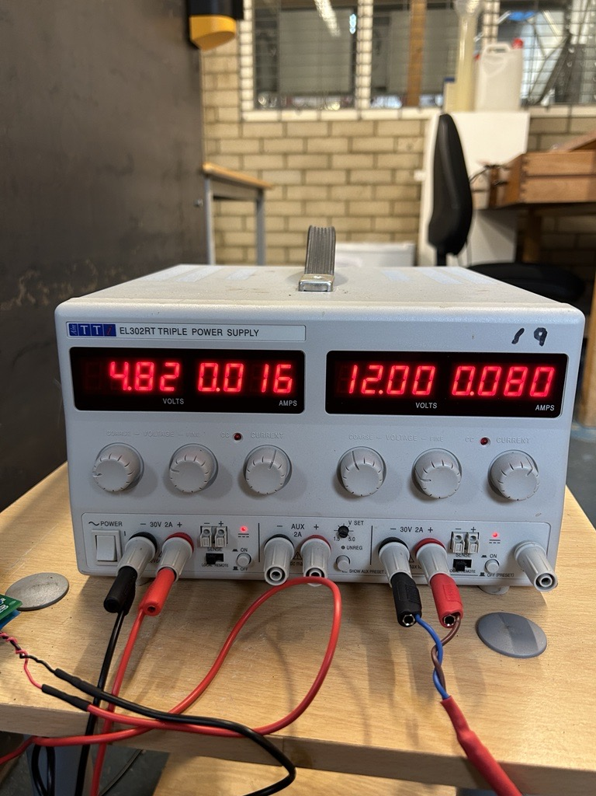
LU Diamond Detector Set up
Hamamatsu c10940-53

Slide 12
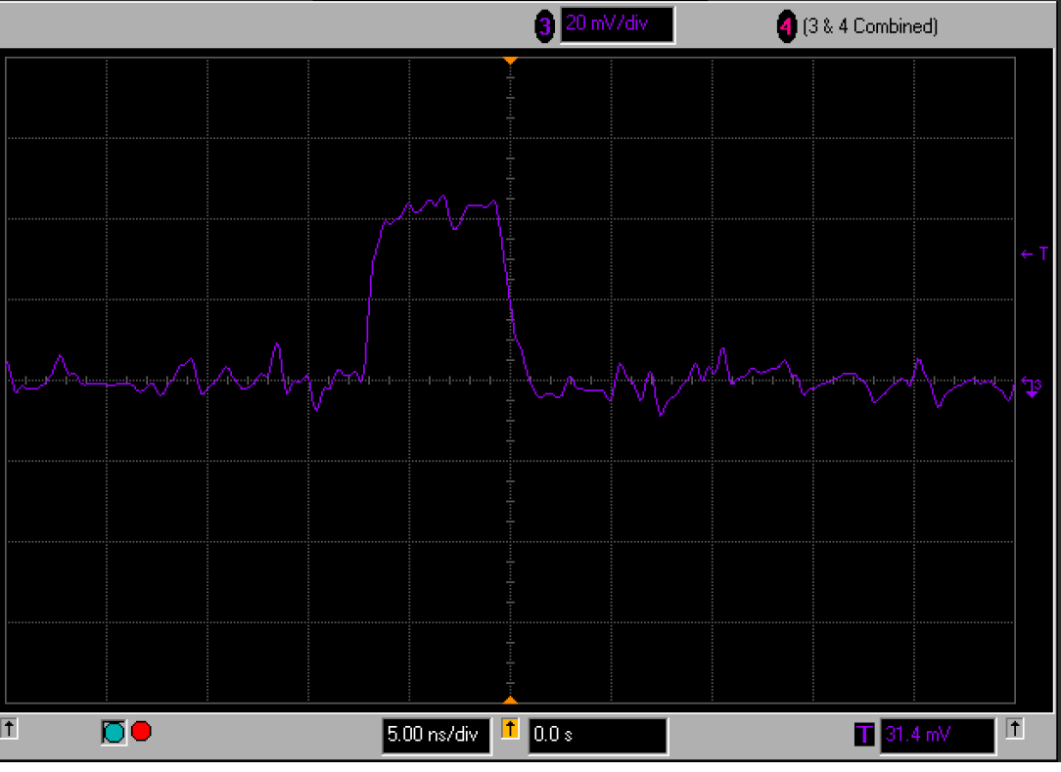
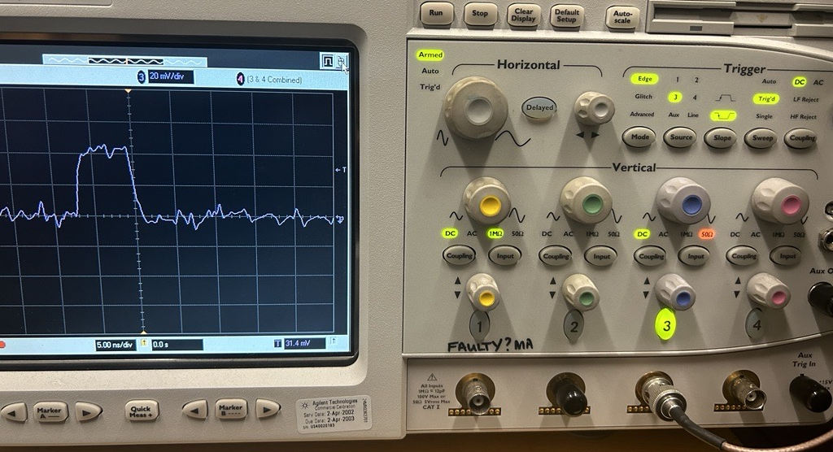
Rectangular signal (Charged particle)
20 mV/div
5.00 ns/div
4 GS/s

Slide 13
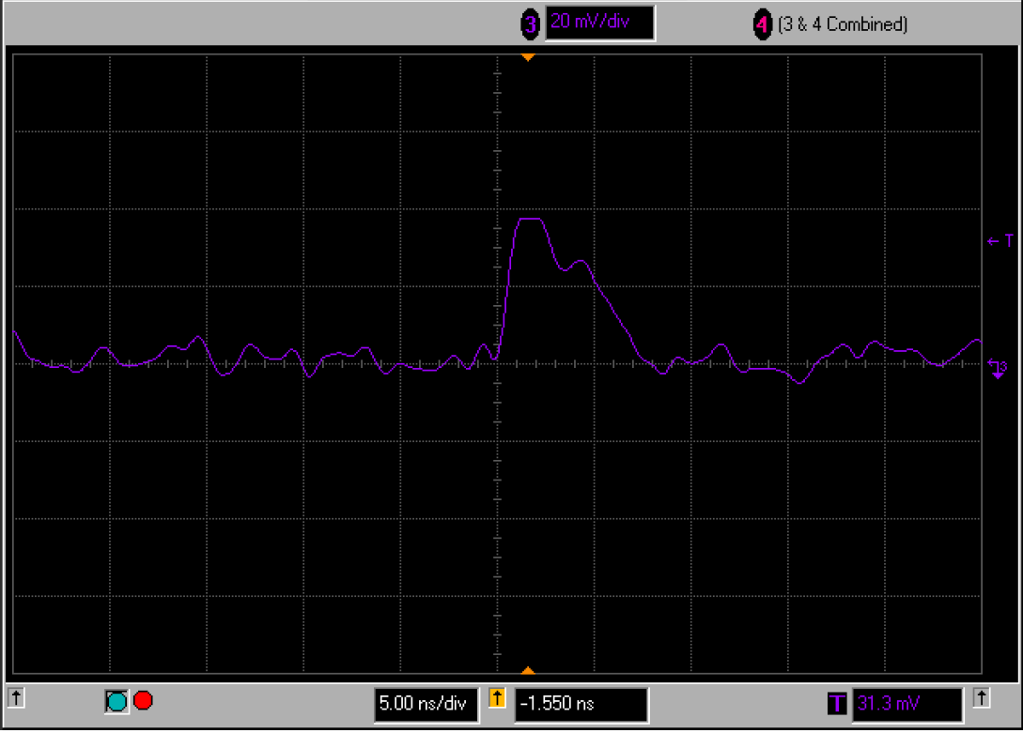
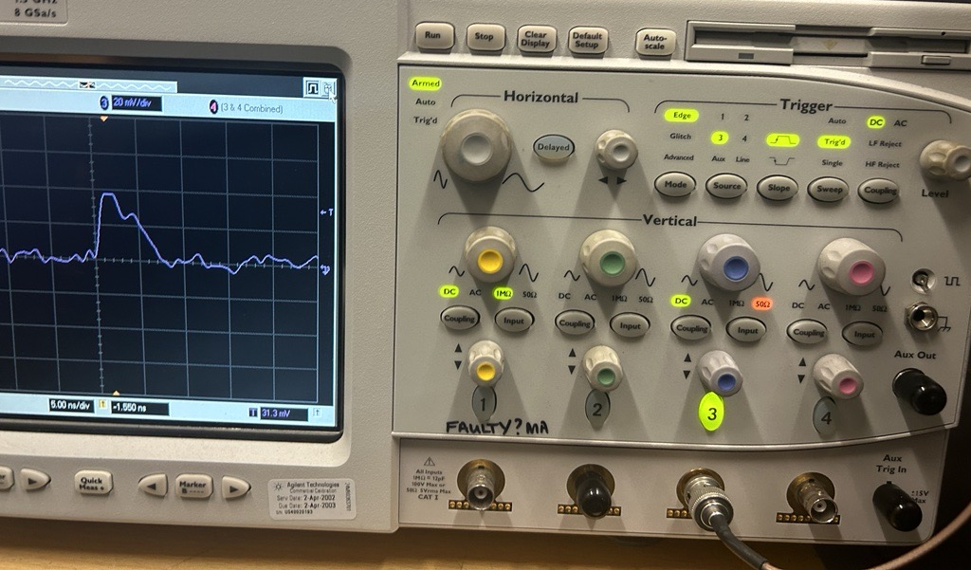
Triangular Signal (γ)

Slide 14
External potential facilities
NILE Facility:
  Mixed flux of fast and thermal neutrons.
  Neutron flux achievable: Up to 10^6 n/s/cm^2.
EMMA Thermal Neutron Beamline:
  Thermal neutron flux of around 10^6 n/s/cm^2.
  Neutron energy selection possible with time of flight.
ChipIR Facility:
  Neutron energy may be too high for the experiment.
  Fast neutron flux saturation potential.
To understand the detector response for different neutron energies
IJS - Jozef Stefan Institute
NPL

Slide 15
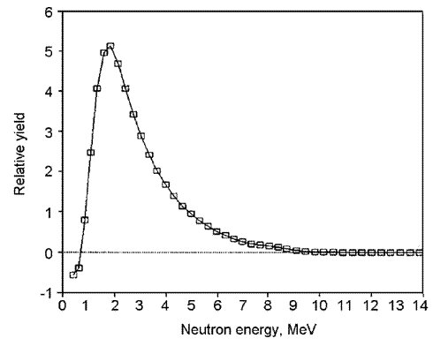
Geant4 MC Simulation
Neutron Source Cf252
Diamond detector
Cf252 neutron energy spectrum
Shielding material mix(ZrO2, Concrete, SS)
Mao, R., Zhang, L., & Zhu, R.-Y. (2023). "Fast Neutron Induced Nuclear Counter Effect in Hamamatsu Silicon PIN Diodes and APDs."
acceptable tolerance for the bias voltage can be within ±5%. This means the voltage supply can range between 380 volts and 420 volts without significantly affecting the detector's performance
Shielding material with different thicknesses

Slide 16
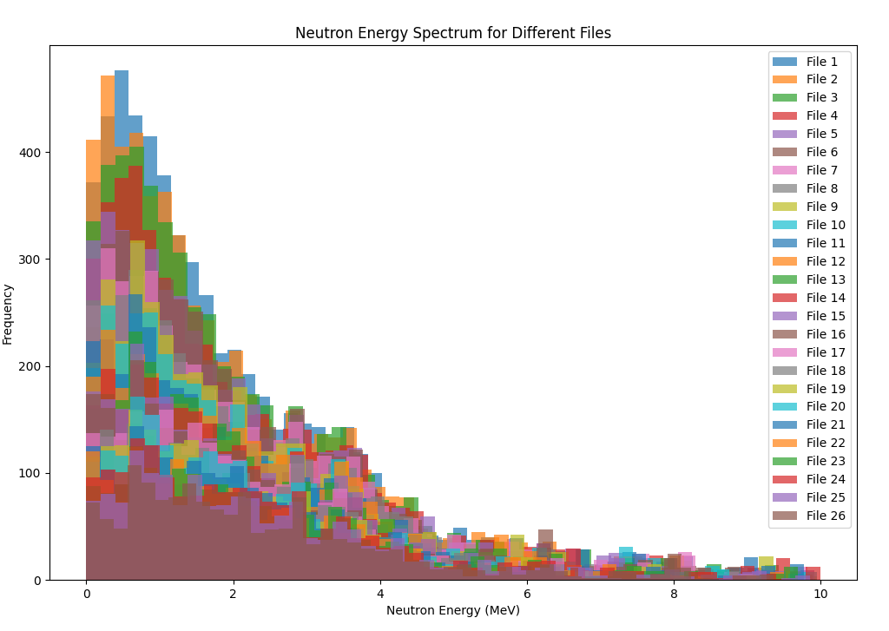
Simulated Cf252 spectrum
Neutron energy spectrum of simulated Cf252 neutron source

Slide 17
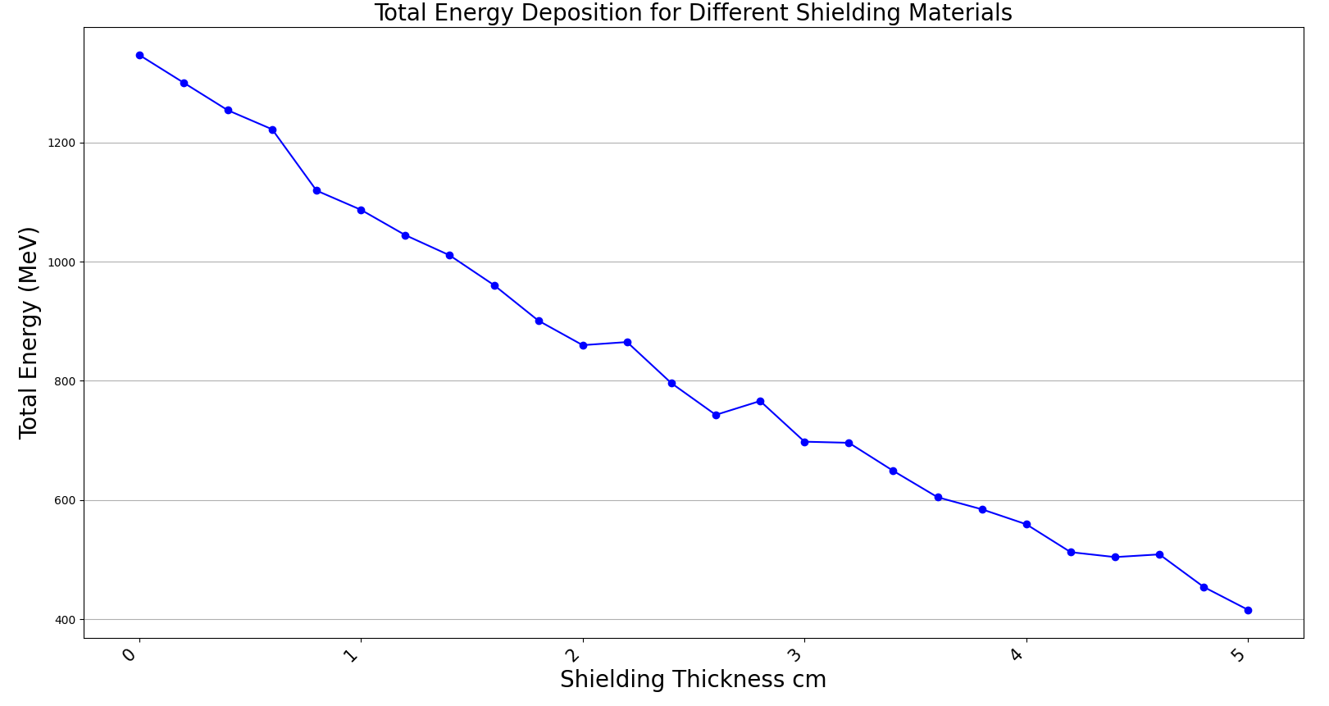
Energy deposition Vs Shielding
Shielding cm | Total Energy(MeV) | Number of Entries | Efficiency %
0 | 1346.995238 | 5617 | 0.5617
0.2 | 1300.465158 | 5369 | 0.5369
0.4 | 1254.038431 | 5084 | 0.5084
0.6 | 1222.0629 | 4757 | 0.4757
0.8 | 1119.260467 | 4416 | 0.4416
1 | 1087.070928 | 4294 | 0.4294
1.2 | 1044.603005 | 3958 | 0.3958
1.4 | 1010.694286 | 3821 | 0.3821
1.6 | 960.731924 | 3646 | 0.3646
1.8 | 901.1170527 | 3424 | 0.3424
2 | 859.9461396 | 3257 | 0.3257
2.2 | 865.1586714 | 3110 | 0.311
2.4 | 796.1386534 | 2957 | 0.2957
2.6 | 742.9587906 | 2793 | 0.2793
2.8 | 766.2246952 | 2694 | 0.2694
3 | 697.9863063 | 2522 | 0.2522
3.2 | 696.1249284 | 2432 | 0.2432
3.4 | 649.0340454 | 2286 | 0.2286
3.6 | 604.8060927 | 2164 | 0.2164
3.8 | 584.5151639 | 2095 | 0.2095
4 | 559.4185682 | 1969 | 0.1969
4.2 | 512.631663 | 1775 | 0.1775
4.4 | 504.3720303 | 1767 | 0.1767
4.6 | 508.9169485 | 1750 | 0.175
4.8 | 454.2168208 | 1562 | 0.1562
5 | 415.7863086 | 1475 | 0.1475

Slide 18
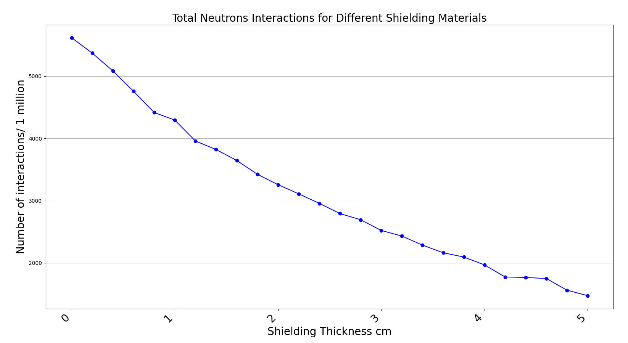
Number of Interactions Vs Shielding
Shielding cm | Total Energy(MeV) | Number of Entries | Efficiency %
0 | 1346.995238 | 5617 | 0.5617
0.2 | 1300.465158 | 5369 | 0.5369
0.4 | 1254.038431 | 5084 | 0.5084
0.6 | 1222.0629 | 4757 | 0.4757
0.8 | 1119.260467 | 4416 | 0.4416
1 | 1087.070928 | 4294 | 0.4294
1.2 | 1044.603005 | 3958 | 0.3958
1.4 | 1010.694286 | 3821 | 0.3821
1.6 | 960.731924 | 3646 | 0.3646
1.8 | 901.1170527 | 3424 | 0.3424
2 | 859.9461396 | 3257 | 0.3257
2.2 | 865.1586714 | 3110 | 0.311
2.4 | 796.1386534 | 2957 | 0.2957
2.6 | 742.9587906 | 2793 | 0.2793
2.8 | 766.2246952 | 2694 | 0.2694
3 | 697.9863063 | 2522 | 0.2522
3.2 | 696.1249284 | 2432 | 0.2432
3.4 | 649.0340454 | 2286 | 0.2286
3.6 | 604.8060927 | 2164 | 0.2164
3.8 | 584.5151639 | 2095 | 0.2095
4 | 559.4185682 | 1969 | 0.1969
4.2 | 512.631663 | 1775 | 0.1775
4.4 | 504.3720303 | 1767 | 0.1767
4.6 | 508.9169485 | 1750 | 0.175
4.8 | 454.2168208 | 1562 | 0.1562
5 | 415.7863086 | 1475 | 0.1475

Slide 19
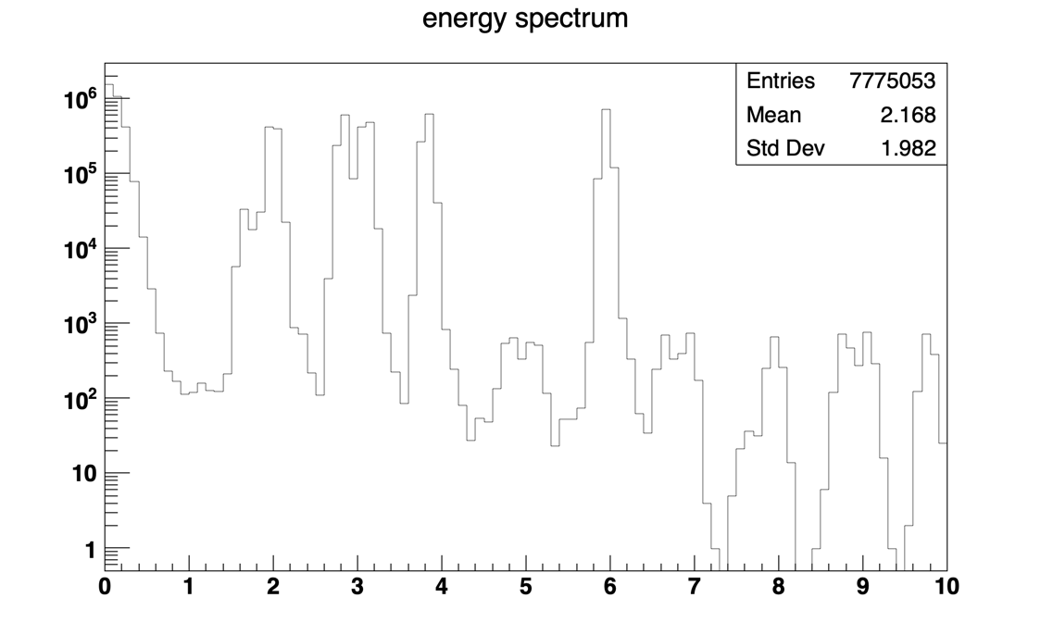
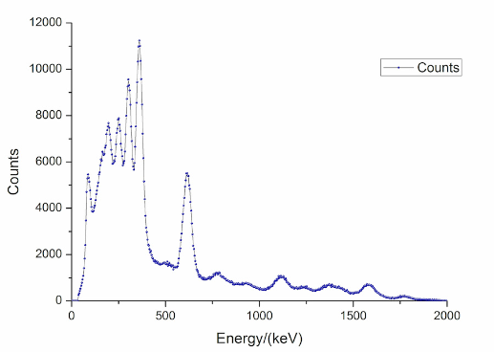
Simulation of ²²⁶Ra Gamma Energy Spectrum
Energy (MeV)
Fig.2 Real ²²⁶Ra gamma spectrum https://www.gammaspectacular.com/blue/ra226-spectrum
Fig.1. Geant4 simulation results for ²²⁶Ra gamma source at Lancaster University Lab
Possible beta decay particles

Slide 20
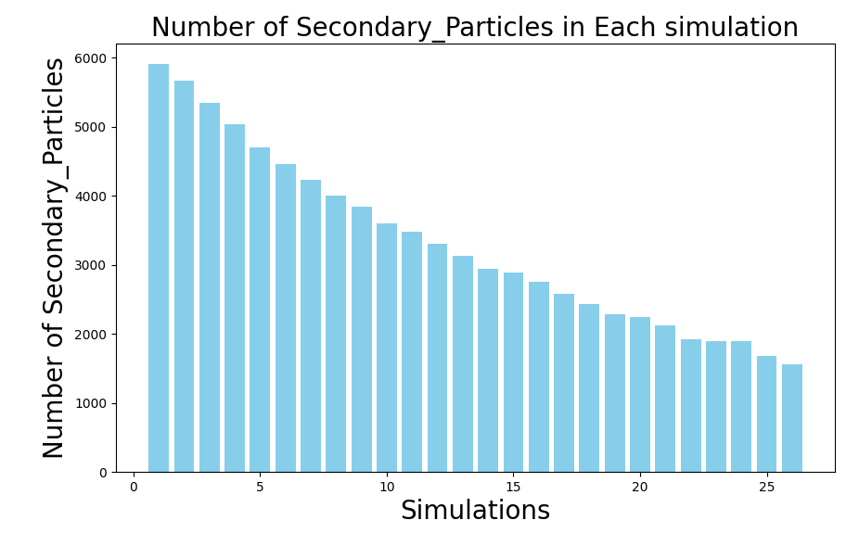
Secondary Particles in the Diamond
Number of secondary particles decreases with increasing shielding thickness
Knowledge of number of secondary particles with different thickness indicate the location of neutron source
Shielding thickness increases

Slide 21
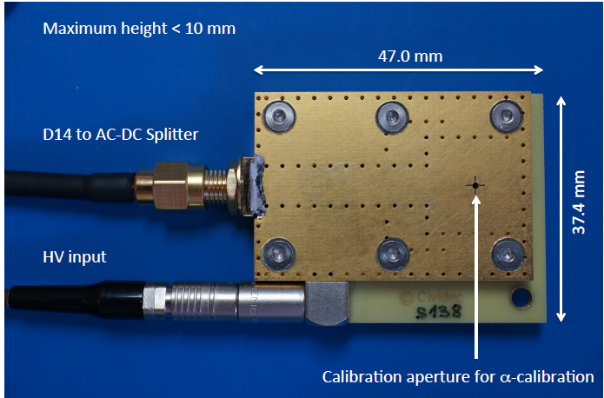
Experimental Results with Gamma sources
Exposed the detector at Lancaster University to gamma sources such as ¹³⁷Cs, ⁶⁰Co, ¹⁵²Eu
Spectra were not as they supposed to be, diamond thickness is too small 500µm gamma passes through without interaction.
Advantages: Potential benefits for gamma rejection in mixed radiation environments

Slide 22
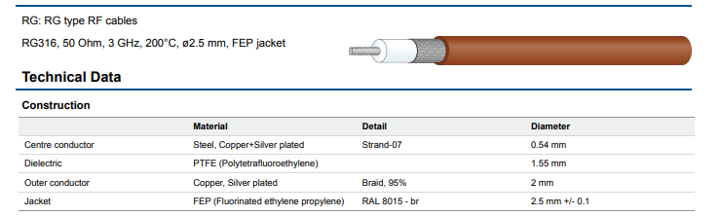
Detector setup
On the robot
Off the robot
Detector
MCA
HV> Cable could be extended to 100m if high quality cable is used (1.6 kg/100 m)
MCA for high accuracy count rate
Amplifier
12 V
5 V
HV
+400 V

Slide 23
Machine Learning Model
Nuclides Inventory (JAEA, ORIGEN2)
Neutron emission rate emission rate
Weight
Corium thickness
Pedestal
Python
Detector Response
Total Energy Deposition
Count rate
Results 1800 files
Python: data extraction
Machine Learning Dataset
MATLAB Regression Learner models
Table 1. Corium mixture components inventory at the time of accident in tons.
Material | MELCOR | MAAP | MCNPX
UO2 | 69.4 | 76.15 | 75.77
Zr | 25.8 | 16.59 | 17.8
ZrO2 | 16.6 | 14.14 | 13.82
B4C | 0 | 0.502 | 0.59
Cr | 5.9 | 1.13 | 1.1
Cr2O3 | 0.03 | 2.732 | 2.73
FeO | 0.23 | 11.2 | 11.2
Ni | 2.53 | 0.55 | 0.556
NiO | 0.03 | 1.2 | 1.2

Slide 24
Future work
Simulation results for the neutron count rate
Comparison between Simulation and experimental data
Monoenergetic neutron exposure produced by Van de Graaff accelerator, NPL.

Slide 25
Thank you for attending, any questions?

Slide 26
Response to Matt questions
Are we trying to detect the material directly below the robot?
Yes, we need no materials in between the detector the corium.
Cable selection?
For the 400V I assume that is very low current? Do you know if it needs to be well regulated.
    Low current, 75mA.
    Yes it is important keep a regulated voltage to ensure consistent and accurate performance

Slide 27
Diamond Vs Silicon Carbide
The count rate of the diamond-based detector has been higher than the count rate of the SiC-based detector.
  This fact is due to the smaller thickness of the active detection volume of the SiC-based detector which is limited to 21 μm.
Better gamma rejection of Diamond to that of SiC
PKA in diamond will create fewer atomic displacements than SiC
parameter | SiC | Diamond
Electron mobility(cm2/Vs) | 1000 | 2000
displacement energy (eV) | 20-30 | 40-50
DPA(x10E-20) (under 1MeV neutron flux) | 4.12 | 1.30
Average PKA energy(keV) under 1MeV neutron flux | 73.68 | 134.30
DPA: displacement per atom
PKA: primary knock-on atom
Z. Zhang and M. D. Aspinal, “Comparison of neutron detection performance of four thin-film semiconductor neutron detectors based on geant4,” Sensors, vol. 21, no. 23, 2021, doi: 10.3390/s21237930.

Slide 28
Diamond Vs Silicon Carbide
Experiment done MINERVE facility at CEA Cadarache.
  The experiment show that diamond has higher gamma rejection, as well as higher detection efficiency.
  It also shows that the diamond has a better signal-to-noise ratio than the SiC
In the same experiment: it Was observed the diamond reaction peak shifting and count rate reduction after 600s of neutron irradiation
The same effect was noticed for the semi-insulating SiC detectors but not for the epitaxial SiC detectors
This effect could be minimized by the reduction of the diamond thickness and by the increase in the applied bias voltage
O. Obraztsova et al., “Comparison between Silicon Carbide and Diamond for Thermal Neutron Detection at Room Temperature,” IEEE Trans. Nucl. Sci., vol. 67, no. 5, pp. 863–871, 2020, doi: 10.1109/TNS.2020.2981059

Slide 29
Experimental evidence of radiation hardness of Diamond-based sensor
Some experiment reported that for a 25 µm thick diamond no effects are visible up to a 14 MeV neutron effluence of 2x10¹⁴ n/cm²
Pillon, M.; etl. Radiation tolerance of a high quality synthetic single crystal chemical vapor deposition diamond detector irradiated by 14.8 MeV neutrons. J. Appl. Phys. 2008, 104, 054513
Neutron effluence inside Fukushima melted core is ~ 10⁰⁹
Whereas in another experiment after a effluence of 2x10¹⁶ n/cm², the 25 µm thick diamond showed a severe degradation in efficiency and energy resolution, from 100% to 47% and from 1.4% to 10.3%, respectively
Almaviva, etl. Characterization of damage induced by heavy neutron irradiation on multilayered L6iF-single crystal chemical vapor deposition
diamond detectors. J. Appl. Phys. 2009

Slide 30
Experimental evidence of radiation hardness of Diamond-based sensor
Few experimental data are available in the literature for gamma exposure
One experiment where diamond exposed to a high dose up to 5MGy of ⁶⁰Co Energy-gamma=1250keV, showed a damage to the metal contact
Inside the melted core radiation intensity could reach 1000 Gy/h
The pressure vessel is flooded with water which acts as a radiation shield. Is the robot submerged?
However
Grácio, J.; Fan, Q.H.; Madaleno, J.C. Diamond growth by chemical vapour deposition. J. Phys. D Appl. Phys. 2010

