Slide 1
RHINO: Radiation Hardened robotics for remote INspectiOn
10 October 2024
Dr Saed Alrawash

Slide 2
Content
Work Plan Review
Diamond detector response
Future Work

Slide 3
Work Plan Review
Monte Carlo Simulations
Real-World Data Collection
Machine Learning Training
Unknown fuel debris sample
Diamond detector response
Data acquisition system
Counting mode
Trained Machine Learning
Fuel material Identification

Slide 4
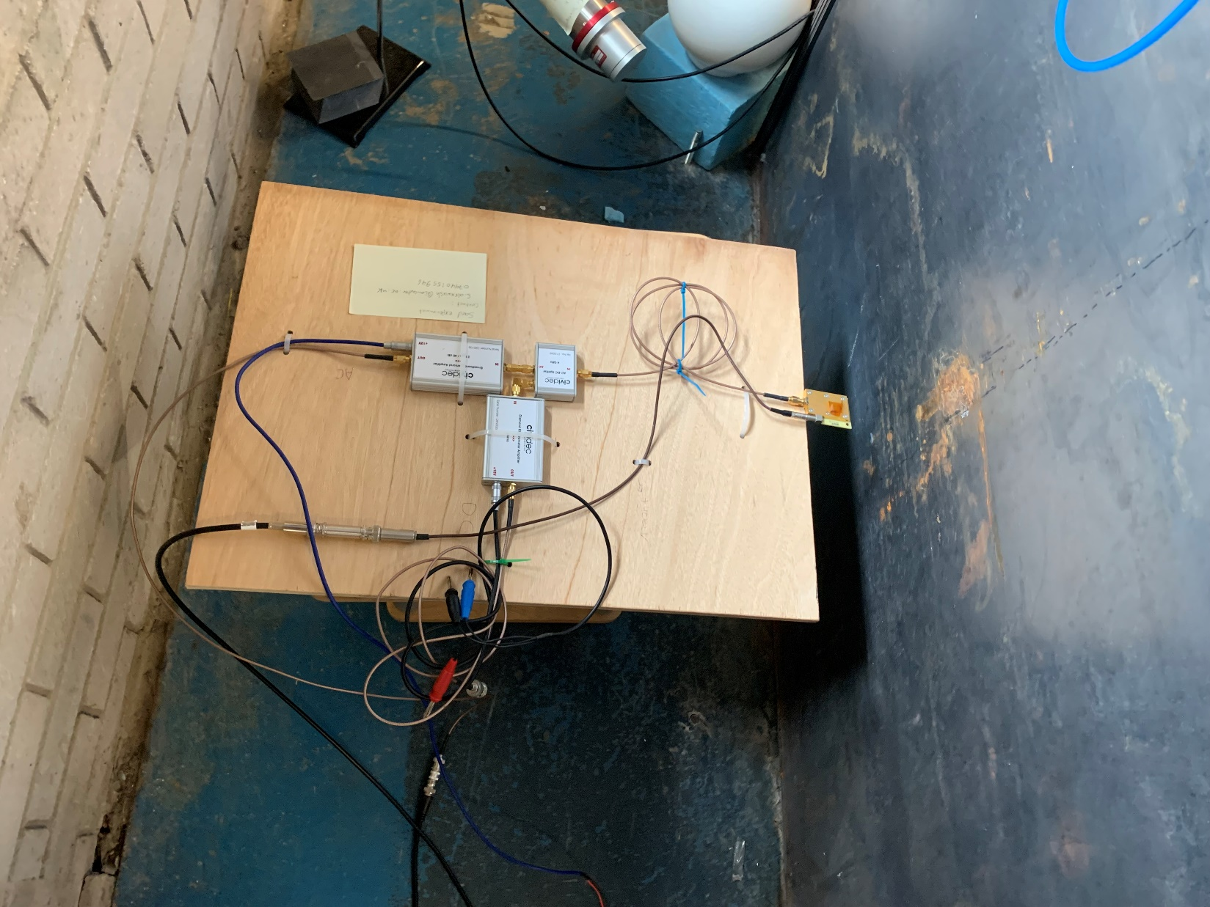
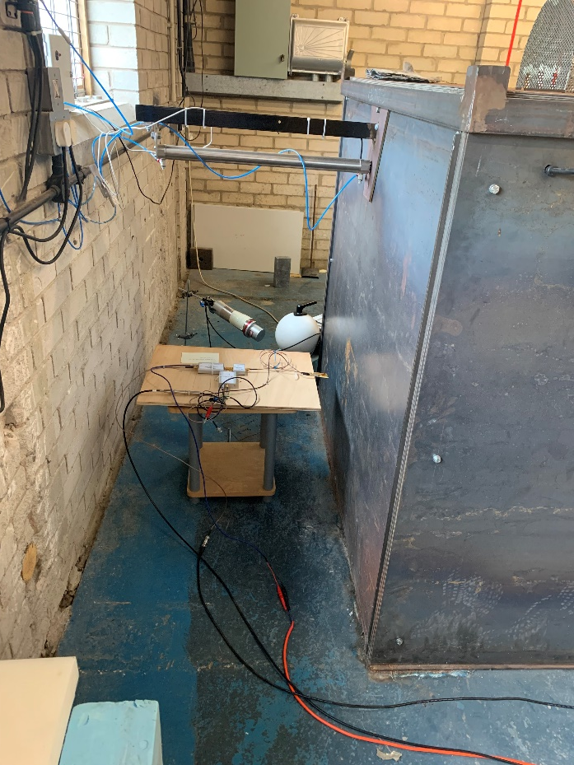
LU Diamond Detector Set up

Slide 5
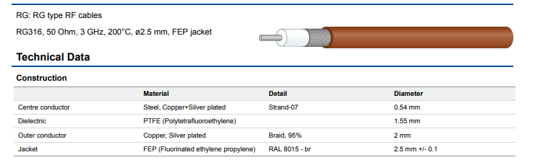
Detector setup
On the robot
Off the robot
Detector
MCA
HV> Cable could be extended to 100m if high quality cable is used (1.6 kg/100 m)
MCA for high accuracy count rate
Amplifier
12 V
5 V
HV
+400 V

Slide 6
Response to Matt questions
Are we trying to detect the material directly below the robot?
Yes, we need no materials in between the detector the corium.
Cable selection?
For the 400V I assume that is very low current? Do you know if it needs to be well regulated.
    Low current, 75mA.
    Yes it is important keep a regulated voltage to ensure consistent and accurate performance

Slide 7
Future work
Simulation results for the neutron count rate
Comparison between Simulation and experimental data
Monoenergetic neutron exposure produced by Van de Graaff accelerator, NPL.

Slide 8
Thank you for attending, any questions?

