Slide 1
Community Resilience to Online Child Sexual Victimisation (OCSV)
May 2022 – May 2024)
Corinne May-Chahal
Adam Crawford
Larissa Engelmann
Christine A Weirich

Slide 2
Aims and Objectives
Taking a place-based approach, to analyse how OCSV is currently understood and responded to by police, public and third sector partners, parents and children.​
Identify how the police can best work in partnership with others to respond to and prevent OCSV. ​
To produce a locality-based OCSA quality standards tool that can be applied nationally with scope to develop in an international context.
Notes:
This project seeks to address some of the gaps identified within the literature by firstly, taking a place-based approach, to analyse how OCSV is currently understood and responded to by key stakeholders such as police, parents and children. We are exploring how the police can best work in partnership with others to anticipate, respond to and prevent OCSV. The information gathered through this process, will help us to produce a locality-based Online Child Sexual Abuse quality standards (OCSAQS) tool that can be applied nationally and internationally.

Slide 3

Pilot Research Site:
Blackpool, England
Notes:
Answer: 13

Slide 4




OCSV Project – What is the project?
Understand
Listen
(Consultation)
Develop
(Co Production)
Test
Jan – March
(2023)
March – Oct
(2023)
Oct – April
2023
April – Sept
2024
Interviews with:
Practitioners
Police
Community Organisations
Health
Focus Groups with:
Practitioners
Police
Parents
Community Organisations
Young People
Educators
Visioning Day
Action Group to finalise following visioning day
Start to develop Toolkit
Pilot takes place in Blackpool
(approx. 6 months)

Slide 5
Case File Analysis
Understand
  Blackmail
  Disclosed private sexual photographs and films with intent to cause distress
  Engage in sexual comms with a child
  Meeting a child following sexual grooming
  Possessing prohibited images of children
  Possession of an indecent or pseudo indecent photo of a child
  Take or make to distribute indecent photograph or pseudo-photograph of children
  Threats to disclose private sexual photographs & film with intent to cause distress
Conducted at Lancashire Constabulary HQ at Hutton (April 22-26th)
185 cases of online related sexual crimes against children in Blackpool.January 1, 2022 – December 31st 2022
Specific focus on 8 types of online crimes (see right)
Additional dip sampling of 89 cases which included over 18s within Blackpool from January 1, 2022 – December 31st 2022

Slide 6
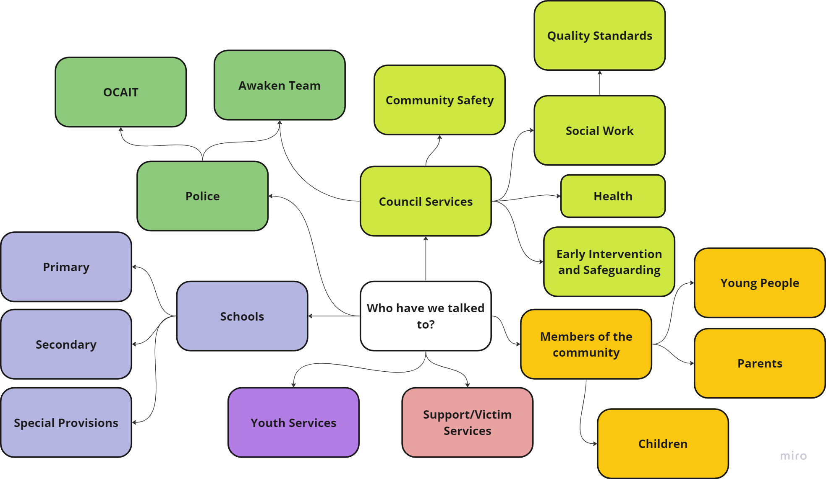
Understand

Slide 7




Co-Production in the project
Development
Young People’s Workshop
Local Spoken word artist (Nathan Parker)
Creative workshops with children and young people of varying ages
Development of a script which reflected their own words
Consultation with young people on draft of animation video
Focus Groups (Consultation)
Young People’s animation
Visioning Day (November 2023)
Blackpool Adult Action Group
Blackpool Young People’s Action Group

Slide 8
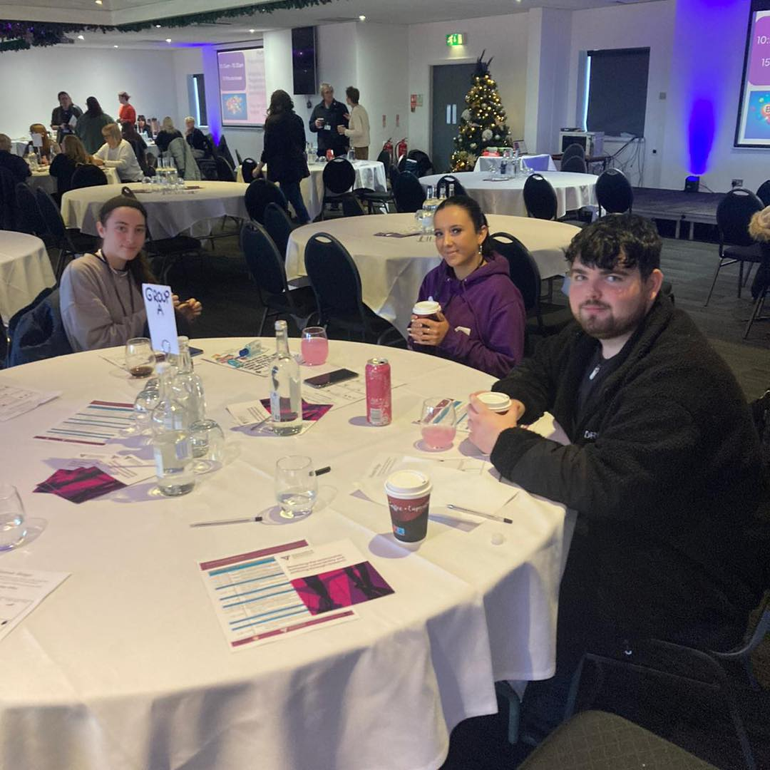
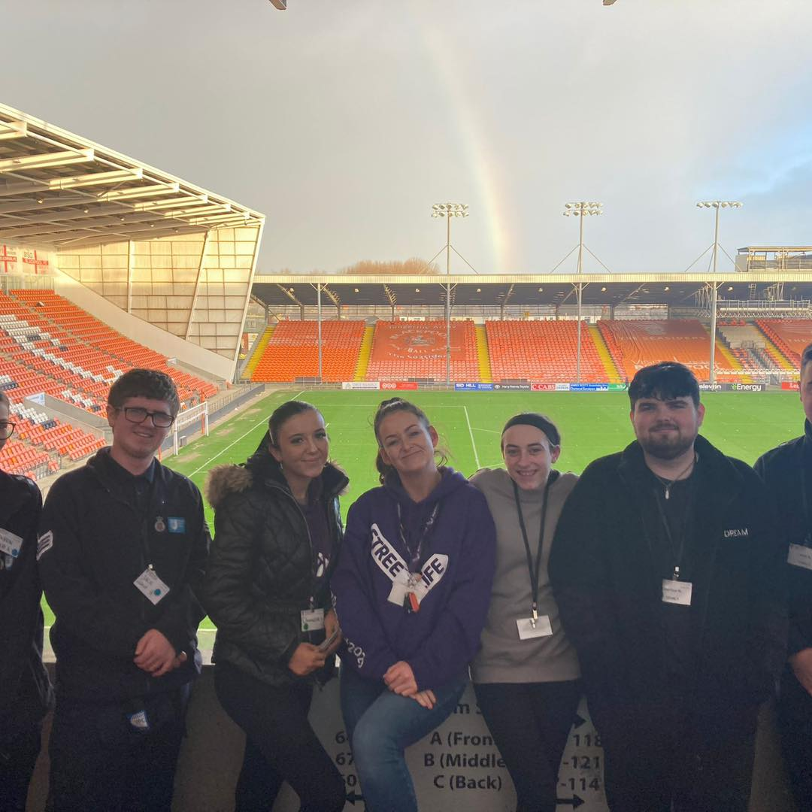
Co-Production in the project
Development
What does a good response to OCSV look like in Blackpool?
What should the Priorities of such a response be?
What can you do to implement these priorities?
Focus Groups (Consultation)
Young People’s animation
Visioning Day (November 2023)
Blackpool Adult Action Group
Blackpool Young People’s Action Group

Slide 9
Co-Production in the project
Development
1
Coordinated Multi-agency approach
2
Listening to Young People/Child Led
3
Education and awareness for all
4
5
Consistency (among services and responses)
Central hub for comm of info/resources
6
Strategic buy-in (including businesses)
Focus Groups (Consultation)
Young People’s animation
Visioning Day (November 2023)
Blackpool Adult Action Group
Blackpool Young People’s
Action Group
7
8
9
10
Transparency of process and communication
Informal Helpline for Young People
Model/Threshold/Graded response
Longer and more intense support for victim/perpetrators/families
11
Overcome issues of Consent/Informal information sharing (i.e. online forum)

Slide 10
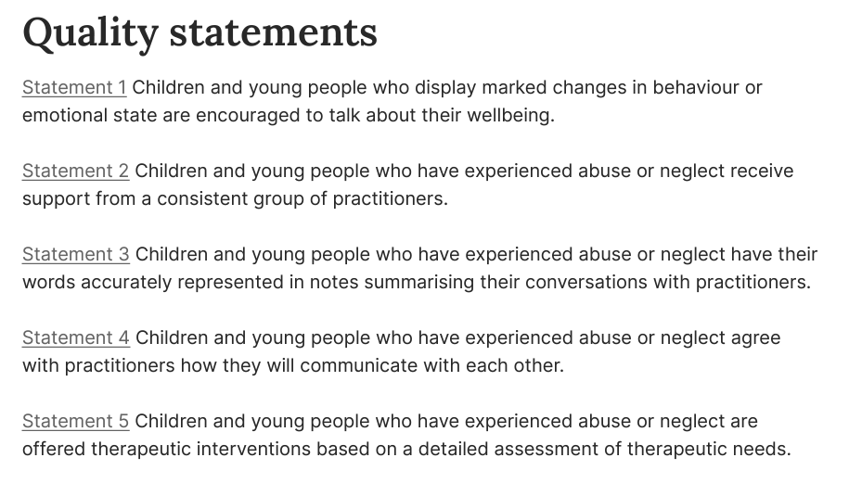
Example of Quality Statement/Standards
National Institute for Health and Care Excellence (NICE)
Child Abuse & Neglect (Feb 2019) Quality Standards

Slide 11
Working Quality Standards for OCSV
Development
Quality Statement 1 | Prioritising multi-agency responses | The response to OCSEA is based on a multi-agency cross community approach, with a shared goal and vision. There is agreement about thresholds for different service interventions. It includes social work, police, youth services, education, health, businesses, children and parents.
Quality Statement 2 | Child led responses | Children and young people are sought out, listened to, and encouraged to be involved in the response to, and prevention of, OCSEA.
Quality Statement 3 | Consistent evidence-based messaging | Organisations engaging with parents and children and young people provide consistent information, shared across services, based on the available evidence.
Quality Statement 4 | Consistent recording and monitoring systems | All cases of OCSEA are recorded and monitored consistently across organisations, with clear information sharing structures to measure the scope and nature of the problem locally.
Quality Statement 5 | Public awareness about impact and responses | The whole community (including services and businesses) are aware of the nature and impact of OCSEA and the evidence-based response mechanisms available to them.
Quality Statement 6 | Support Interventions | Children and young people and their families have access to trauma-informed, co-designed support interventions that reflect on gender, sexuality, culture, race, ability and maturity

Slide 12
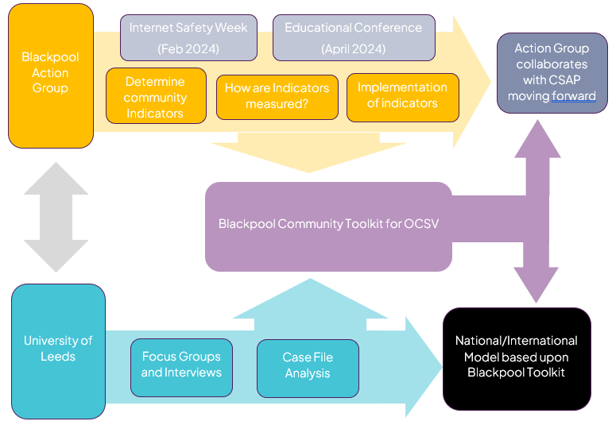

Slide 13
Questions
QS1. (How) can thresholds be agreed? Is there an option for diversion? And if so at what level?
QS2. What are the best ways of measuring CYP led responses in Blackpool?
QS3. How will you ensure messaging is evidence based and up to date?
QS4. How can recording systems be aligned across services?
QS5. Who will take responsibility for public awareness?
QS6. Who will deliver support services? How will their effectiveness be measured?

Slide 14
Thank you for your attention!
Any Questions?

