Slide 1


Why ‘donation’?
DECONSTRUCTING DONATION CONFERENCE 2014

Slide 2
Donation
Altruistic
Voluntary
Independent
Control
?
?
Notes:
Throughout my research, when writing publications, I have always felt compelled to read and referenced Richard Titmuss’ work. Even now, the thought of running a conference on donation and not mentioning The Gift Relationship published by Titmuss on blood donation in 1970 would seem unthinkable! Type in the word ‘donation’ in google scholar and up pops articles using Titmuss and the idea of donation being an altruistic gesture.
Is Titmuss’ work the only way to theorise donation? Is it possible to treat donation as a homogenous entity and therefore apply a theory which relates to all types of donation?

Slide 3
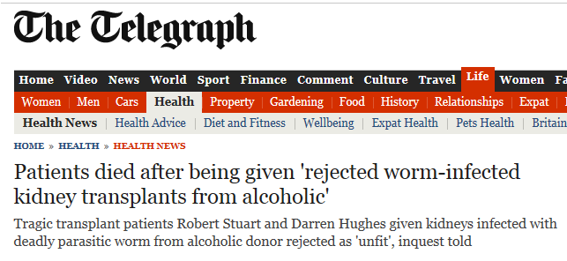
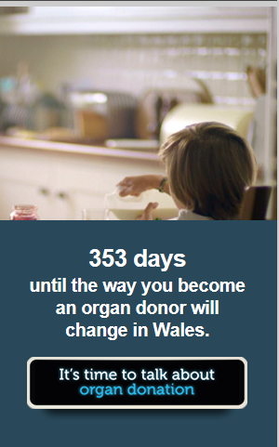
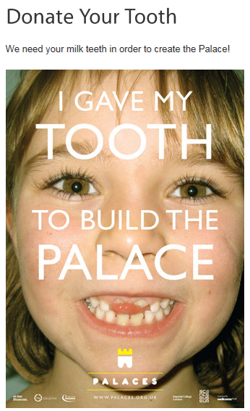
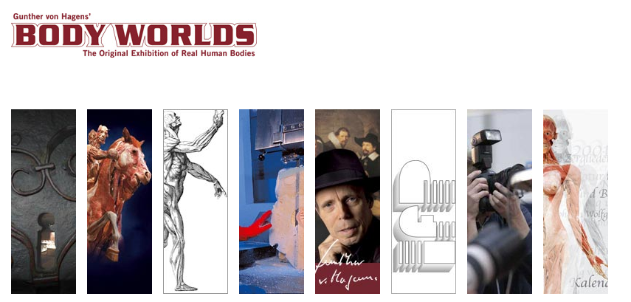
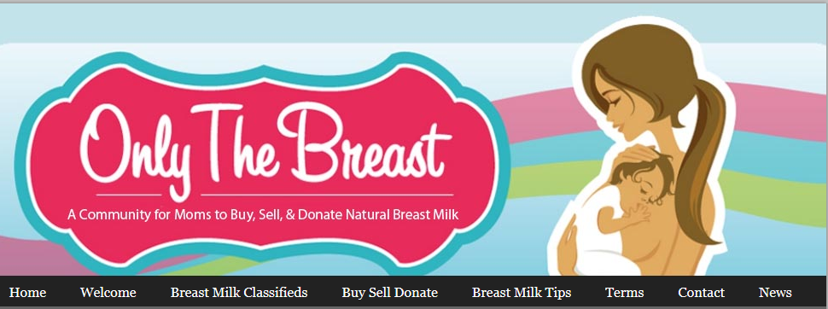
Notes:
There has been much policy and practice developments relating to all aspects of donation, what can be donated and for what purposes means, raises the question whether our understanding of donation has shifted and evolved from Titmuss’ version. In essence, what does donation in the 21st century look like?
What can we learn by applying different theoretical concepts and lens from different disciplines to the concept of donation? When making sense of donation?

Slide 4
Why ‘DECONSTRUCT’?
DECONSTRUCTING DONATION CONFERENCE 2014

Slide 5
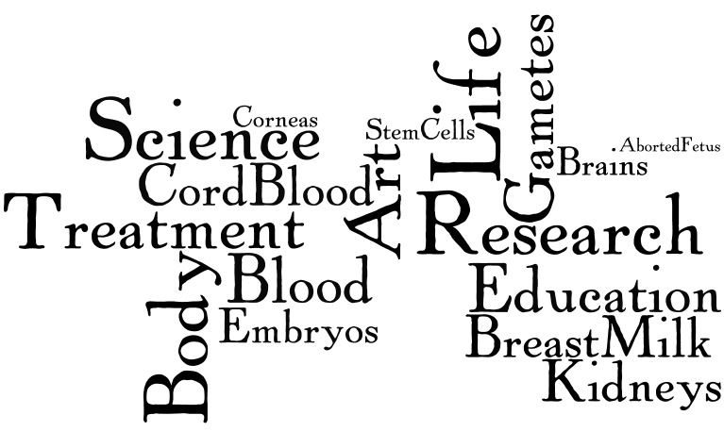
Notes:
I’ve been exploring donation since my PhD 10 years ago. During this time, I have realised that all donations are not equal. Donors are treated differently according to what is being donated, for what purpose, and in turn, people’s responses to donation differ according to what is donated and for what purpose. We therefore need to break donation down to its component parts to explore how it is understood today.

Slide 6
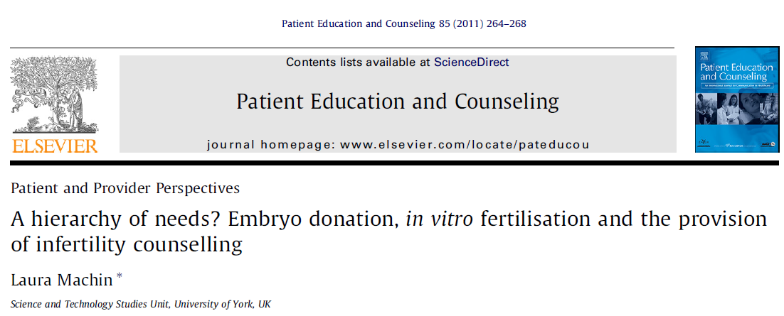
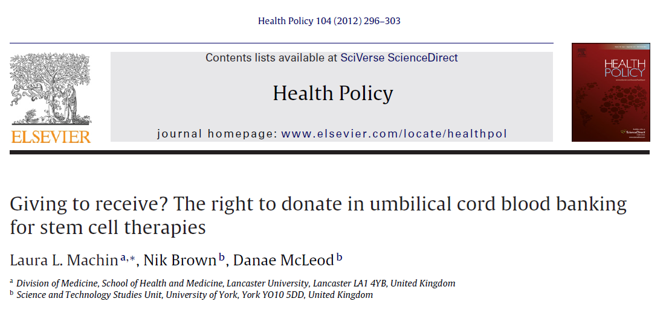
Notes:
My PhD on donated embryos for stem cell research or infertility treatment in the UK and Australia showed how donors to infertility treatment were perceived as having more needs compared to those donors to stem cell research thereby creating a hierarchy of the purposes of donations, with some perceived as more riskier than others. Recipients were portrayed as more or less grateful according to the level of risk perceived with the donation.
Whilst my postdoc work on cord blood donation challenged the idea that donation was wholly altruistic, and instead donation could be enacted in order to receive something in return, in essence to gain from the act that would not be achieved if the donation had not taken place. In this case, donors claimed to donate in order to receive ‘free’ storage of cord blood for their family in the future as they couldn’t afford to pay for the commercial storage.
My consultancy work with the National Gamete Donation Trust exploring donor satisfaction with the donation process highlighted to me that donors cannot be viewed one-dimensionally, and instead have complex needs just as patients and customers do, which I mention in a forthcoming paper.
Finally, my current research exploring stem cell therapies using cord blood in Japan and the UK has demonstrated the need to consider donation in its wider context – within the wider process such as collection, processing, storage. All of which influence how donation is discussed in terms of costing, contribution, value, to society, government, the donor, and recipients.

Slide 7
Why A conference?
DECONSTRUCTING DONATION CONFERENCE 2014
Notes:
It is possible to argue that ‘donation’ has never truly been off the research or policy ‘agenda’, but I do wonder if we have stopped looking at the process and act of ‘donation’ with fresh eyes? If we could wipe the slate clean what would donation and the respective donors and recipients look like today?
Is Titmuss’ work the only way to theorise donation? What can we learn by applying different theoretical concepts and lenses from different disciplines to the concept of donation? When making sense of donation? And as a consequence, what do we learn about how we understand our bodies and the relationship we have with our bodies?
I wish to ignite an inter and multi disciplinary dialogue that will continue after the conference is finished by establishing a study group made up of practitioners and researchers working in the field of ‘donation’. To achieve this, I need your help…signatures for BSA proposal.
-

Slide 8
Today:
  Health and safety
  Appointments with Paul Woodgate, Wellcome Trust
  Choosing presentations
  Acknowledge presenters/work
  Taxis and conference dinner
Looking forward:
  Feedback form
  Special issue
  Edited book collection
  Conference 2015

